Slide 1
The future we want: A scenario for a transformative power of TVET
Borhene Chakroun

Slide 2
Our World Today: A time of immense challenges to sustainable development

Slide 3
Skills are important Constraint for businesses
Source: Enterprise Surveys, 2010
Notes:
According to the data from the Enterprise Surveys employers list skills as a key constraint.
A high proportion of production workers are unskilled (blue bars in the graph). In Sub-Saharan Africa, East Asia, Middle East and North Africa and Latin America the proportion of unskilled production workers is more than 35%
In the Middle East and North Africa and Latin America, more than 2/3 of firms identify an inadequate educated workforce as a major constraint (green bars in the graph)

Slide 4
Growth but is it sustainable in the long run?
Prepared based on ILO Global Employment Trends 2014 database

Slide 5
Source: ILO 2014

Slide 6
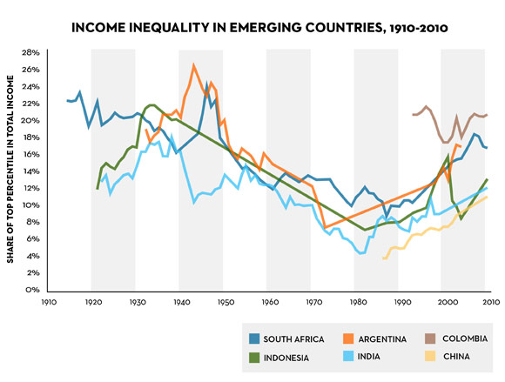
The richest 85 people have as much combined wealth as the poorest 3.6 billion
Source: Piketty 2014

Slide 7
Skills for sustainable development: In 2014 in less than 8 Months, Humanity exhausts Earth's budget for the year
Source: Global Footprint Network

Slide 8
Quality of basic education
Source: GMR 2014

Slide 9
The World in 2030: Sustainable Development Scenario

Slide 10
2015: Year of Aspiration

Slide 11
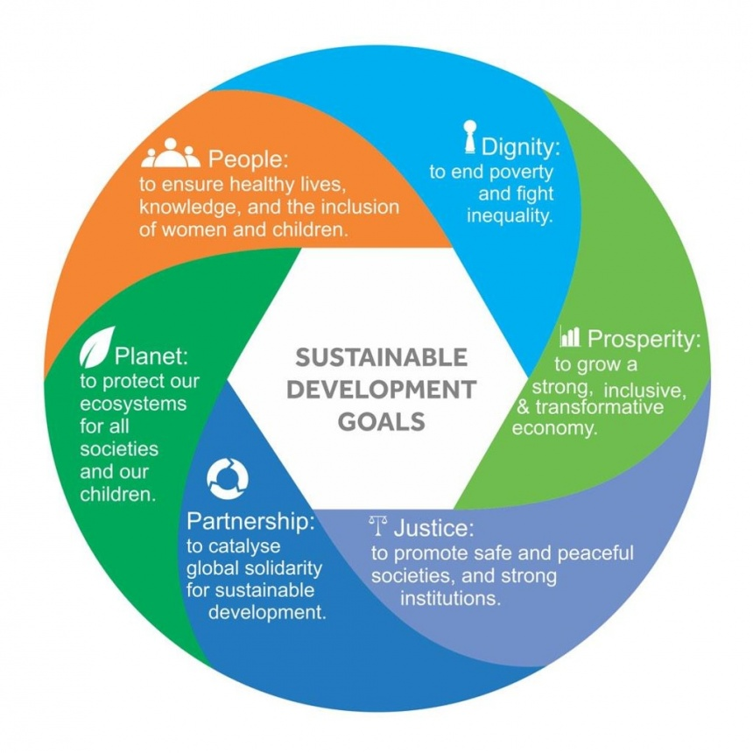
Skills are important to achieve the six elements of the Sustainable Development Goals

Slide 12
Post-2015 Education agenda: Universal goal, national targets
Overarching goal:
Ensure equitable and inclusive quality education and lifelong learning opportunities for all by 2030

Slide 13
Vocational Skills agenda
By 2030, ensure equal access for all women and men to affordable and quality technical, vocational and tertiary education, including university
By 2030, substantially increase the number of youth and adults who have relevant skills, including technical and vocational skills, for employment, decent jobs and entrepreneurship
By 2030, eliminate gender disparities in education and ensure equal access to all levels of education and vocational training for the vulnerable, including persons with disabilities, indigenous peoples and children in vulnerable situations .

Slide 14
How to get there?

Slide 15
Game Changers
The changing role and nature of TVET
Governance and partnerships
Impact of Technologies
Regional and global integration
Smart access to data and information

Slide 16
Changing role: Three analytical lenses
Source: Marope, M., Chakroun,B. & Holmes,K (2015)

Slide 17
Changing nature
Variety
Volume
Velocity
Validity
TVET in many forms
TVET for Mass
TVET in motion
TVET in Doubt
At secondary
At tertiary
Skills development
Initial/continuing
School-based
Work-based
On-line
Economic demands
Social demands
Lifelong learning imperatives
Responsiveness imperatives
Rapidely changing labour markets
Policy pressures
Uncertainty due to quality/relevance/
attractiveness
data inconsistency
& ambiguities,
Past deception

Slide 18
Governance and partnerships
Governance gap: Will governments and institutions be able to adapt fast enough to harness change instead of being overwhelmed by it?
Large partnerships: PPP+

Slide 19
Skills in a new wave of innovation: What about technological unemployment

Slide 20
Regional Qualifications Framework
SADC
15 member states
No specification for credit transfer
ASEAN
10 member states
EQF
27 member states
Caribbean
TQF
No specification for credit transfer
ECVET
15 member states
Credit system envisaged
29 member states
Clearing
House

Slide 21
Smart access to data and information
Administrative Data
Survey Data
All sorts of Data:
Administrative
Survey Data
Applications
Social Networks
MOOCs
Others

Slide 22
Time for action
Act now to make our generation the generation that ends extreme poverty, reduces inequality and that does something about climate change.

