Slide 1
Transform TVET first, then scale up
Shyamal Majumdar
Head, UNESCO-UNEVOC

Slide 2
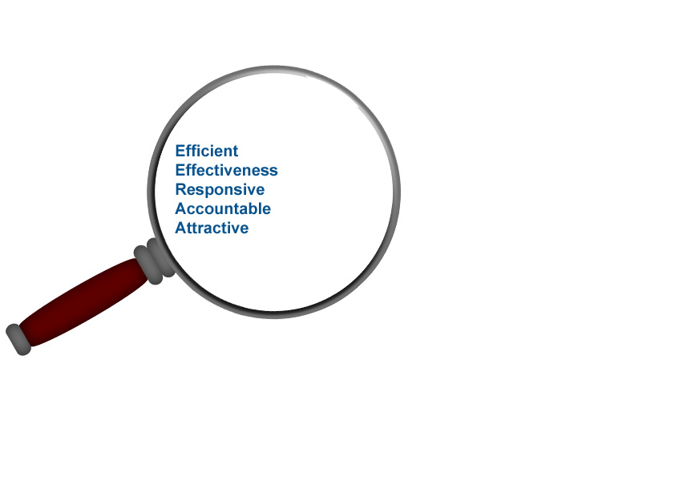
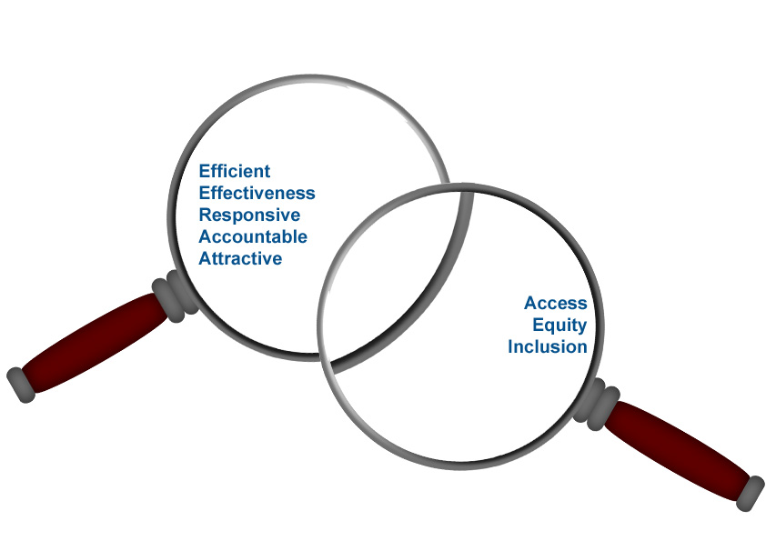
Transforming TVET
Transformational
Economic
Equity

Slide 3
Dimensions of Transformation in Post 2015
Life long learning
School to work and work to school, ECCE, ACE
Greening TVET
Poverty and sustainable development together
Multi stake holder partnership
- Engagement with private sector, community and social actors
Inclusive TVET
Covering dis-advantages/rural groups and non formal sector
STEAMing TVET
Enhancing the foundation for emerging occupations
Holistic TVET
Not only for industrial work but also life and entrepreneurship

Slide 4
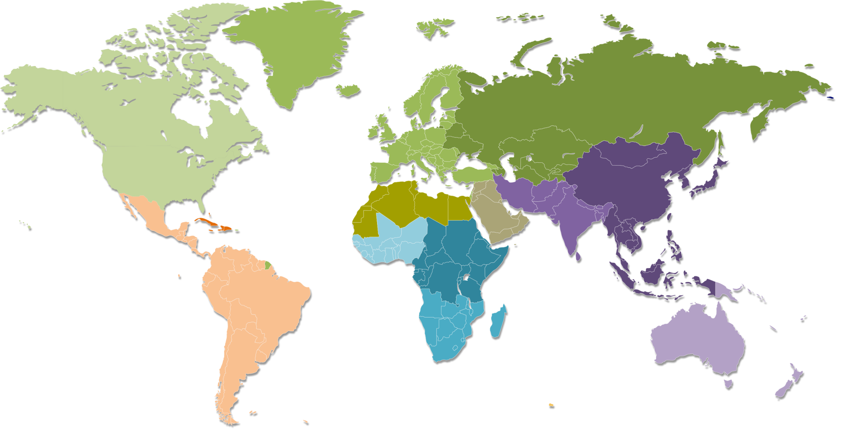
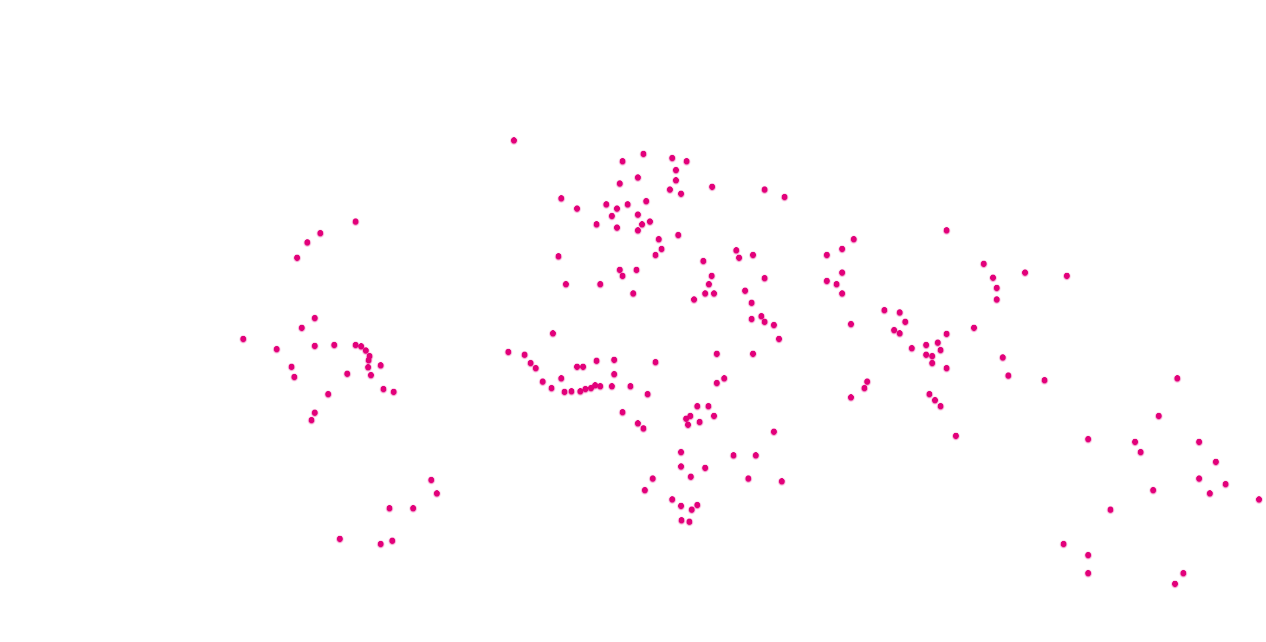
The UNEVOC Network
Worldwide Network of TVET Institutions
North America Cluster
Europe Cluster
Commonwealth Independent States Cluster
North Africa/Arab States Cluster
South Africa
Caribbean
East and South-Eastern Asia
Mashreq States Cluster
West Africa
East Africa
Central and Latin America
Pacific Islands
Southern Africa
Cluster Coordinating Centres
UNEVOC Centres
Over 200 UNEVOC Centres in 167 UNESCO Member States

Slide 5
Multi-stakeholder representation
Ministries or Departments of Ministries
21%
34%
Schools or Training Centres
National TVET Bodies
16%
29%
Universities, Research or Teacher Training Institutes

Slide 6
Good Practices of N-S-S Cooperation
Learning from each other experiences
Regional and inter-regional dialogue
Pooling of resources
Testing of new ideas and conceptualization
Benchmarking and comparative research
Strengthening of capabilities

Slide 7
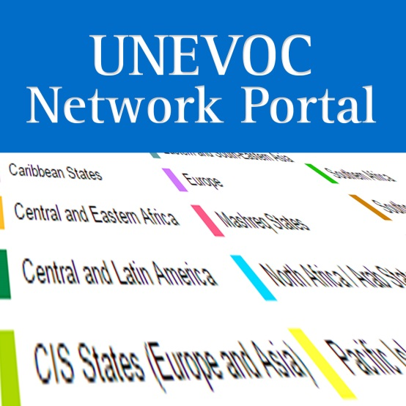
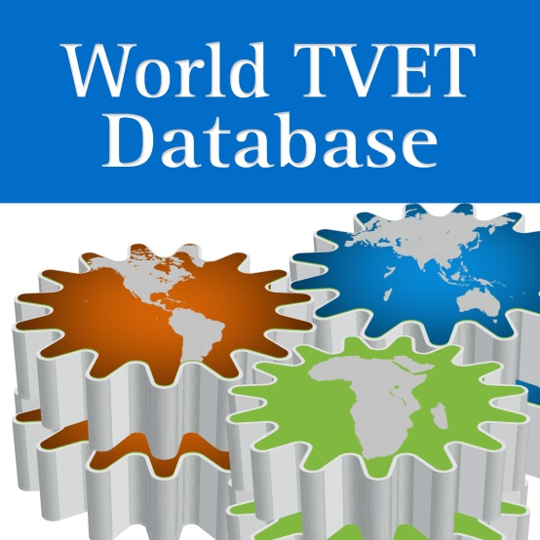
Good Practices of Knowledge Management

Slide 8
UNEVOC Centre
UNEVOC Network structure before regionalisation
UNEVOC Centre
UNEVOC Centre
UNEVOC Centre
UNEVOC Centre
UNEVOC Centre
UNEVOC Centre
UNEVOC Centre
UNEVOC Centre
UNEVOC Centre
UNEVOC Centre
UNEVOC Centre
UNEVOC Centre
UNEVOC Centre
UNEVOC Centre
UNEVOC Centre
UNEVOC Centre
UNEVOC Centre
UNEVOC Centre
UNEVOC Centre
UNEVOC Centre
UNESCO-UNEVOC International Centre
UNEVOC Centre
UNEVOC Centre
UNEVOC Centre
UNEVOC Centre
UNEVOC Centre
UNEVOC Centre
UNEVOC Centre
UNEVOC Centre
UNEVOC Centre
UNEVOC Centre
UNEVOC Centre
UNEVOC Centre
UNEVOC Centre
UNEVOC Centre
UNEVOC Centre
UNEVOC Centre
UNEVOC Centre
UNEVOC Centre
UNEVOC Centre
UNEVOC Centre
UNEVOC Centre
UNEVOC Centre
UNEVOC Centre

Slide 9
Africa Region
UNEVOC Centre
Central and Eastern Africa Cluster
UNEVOC Centre
Southern Africa Cluster
UNEVOC Centre
Western Africa Cluster
UNEVOC Centre
UNEVOC Centre
UNEVOC Network structure after regionalisation
Arab States Region
UNEVOC Centre
UNEVOC Centre
Mashreq States Cluster
UNEVOC Centre
Northern Africa/Arab States Cluster
UNEVOC Centre
UNEVOC Centre
UNESCO-UNEVOC International Centre
Asia Pacific Region
UNEVOC Centre
UNEVOC Centre
Eastern and South Eastern Asia Cluster
UNEVOC Centre
Pacific Islands Cluster
UNEVOC Centre
South Asia Cluster
UNEVOC Centre
UNEVOC Centre
Europe, CIS and North America Region
UNEVOC Centre
CIS Cluster
UNEVOC Centre
Europe Cluster
UNEVOC Centre
North America Cluster
UNEVOC Centre
UNEVOC Centre
Latin America and the Caribbean Region
UNEVOC Centre
UNEVOC Centre
Caribbean Cluster
UNEVOC Centre
Central and Latin America Cluster
UNEVOC Centre
UNEVOC Centre

Slide 10
UNEVOC Network Regions and
Clustering
21 UCs
23 UCs
24 UCs
17 UCs
10 UCs
Central and Eastern Africa
Southern Africa
West Africa
13 UCs
Mashreq States
North African Arab States
23 UCs
Africa
Caribbean
Central and Latin America
Arab States
Latin America and the Caribbean
UNESCO-UNEVOC International Centre
Asia Pacific
Europe, CIS and North America
Eastern and South Eastern Asia
Sothern Asia
North America
14 UCs
Pacific Islands
CIS
30 UCs
Europe
21 UCs
4 UCs
14 UCs
41 UCs

Slide 11
Cooperation between International, Regional and National Network
Sample region
Sample member state
UNESCO-UNEVOC International Centre
Asia Pacific Region
Each cluster has a coordinator coming from Cluster Coordinating Centres (CCCs)
A South-Eastern Asian Member State
Eastern and South-Eastern Asia Cluster
UNEVOC Centre
Ministry
Local Government and Private TVET Institutes
UNESCO
Community
(HQ/Field Office/Chairs/Institutes)
Pacific Islands Cluster
UNEVOC Centre National Body
South Asia Cluster
UNEVOC Centre
Training Centre
UNEVOC Centre University-Research
lead and coordinate national TVET network
act as a clearinghouse in TVET
cascade information and experience from the UNEVOC Network to member state
Contribute innovative experience and practices to the UNEVOC Network
International Organizations
Regional TVET Players
UNESCO Regional Office

Slide 12
“Networking and Partnership are the new Strategic Resources in Post 2015 era” Thank you !

