Slide 1
Building SENAI’s Model of Technological Forecasting
WSC 2015
Prof. Paulo Tigre
Rio de Janeiro Federal University

Slide 2
Background
The diffusion of new equipment and organizational techniques requires new skills profile and quantitative changes on the demand for workers.
In order to reduce the risks of professional obsolescence and unnecessary investments, SENAI must anticipate qualitative and quantitative changes in future demand for training and technical services.
Partnership with universities: search for academic research skills, low costs and total knowledge and methodologies transfer.

Slide 3
Adaptation of existing models to SENAI’s needs and to the Brazilian context.
Search for practical short term results and appropriate models considering the time and the resources available.
Sectorial approach of the diffusion of emerging technologies already available internationally. This contrast with traditional forecast models which focus on scientific advances. technology gap opportunities
Adapted to the characteristics of Brazilian industrial structure: size of firms, competition profiles, technological gaps, skills and international trade.

Slide 5
Model of technology diffusion
Direction: dominant technology trajectories
Speed: rate of diffusion of a new technology in the market.
Driving forces: positive and negative
Impacts: quantitative and quatitative changes in workforce demand.

Slide 6
Many variations in basic projects
Look-in
Mature technologies
Impacts on skills
Technology trajectories
Rate of diffusion/time

Slide 7
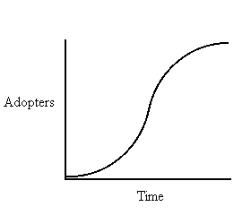
Pearl Curve: the rate of technology diffusion
Rapid growth following pioneers success
Declining due to widespread adoption and competing innovations
Slow: technical uncertainties, high costs lack of supporting services and infrastructure

Slide 8
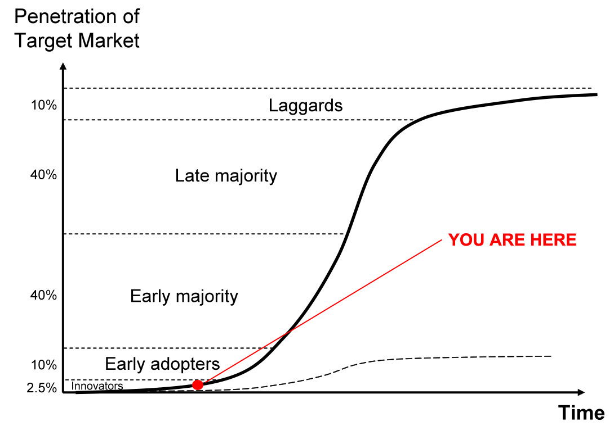
S - Curve Adoption Model
Emergent tecnology

Slide 9
Directions and speed of technology diffusion
Methodology:
Expert analysis (technology, economics and organization)
Specialists committees
Delphi
Results:
► Specialists perception about the speed of diffusion of innovation

Slide 10
Expert report
Specialists commitee
Delphi
Evaluation of speed of diffusion

Slide 11
Sector economic analysis
Technological forecast
Organizational forecast
Thematic Group: occupational impact analysis
Delphi (Specialists committee)
Occupational trends
Occupational impacts

Slide 12
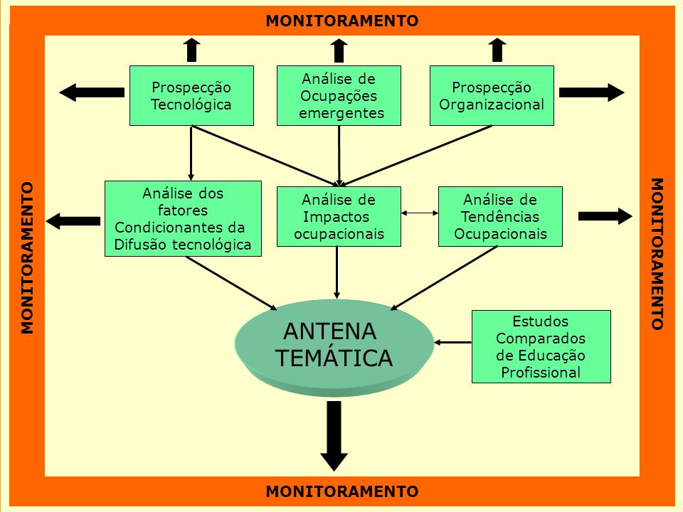

Slide 13
Results
More than 100 SENAIs publications on technology diffusion in different sectors of the Brazilian industry
Flexible model that can be adapted to different situations: sector, time, resources, etc.
Absorption and further development of forecasting methodologies by SENAI
Methodology transfer to several countries

