Slide 1
Cedefop’s European Skills Forecasting Model
Konstantinos POULIAKAS
Expert, CEDEFOP
World Skills conference 2015 (WSC)
Sao Paulo, Brazil, 12 August 2015

Slide 2
What and why?
Imbalances
Demand: | Supply:
33 countries (EU28 + NO, CH, IS, CCs)
41 NACE sectors | 5 year age bands
21 ISCO occupations | Gender
3 broad ISCED level | 3 broad ISCED levels
Replacement needs
Projections of skill supply and demand trends up to 2025
Comparable across countries using harmonised data
Informs skills and labour market policies by providing LMI/policy scenarios → support to policy community
Mandate from Council (every 2 years)
Validation via Skillsnet network
Notes:
Quantitative models can:
help to make assumptions about the future explicit and transparent;
help to reinforce systematic and logical thinking and act as a focus for intelligent debate;
provide a useful counterfactual to assess policy impacts (i.e. what would have happened in the case of the presence or the absence of the policy intervention).
But they are not intended to provide:
background for mechanistic “manpower” planning;
precise indications of education and training requirements;
any detailed information that goes beyond the already available set of data.
But they are not intended to provide:
background for mechanistic “manpower” planning;
precise indications of education and training requirements;
any detailed information that goes beyond the already available set of data.

Slide 3
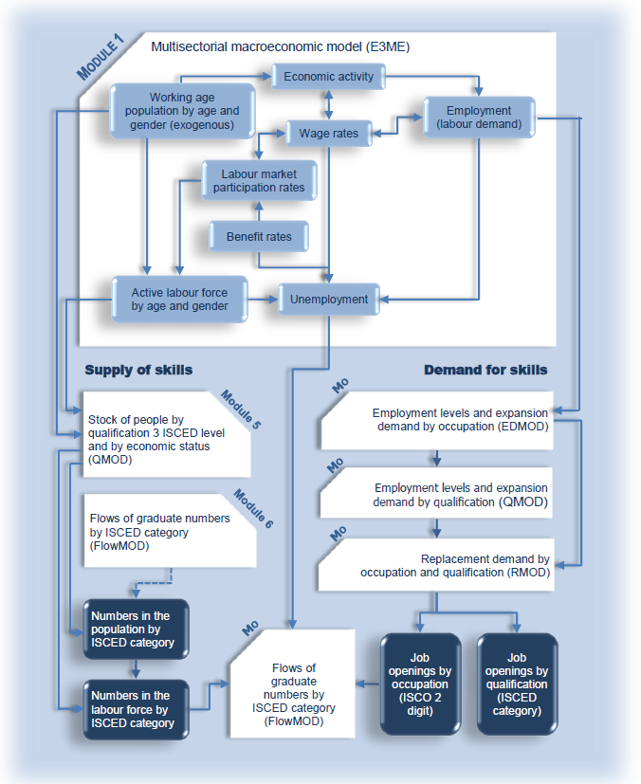
Framework of Cedefop model: How?

Slide 4
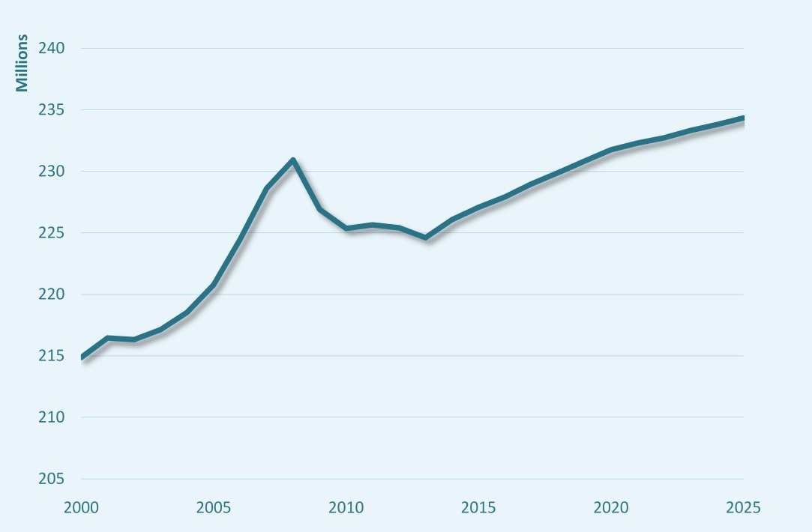
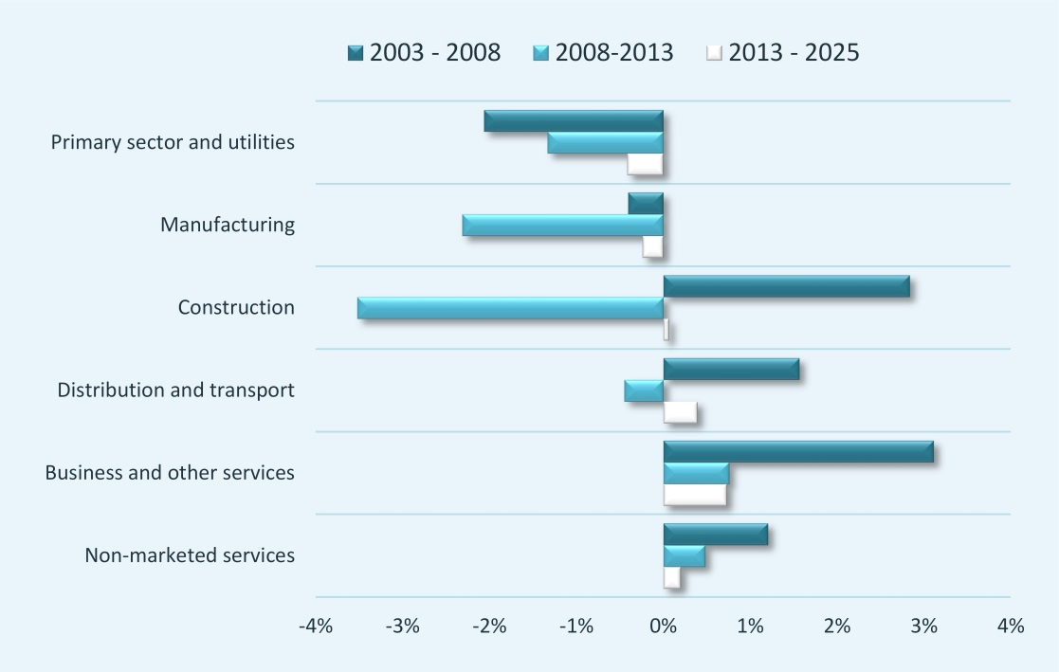
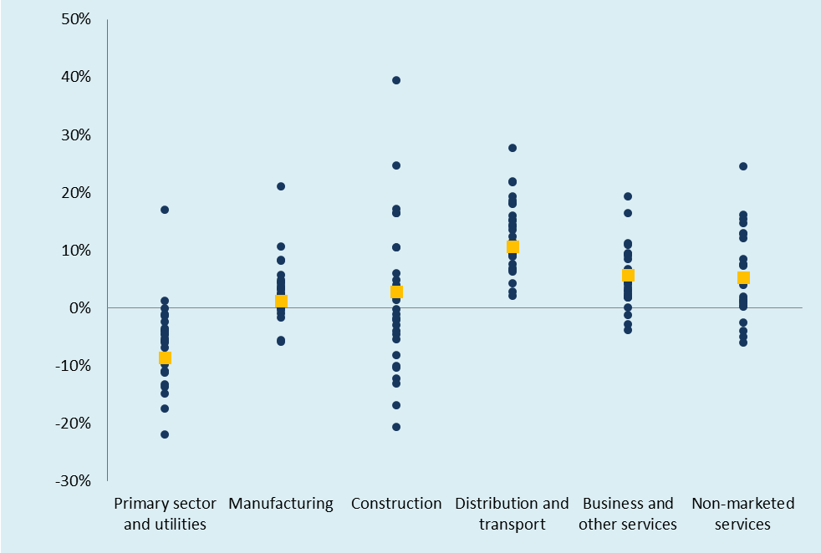
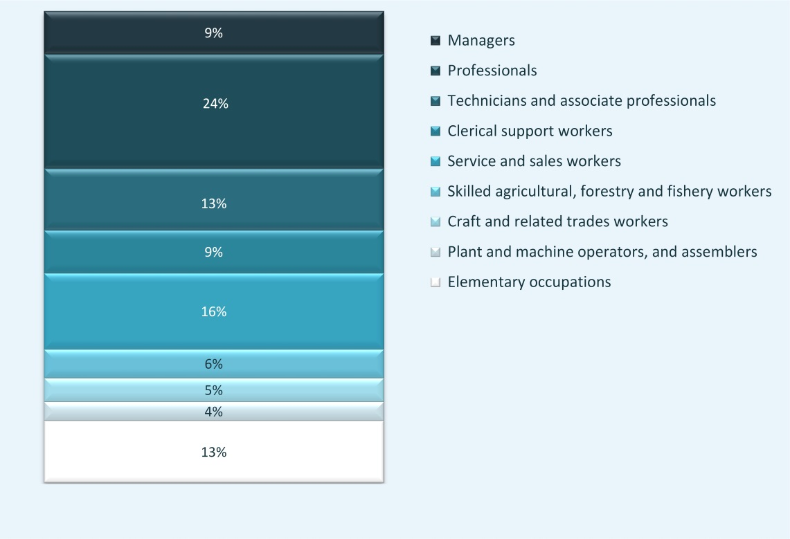
Source: Cedefop (2015)

Slide 5
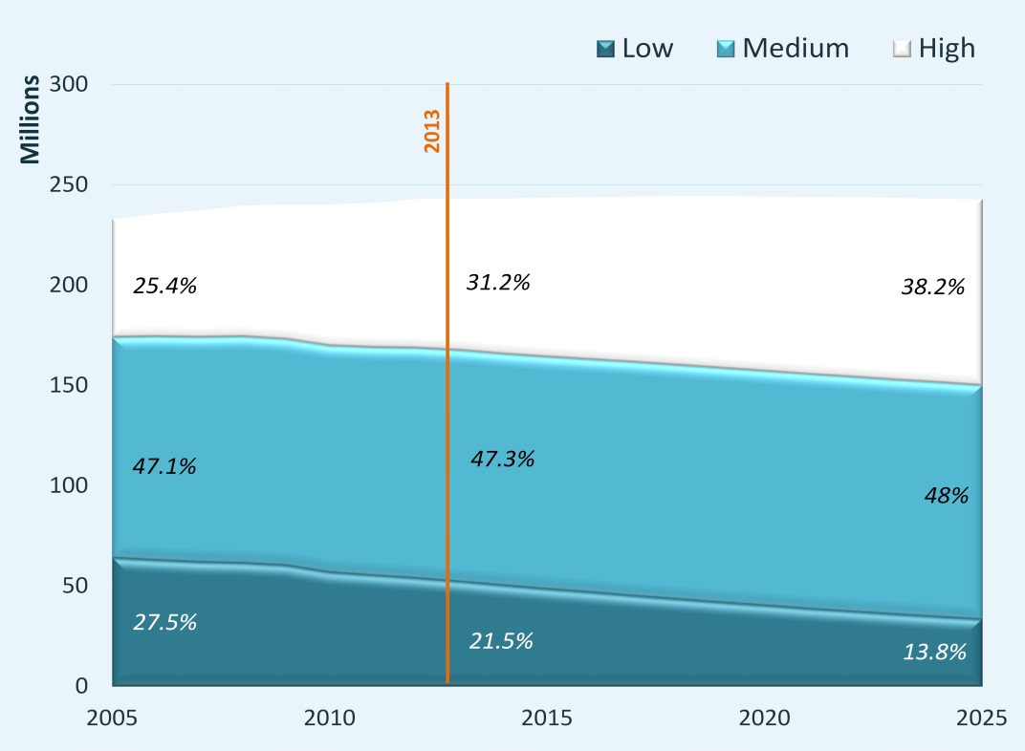
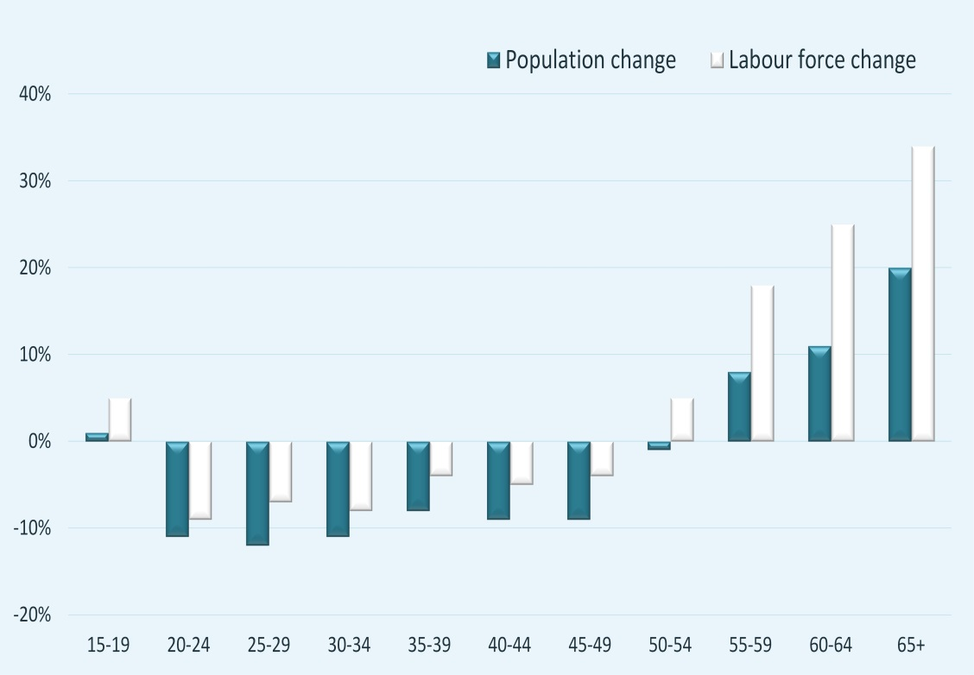
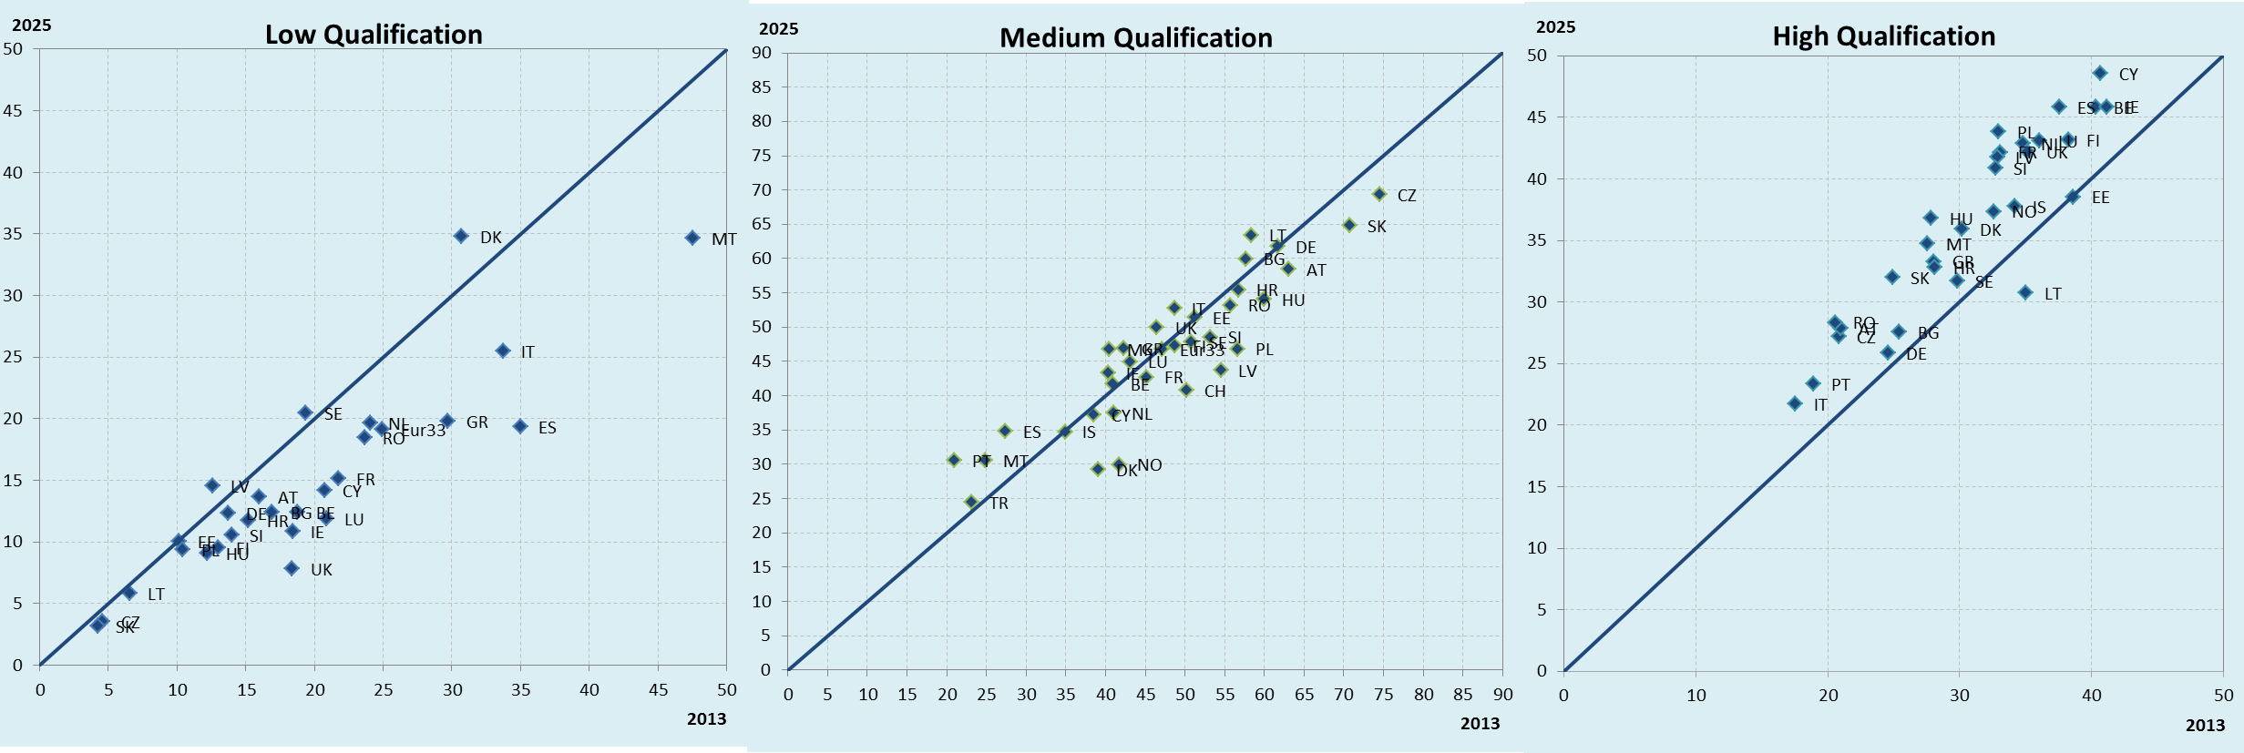
Source: Cedefop (2015)

Slide 6
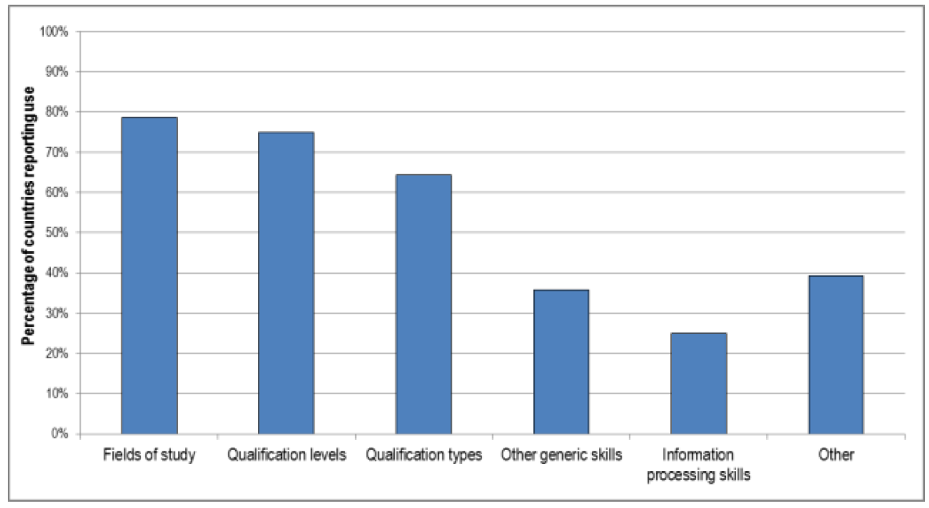
OECD-Cedefop-ETF-ILO project on Assessing and responding to skill needs
…conventional reliance on levels of qualifications/types…
…with significant difficulties in extending to (occupational) skills profiles?
Source: OECD (2015)
Notes:
Cedefop has tried analysis of occupational skill profiles
Currently online job vacancies

Slide 7
Barriers to efficient use…
OECD-Cedefop-ETF-ILO project on Assessing and responding to skill needs
Source: OECD (2015)
Notes:
Common uses
Decide course provision or funding
Provide information to students
Developing on-the-job and re-training programmes
Develop apprenticeship programmes
Informing migration policy
But uncommon uses
Developing tax incentives for workers or employers
Inform collective bargaining processes
Up- or re-skilling of teachers

Slide 8
Assessing and responding to skill needs
Elements of success
Effective skills needs anticipation
Stakeholder involvement (Design, dissemination, development of policy response)
Embed in wider economic development strategy
Dissemination to wide audience
Adjust level of disaggregation to level of policy
Acknowledge available infrastructure and resources
Follow-up

Slide 10
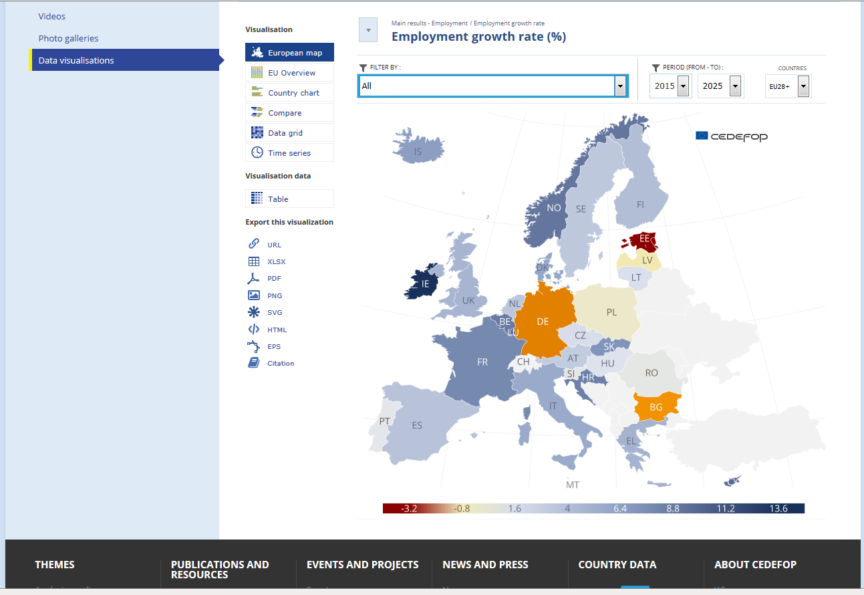

Slide 11
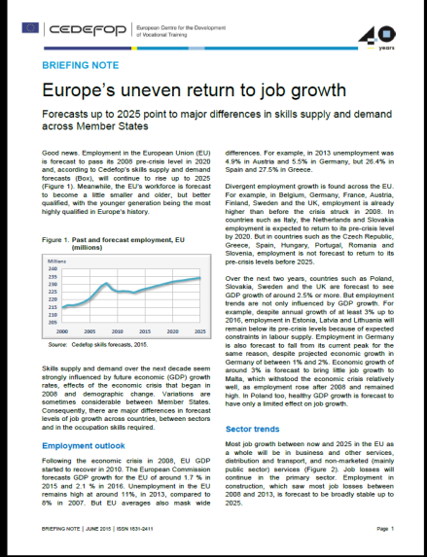
For more information:
Konstantinos.Pouliakas@cedefop.europa.eu
www.cedefop.europa.eu

