Slide 1
Early identification of Skill Needs
Use of Patent Information
in identifying the future skills needs
- Case of Information Security
Hwang Gyu-hee
g.hwang@krivet.re.kr
Korea Research Institute for Vocational Education & Training

Slide 2
Introduction
Job Analysis
Extraction of Patent
Skill-unit
Mapping
IPC
Analysis of
Trend
Outlook of
Skills Needs
Verification of Validity
of Future Skills Needs
Concluding remarks
1/16

Slide 3
Introduction
Challenging Issue)
Confronted with fast and persistent technology change,
How can future skills needs be prepared ?
Mission) How to identify the future skills needs
=> There might be many ways including employer’s survey, LMI etc.
One of other options is to see the technological change directly.
=> Technological change can be detected through patent analysis,
even though the analysis of patent might be applicable in limited field.
=> How:
- using keywords, IPC(international patent classification), context etc.
- trend, cluster analysis, data mining etc.
Aim of the presentation)
To show a methodology that identifies the future skills needs by using
a kind of patent analysis
2/16

Slide 4
Step 1. Extracting Skill-unit from Job Analysis
- Job configuration & required skills for Information security sector
Classification |  | Required skills (Limited to technical items)
Category | Sub-category
Strategy & planning | (A) Risk analysis | (A-1) Security weakness analysis
 |  | (A-2) Network security scanner
 |  | (A-3) Pilot hacking, simulated infiltration
 | (B) Establishing information protection policy & plan | (B-1) Information protection management system ISMS
 |  | (B-2) Security policy
 |  | (B-3) Security management on outsourcing
 |  | (B-4) Task Identification
 |  | (B-5) Inspection logging
 |  | (B-6) PC security
 |  | (B-7) Data security
 |  | (B-8) Network security
 |  | (B-9) Server security
 | (C) Privacy protection management | (C-1) Privacy protection law
 |  | (C-2) Privacy information encryption
Marketing & sales | (D) Marketing management
 | (E) Technical sales
R&D, Implementation | (F) R&D | (F-1) Encryption algorism
 | (G) Implementation
Education & training | (H) Public & user education
 | (I) Expert education
<continue>
3/16

Slide 5
- Job configuration & required skills for Information security sector
Classification |  | Required skills (Limited to technical items)
category | Sub-category
Management & operation | (J) Project management | (J-1) Security architecture
 | (K) Information infrastructure security management | (K-1) Firewall configuration
 |  | (K-2) Virus vaccine
 |  | (K-3) Spyware
 |  | (K-4) Phishing
 |  | (K-5) Spam
 |  | (K-6) (DB security encryption
 |  | (K-7) OTP
 |  | (K-8) Public key based structure PKI
 |  | (K-9) VPN
 |  | (K-10) DDOS
 |  | (K-11) MDM mobile device management
 |  | (K-12) IPS infiltration prevention
 |  | (K-13) Certification service
 | (L) Physical security
Emergency response | (M) Monitoring & responding | (M-1) Weakness analysis
 |  | (M-2) Log analysis
 |  | (M-3) Security control
 |  | (M-4) Intelligent sustaining attack(APT)
 | (N) Digital forensic | (N-1) Understanding forensic
 |  | (N-2) Cryptology
 |  | (N-3) Hacking technique
 |  | (N-4) Cyber attack
 | (O) Job continuance management
Evaluation & certification | (P) Evaluation certification & quality assurance
 | (Q) Information system security inspection | (Q-1) Security inspection
 |  | (Q-2) Information security event management
4/16

Slide 6
Step 2. Matching bundle of IPC to the skills needs
2.1 Extraction of Patent
Search expression for KIPRIS DB (http://eng.kipris.or.kr/enghome/main.jsp)
(IPC=[G06F21+G06K1+G06K7+G09C1+H04B1+H04J1+H04K1+H04L9+H04W4+H04W8+H04W12+H04W48+H04W60+H04W80+H04W84+H04W88+H04W92+G06F5+G06F9+G06F17+G06F19+G06T1+H04W28+H04W64]) +
(AB=[(information+internet+network+cyber+server+DB+Data^1base+wireless+mobile)*(security)])
=> Finally 174,155 Korean patents filed at the time of September 30, 2013.
5/16

Slide 7
Step 2. Matching bundle of IPC to the skills needs
2.2 Overview of extracted patents
Patents pending for Information security (Korean Intellectual Property Office)
Patents pending for Information security (Korean Intellectual Property Office)
Source: http://kpat.kipris.or.kr/ (accessed on Sep. 30, 2013)
6/16

Slide 8
Step 3. Mapping IPC to skill-units
During the process, co-worked with experts of information technology (including information security)
Basic /Specific | B | B | B | B | S | S | S | B | S | S | S | S | S | S | S | S | B | S | S | B | S | S | S | S
Required skills (Limited to technical items) | G06F5 | G06F9 | G06F17 | G06F19 | G06F21 | G06K1 | G06K7 | G06T1 | G09C1 | H04B1 | H04J1 | H04K1 | H04L9 | H04W4 | H04W8 | H04W12 | H04W28 | H04W48 | H04W60 | H04W64 | H04W80 | H04W84 | H04W88 | H04W92
Frequency in extracted patents | 266 | 14,022 | 20,378 | 4,358 | 5,866 | 134 | 1,839 | 2,405 | 153 | 48,330 | 290 | 276 | 6,461 | 28,163 | 8,676 | 7,586 | 3,665 | 3,844 | 507 | 1,986 | 1,772 | 6,225 | 13,255 | 2,630
(A-1) Security weakness analysis |  |  |  |  | 1
(A-3) Pilot hacking |  |  |  |  | 1
(B-1) ISMS |  |  |  | 1 |  |  |  |  |  |  |  |  |  | 1 | 1 | 1 | 1 |  |  | 1
(B-2) Security policy |  |  |  | 1 |  |  |  |  |  |  |  |  |  |  |  | 1 |  |  |  | 1
(B-6) PC security |  |  |  |  | 1
(B-7) Data security | 1 |  | 1 |  | 1 | 1 | 1 | 1
(B-8) Network security |  |  |  |  |  |  |  |  |  | 1 | 1 | 1 | 1 | 1 | 1 |  | 1 | 1 |  | 1 | 1 | 1 | 1 | 1
(C-1) Privacy protection law |  |  |  | 1 |  |  |  |  |  |  |  |  |  |  |  | 1
✔ It is a part of whole mapping table for demonstration.
7/16

Slide 9
Step 3. Mapping IPC to skill-units
International Patent Classification (IPC) http://www.wipo.int/classifications/ipc/en/
G06F005 Methods or arrangements for data conversion without changing the order or content of the data handled
G06F009 Arrangements for programme control, e.g. control unit (programme control for peripheral devices G06F 13/10)
G06F017 Digital computing or data processing equipment or methods, specially adapted for specific functions
G06F019 Digital computing or data processing equipment or methods, specially adapted for specific applications (G06F 17/00 takes precedence; data processing systems or methods specially adapted for administrative, commercial, financial, managerial, supervisory or forecasting purposes G06Q)
G06F021 Security arrangements for protecting computers or computer systems against unauthorized activity (multiprogramming G06F 9/46; protection against unauthorized use of memory G06F 12/14; dispensing apparatus actuated by coded identity card or credit card G07F 7/08; equipment anti-theft monitoring by a central station G08B 26/00; secret or secure communication H04L 9/00; data switching networks H04L 12/00 G06K007 Methods or arrangements for sensing record carriers (G06K 9/00 takes precedence)
8/16

Slide 10
Step 4. Future Skills Needs based on Trends of IPC
- Trend from the absolute frequency of IPC
 | 2000 | 2001 | 2002 | 2003 | 2004 | 2005 | 2006 | 2007 | 2008 | 2009 | 2010 | 2011 | 2012 | 2013
(A-1) Security weakness analysis | 162 | 110 | 117 | 170 | 245 | 180 | 423 | 637 | 848 | 780 | 725 | 928 | 364 | 100
(A-3) Pilot hacking, simulated infiltration | 162 | 110 | 117 | 170 | 245 | 180 | 423 | 637 | 848 | 780 | 725 | 928 | 364 | 100
(B-1) ISMS (Information Security Management System) | 1795 | 2006 | 2585 | 3342 | 4081 | 4823 | 4811 | 4941 | 3652 | 4198 | 4241 | 3775 | 1489 | 330
(B-2) Security policy | 262 | 309 | 449 | 484 | 735 | 1152 | 1556 | 1488 | 1086 | 1376 | 1528 | 1796 | 531 | 118
(B-6) PC security | 162 | 110 | 117 | 170 | 245 | 180 | 423 | 637 | 848 | 780 | 725 | 928 | 364 | 100
(B-7) Data security | 1750 | 1137 | 982 | 1139 | 1668 | 1852 | 2457 | 2904 | 2722 | 2885 | 2890 | 3175 | 1426 | 329
(B-8) Network security | 4324 | 4857 | 5747 | 8462 | 11689 | 13171 | 10690 | 10516 | 8770 | 9607 | 8749 | 8590 | 3727 | 710
(C-1) Privacy protection law | 190 | 244 | 361 | 385 | 641 | 1038 | 1440 | 1353 | 1002 | 1118 | 1156 | 1581 | 415 | 92
(C-2) Privacy information encryption | 62 | 51 | 67 | 146 | 113 | 276 | 289 | 324 | 231 | 395 | 560 | 904 | 269 | 64
(F-1) Encryption algorism | 559 | 460 | 503 | 572 | 998 | 1082 | 1348 | 1850 | 1886 | 1881 | 1629 | 2034 | 845 | 233
(J-1) Security architecture | 522 | 615 | 853 | 968 | 1417 | 1723 | 1926 | 2045 | 1445 | 1333 | 1089 | 967 | 370 | 87
(K-1) Firewall configuration | 524 | 619 | 835 | 978 | 1277 | 1474 | 1349 | 1768 | 1182 | 1284 | 994 | 749 | 413 | 83
(K-6) DB security encryption | 62 | 51 | 67 | 146 | 113 | 276 | 289 | 324 | 231 | 395 | 560 | 904 | 269 | 64
(K-7) OTP | 128 | 193 | 294 | 239 | 528 | 762 | 1151 | 1029 | 771 | 723 | 596 | 677 | 146 | 28
(K-11) MDM | 1104 | 1174 | 1502 | 2016 | 2242 | 2563 | 2289 | 2174 | 1719 | 2148 | 2251 | 1660 | 659 | 120
(K-13) Certification service | 1257 | 1384 | 1813 | 2272 | 2799 | 3370 | 3473 | 3240 | 2522 | 2924 | 2892 | 2374 | 845 | 155
(M-1) Weakness analysis | 1032 | 1109 | 1414 | 1917 | 2148 | 2449 | 2173 | 2039 | 1635 | 1890 | 1879 | 1445 | 543 | 94
(N-2) Cryptology | 199 | 157 | 188 | 219 | 506 | 539 | 506 | 702 | 654 | 650 | 565 | 763 | 317 | 71
(Q-1) Security inspection | 571 | 591 | 668 | 807 | 1341 | 2027 | 2497 | 2373 | 2123 | 2448 | 2676 | 3095 | 1205 | 278
(Q-2) Information security event management | 509 | 540 | 601 | 661 | 1228 | 1751 | 2208 | 2049 | 1892 | 2053 | 2116 | 2191 | 936 | 214
Total | 15336 | 15827 | 19280 | 25263 | 34259 | 40868 | 41721 | 43030 | 36067 | 39648 | 38546 | 39464 | 15497 | 3370
9/16

Slide 11
Step 4. Future Skills Needs based on Trends of IPC
- Trend from the relative frequency of IPC
 | 2000 | 2001 | 2002 | 2003 | 2004 | 2005 | 2006 | 2007 | 2008 | 2009 | 2010 | 2011 | 2012 | 2013
(A-1) Security weakness analysis | 1.1 | 0.7 | 0.6 | 0.7 | 0.7 | 0.4 | 1.0 | 1.5 | 2.4 | 2.0 | 1.9 | 2.4 | 2.3 | 3.0
(A-3) Pilot hacking, simulated infiltration | 1.1 | 0.7 | 0.6 | 0.7 | 0.7 | 0.4 | 1.0 | 1.5 | 2.4 | 2.0 | 1.9 | 2.4 | 2.3 | 3.0
(B-1) ISMS (Info. Security Management System) | 11.7 | 12.7 | 13.4 | 13.2 | 11.9 | 11.8 | 11.5 | 11.5 | 10.1 | 10.6 | 11.0 | 9.6 | 9.6 | 9.8
(B-2) Security policy | 1.7 | 2.0 | 2.3 | 1.9 | 2.1 | 2.8 | 3.7 | 3.5 | 3.0 | 3.5 | 4.0 | 4.6 | 3.4 | 3.5
(B-6) PC security | 1.1 | 0.7 | 0.6 | 0.7 | 0.7 | 0.4 | 1.0 | 1.5 | 2.4 | 2.0 | 1.9 | 2.4 | 2.3 | 3.0
(B-7) Data security | 11.4 | 7.2 | 5.1 | 4.5 | 4.9 | 4.5 | 5.9 | 6.7 | 7.5 | 7.3 | 7.5 | 8.0 | 9.2 | 9.8
(B-8) Network security | 28.2 | 30.7 | 29.8 | 33.5 | 34.1 | 32.2 | 25.6 | 24.4 | 24.3 | 24.2 | 22.7 | 21.8 | 24.0 | 21.1
(C-1) Privacy protection law | 1.2 | 1.5 | 1.9 | 1.5 | 1.9 | 2.5 | 3.5 | 3.1 | 2.8 | 2.8 | 3.0 | 4.0 | 2.7 | 2.7
(C-2) Privacy information encryption | 0.4 | 0.3 | 0.3 | 0.6 | 0.3 | 0.7 | 0.7 | 0.8 | 0.6 | 1.0 | 1.5 | 2.3 | 1.7 | 1.9
(F-1) Encryption algorism | 3.6 | 2.9 | 2.6 | 2.3 | 2.9 | 2.6 | 3.2 | 4.3 | 5.2 | 4.7 | 4.2 | 5.2 | 5.5 | 6.9
(J-1) Security architecture | 3.4 | 3.9 | 4.4 | 3.8 | 4.1 | 4.2 | 4.6 | 4.8 | 4.0 | 3.4 | 2.8 | 2.5 | 2.4 | 2.6
(K-1) Firewall configuration | 3.4 | 3.9 | 4.3 | 3.9 | 3.7 | 3.6 | 3.2 | 4.1 | 3.3 | 3.2 | 2.6 | 1.9 | 2.7 | 2.5
(K-6) DB security encryption | 0.4 | 0.3 | 0.3 | 0.6 | 0.3 | 0.7 | 0.7 | 0.8 | 0.6 | 1.0 | 1.5 | 2.3 | 1.7 | 1.9
(K-7) OTP | 0.8 | 1.2 | 1.5 | 0.9 | 1.5 | 1.9 | 2.8 | 2.4 | 2.1 | 1.8 | 1.5 | 1.7 | 0.9 | 0.8
(K-11) MDM | 7.2 | 7.4 | 7.8 | 8.0 | 6.5 | 6.3 | 5.5 | 5.1 | 4.8 | 5.4 | 5.8 | 4.2 | 4.3 | 3.6
(K-13) Certification service | 8.2 | 8.7 | 9.4 | 9.0 | 8.2 | 8.2 | 8.3 | 7.5 | 7.0 | 7.4 | 7.5 | 6.0 | 5.5 | 4.6
(M-1) Weakness analysis | 6.7 | 7.0 | 7.3 | 7.6 | 6.3 | 6.0 | 5.2 | 4.7 | 4.5 | 4.8 | 4.9 | 3.7 | 3.5 | 2.8
(N-2) Cryptology | 1.3 | 1.0 | 1.0 | 0.9 | 1.5 | 1.3 | 1.2 | 1.6 | 1.8 | 1.6 | 1.5 | 1.9 | 2.0 | 2.1
(Q-1) Security inspection | 3.7 | 3.7 | 3.5 | 3.2 | 3.9 | 5.0 | 6.0 | 5.5 | 5.9 | 6.2 | 6.9 | 7.8 | 7.8 | 8.2
(Q-2) Information security event management | 3.3 | 3.4 | 3.1 | 2.6 | 3.6 | 4.3 | 5.3 | 4.8 | 5.2 | 5.2 | 5.5 | 5.6 | 6.0 | 6.4
Total | 100 | 100 | 100 | 100 | 100 | 100 | 100 | 100 | 100 | 100 | 100 | 100 | 100 | 100
10/16

Slide 12
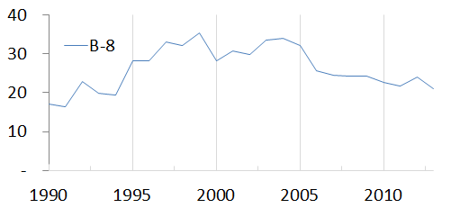
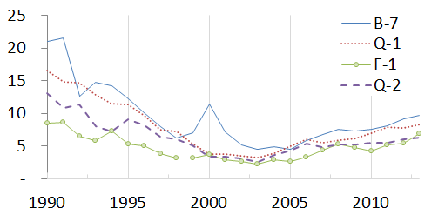
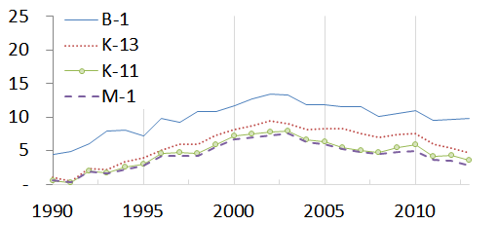
Step 4. Future Skills Needs based on Trends of IPC
- Trend from the relative frequency of IPC
Increasing trend (I) after 2005
Decreasing trend (D) after 2005
11/16

Slide 13
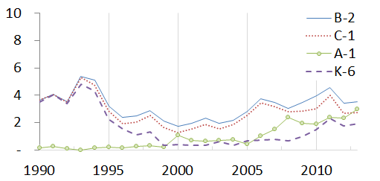
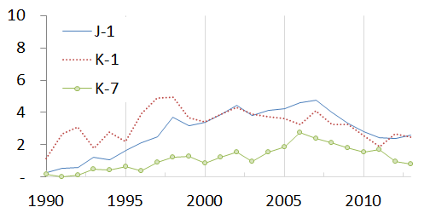
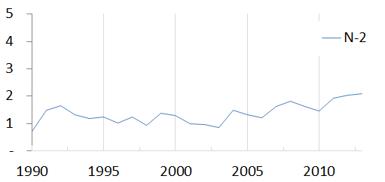
Step 4. Future Skills Needs based on Trends of IPC
- Trend from the relative frequency of IPC
Increasing trend (I) after 2005
Decreasing trend (D) after 2005
12/16

Slide 14
Step 5. Verification of Validity of Future Skills Needs
Forecasting based on IPC trend | Skills | surveys on validity of forecast
 |  | Corporate only(6) |  |  |  | Corporate (6) + Expert group (5)
 |  | ① | ② | ③ | ④ | ① | ② | ③ | ④
① continuing importance | (B-8) Network security | 100% | 0% | 0% | 0% | 100% | 0% | 0% | 0%
② getting important | (A-1) Security vulnerability analysis | 17% | 83% | 0% | 0% | 36% | 64% | 0% | 0%
 | (A-3) Simulated hacking and simulated penetration | 17% | 83% | 0% | 0% | 40% | 60% | 0% | 0%
 | (B-2) Security policy | 17% | 50% | 33% | 0% | 30% | 50% | 20% | 0%
 | (B-6) PC security | 17% | 50% | 17% | 0% | 50% | 40% | 10% | 0%
 | (B-7) Data security | 0% | 100% | 0% | 0% | 11% | 89% | 0% | 0%
 | (C-1) Privacy information protection law | 0% | 100% | 0% | 0% | 0% | 100% | 0% | 0%
 | (C-2) Privacy information encryption | 17% | 83% | 0% | 0% | 27% | 73% | 0% | 0%
 | (F-1) Encryption Algorithm | 33% | 67% | 0% | 0% | 36% | 55% | 9% | 0%
 | (K-6) DB security encryption | 0% | 83% | 0% | 17% | 18% | 73% | 0% | 9%
 | (N-2) Cryptology | 50% | 50% | 0% | 0% | 45% | 45% | 9% | 0%
 | (Q-1) Security audit | 0% | 100% | 0% | 0% | 30% | 70% | 0% | 0%
 | (Q-2) Information security event management | 0% | 83% | 17% | 0% | 10% | 80% | 10% | 0%
③ becoming general skills | (B-1) Information security management system | 17% | 0% | 83% | 0% | 20% | 20% | 60% | 0%
 | (J-1) Security architecture | 0% | 0% | 100% | 0% | 20% | 0% | 80% | 0%
 | (K-1) Firewall building | 0% | 0% | 100% | 0% | 20% | 0% | 80% | 0%
 | (K-11) Mobile device management | 0% | 50% | 50% | 0% | 9% | 64% | 27% | 0%
 | (K-13) Authentication service | 0% | 0% | 100% | 0% | 18% | 18% | 64% | 0%
 | (K-7) OTP | 0% | 0% | 100% | 0% | 0% | 10% | 90% | 0%
 | (M-1) Vulnerability analysis | 17% | 0% | 83% | 0% | 40% | 0% | 60% | 0%
13/16

Slide 15
Step 5. Verification of Validity of Future Skills Needs
Survey on actuality of the forecasting
information security companies and the relevant experts.
Results of survey
Fisher’s Exact-Test is significant, with the significant level of 5%
The results of survey approve the forecasted results to be acceptable.
Information from Patent Data could be applied to the “information security” in identifying the future skills needs.
14/16

Slide 16
Concluding Remarks
Information from Patent Data could be useful in identifying the future skills needs.
However, there are certain limitations in using patent information
1. Generally known limitation in patent information
Not all technological developments are patented
Patent data are permanently lagged
Classification of IPC is imperfect
To be cautious in using patent information
2. Previous research experiences by Hwang
Iron & Steal Industry : Even though there are serious technical changes, the change of production process is not easy due to heavily locked existing facilities. It might be the same in sectors required huge infrastructure such as Chemical industry
Green Car : scope of technological change is too wide
Rechargeable Battery : it is too specific area
To be careful in considering the speed and scope of technical changes
3. The most important things in identifying the future skills might be
Reasonable relationship between skill-unit and the proxies(herein, IPC)
Mapping itself
To co-work with experts in different field
15/16

Slide 17
Concluding Remarks
Despite certain limitations, the usefulness of patent information is still highly appreciated in identifying the future skills needs.
Further development might include text analysis, citation analysis etc. as a kind of data mining.
Also other information (i.e. academic paper, web-searching etc.) can be used in the similar way.
16/16

