Slide 1
Skills supply and demand forecasts International Overview Borhene Chakroun Section Chief UNESCO World Skills conference 2015 (WSC) Sao Paulo, Brazil, 12 August 2015

Slide 2
Overview
International context for skills forecasting
Why and how to forecast?
UNESCO experience
Key findings

Slide 3
Towards 2030: The Future We Want
New Global Sustainable Development that outline a set of global outcomes (SDGs) and targets for the next 15 years.
Our vision is to transform lives through education, recognizing the important role of education as a main driver of development and in achieving the other proposed Sustainable Development Goals.
This new vision is fully captured by the proposed SDG 4 “Ensure inclusive and equitable quality education and promote lifelong learning opportunities for all” and its corresponding targets.
Source: Incheon Declaration 2015

Slide 4
Skills are important to achieve the six elements of the Sustainable Development Goals

Slide 5
Skills Are important Constraint for businesses
Source: Enterprise Surveys, 2010
Notes:
According to the data from the Enterprise Surveys employers list skills as a key constraint.
A high proportion of production workers are unskilled (blue bars in the graph). In Sub-Saharan Africa, East Asia, Middle East and North Africa and Latin America the proportion of unskilled production workers is more than 35%
In the Middle East and North Africa and Latin America, more than 2/3 of firms identify an inadequate educated workforce as a major constraint (green bars in the graph)

Slide 6
Need for skills forecasts:
Issues:
How will we know what skills we will need to achieve the vision embodied in the SDGs?
What countries can do to get better understanding of the skills required to achieve their own sustainable development goals?
Approaches:
Some form of regular skills and labour market anticipation is now a key feature of policy in many countries across the world.
This is seen by most governments as a key instrument for better skills development planning and for making labour markets work more efficiently and effectively.
This is not about top down planning of education and training systems to meet demands from the economy.
It is about providing all the actors within the economy, the labour market and education and training with robust information to help them make informed choices and decisions.

Slide 7
Approaches to Forecasting
There are many alternative methods, each has
Strengths & weaknesses
Problems & pitfalls
Most require
Data
Modelling or Analysis
Assumptions; and
Judgement
Forecasting as a “process” rather than an “end” in itself
Some care needed in how to interpret and use forecasts

Slide 8
Enablers
Partnerships and networks for integrated approaches
Knowledge, information base & inventory
A culture of learning
Incentives and accountability
Capacity development

Slide 9
International Initiatives
CEDEFOP Regional work (EU perspective);
European Countries: France released in June 2015 skills forecasting for 2022;
US Department of Labour experience;
ILO;
UNESCO.

Slide 10
Findings from UNESCO’s work in assessing feasibility of skills anticipation in developing countries

Slide 11
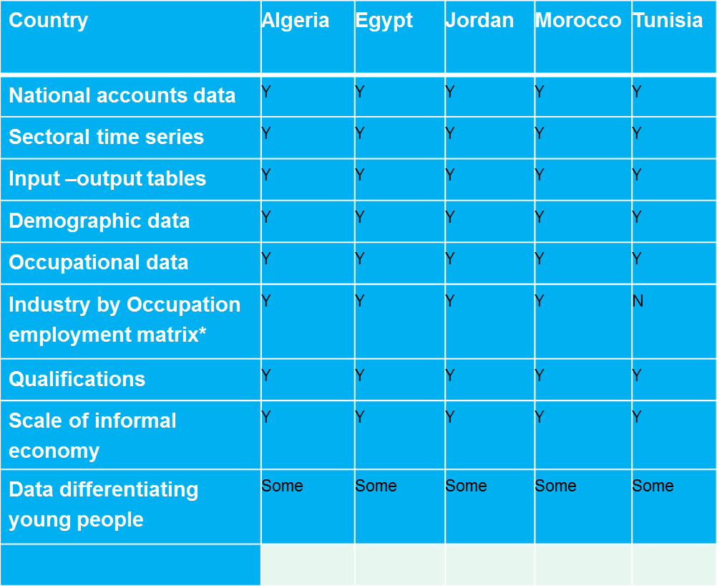
Feasibility of skills projections

Slide 12
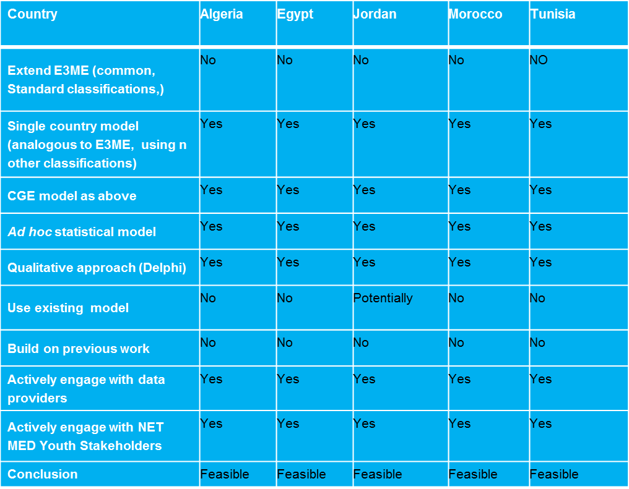
Feasibility of skills projections

Slide 13
Problems and challenges
Lack of stable trends in the formal economy and labour market (political and other uncertainties);
Significance of the informal economy (difficulties in measurement and modelling the informal economy);
Lack of well-established macro-economic models;
Lack of a focus on the youth situation in labour market;
Difficulties in access to relevant detailed data.

Slide 14
Problems and Challenges
Three particular characteristics need to be addressed:
the significance of the informal economy;
the importance of youth: graduates unemployment
the importance of remittances from abroad.
A further challenge arises from the focus on young people:
Most standard forecasting models do not focus on employment by age; However
They account for a large proportion of the working age population

Slide 15
Summary of findings
Constraints on the data availability side are not binding;
Best way to secure data access is to involve relevant organisations as partners: Importance of the platform of stakeholders);
Use of simple models & techniques for skills anticipation is possible as first phase, but the focus should be also on longer term capacity development;
Need to take into account institutional setting & limited resources;

Slide 16
Summary of findings
Skills Forecasting can be defined as a PUBLIC GOOD;
Platform for Dialogue (including the involvement of Social Partners) is Paramount!
The Model has to be country-tailored though, regional and international cooperation cannot be neglected;
Financing has to be continuous or otherwise – no sustainability

Slide 17
Sources: Sources Professor Rob Wilson ( Warwick Institute for Employment Research): Skills Forecasting in the Mediterranean Region UNESCO, Paris, 9-10 June 2015 Workshop Report Marope, Chakroun & Holmes (2015). Unleashing the potential: Transforming Technical and Vocational Education and Training Gardner Ben & Chakroun Borhene (2015). National Situational Report on Skills Forecasting: The Dominican Republic
Notes:
17

