Slide 1
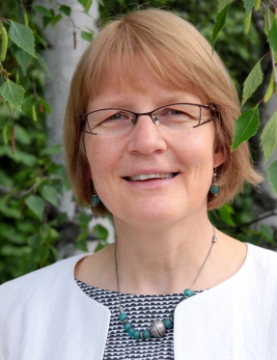
VET teachers and their role in developing skills excellence in Finland
Seija Mahlamäki-Kultanen
Häme University of Applied Sciences
Dean of Professional Teacher Education
Adjunct Professor, University of Tampere

Slide 2
Basic facts and assumptions of the Finnish VET for a VET professional
VET is not ” a second choice”, it can often be the first -> There are gifted and excellent students in VET organizations!
Information about VET is easily available, for example students from primary schools visit skills competions, Taitaja 9 and Taitaja Plus and thus get career councelling
Skills competitions and preparation for them can be included in the VET curricula and they serve as teachers´professional networking arena
Through skills coaching teachers learn motivating pedagogical methods for all the students and develop their teaching

Slide 3
Highly educated teaching personnel in VET
All VET teachers must be able to implement a competence-based curriculum and plan individualized curricula according to the students needs (from learning difficulties to skills excellence and skills competitions)
The teachers must possess both theoretical and practical skills -> highly requirements for a VET teacher: The most common pre-service requirement is a higher education degree, at least 3 years of work experience and a 60 cp pedagogical qualification
A teacher qualification is required from educational leaders
Continuing teacher education is encouraged and several national in-service programmes are delivered widely

Slide 4
Finnish Academy of Skills Excellence
Networked organisation in HAMK, serves the development of VET Skills Excellence in Finland and vocational teachers
Research on Skills excellence in VET
Development projects
Services for vocational education providers and VET teachers

Slide 5
VET Teachers career and skills competitions
Professional networking
Professional development
Internationalisation
Competences gained in organising skills competitions can be accredited in teachers´own studies and qualifications

Slide 6
Conclusions
The basic assumptions and attitudes (teachers, students, parents) play a role and thus it is necessary to consider the image and prestige of VET, not only the curricula as itself
National structures like national competence-based and flexible curricula including skills excellence approach, proper teacher qualifications and spesified in-service training in preferably an international environment as well as some development programmes form a holistic policy approach to develop excellenceand enhance teachers professional development

Slide 7
Resources and case examples from Finland
For the interested audience some case examples which demonstrate the ideas in practice

Slide 8
International teacher training in Skills Excellence
https://www.youtube.com/watch?v=tPuuUxn4kN8

Slide 9
International teacher training case examples
https://www.youtube.com/watch?v=-1nRm4tQL0A
https://www.facebook.com/vetteachersforthefuture

Slide 10
International teacher training internships
Case: The Bolashak fellowship programme:
https://publications.theseus.fi/handle/10024/80287

Slide 11
More information
www.minedu.fi
Ministry of Education and Culture
www.edu.fi
the Finnish education portal
www.oph.fi
Finnish National Board of Education

Slide 12
More information
https://webgate.ec.europa.eu/fpfis/mwikis/eurydice/index.php/Finland:Teaching_and_Learning_in_Vocational_and_Technical_Upper_Secondary_Education

Slide 13
Competence based higher education
https://prezi.com/bxobv5zvnlaw/competence-based-curriculum/ for your further reading
Brochure ”Developing a Competence-based Curriculum” http://ospe.utu.fi/tiedotteet/Ospe_kriteeristo_102x21cm_8s_2014_ENG_netti.pdf
Competence-based higher education enhances the continuity to students´learning paths and increases the students´employability

