Slide 1
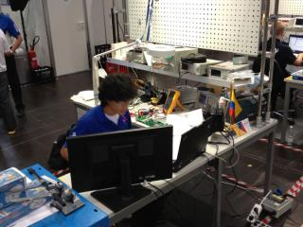
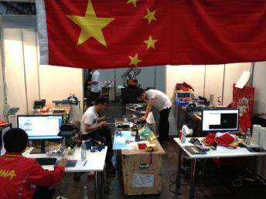
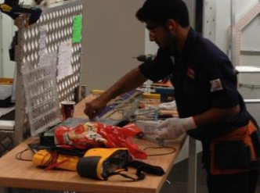
Future skills and Fluke Corporation

Slide 2
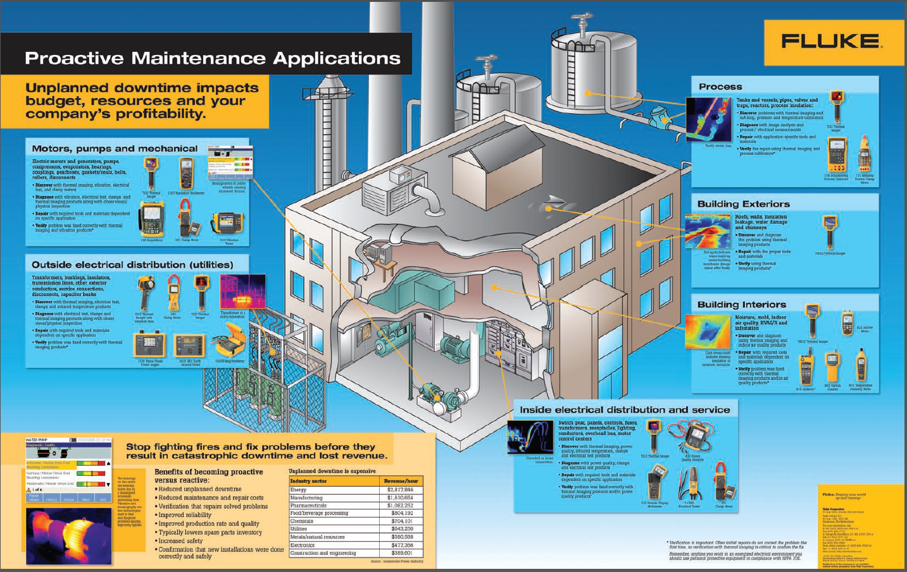
Who we are
Classic model: Design, Build, Test
New reality: Troubleshooting, Systems integration

Slide 3
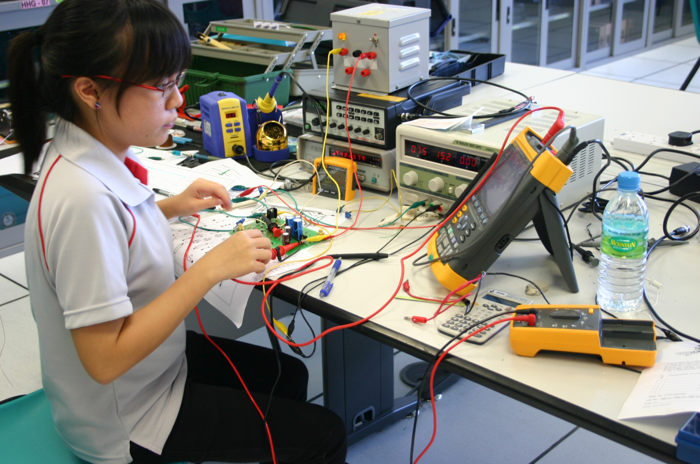
Skills we support
Electrical
Refrigeration / Air conditioning
Electronics
Mechatronics
Information network cabling
Industrial Millwright
Automobile technology
Manufacturing team challenge
Industrial control
Mobile robotics
Aircraft maintenance
IT Network administration

Slide 4
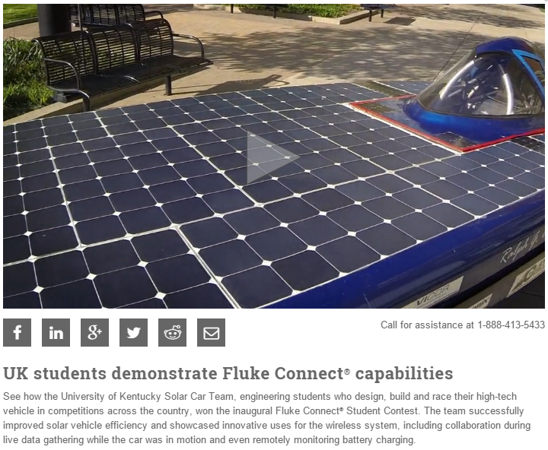
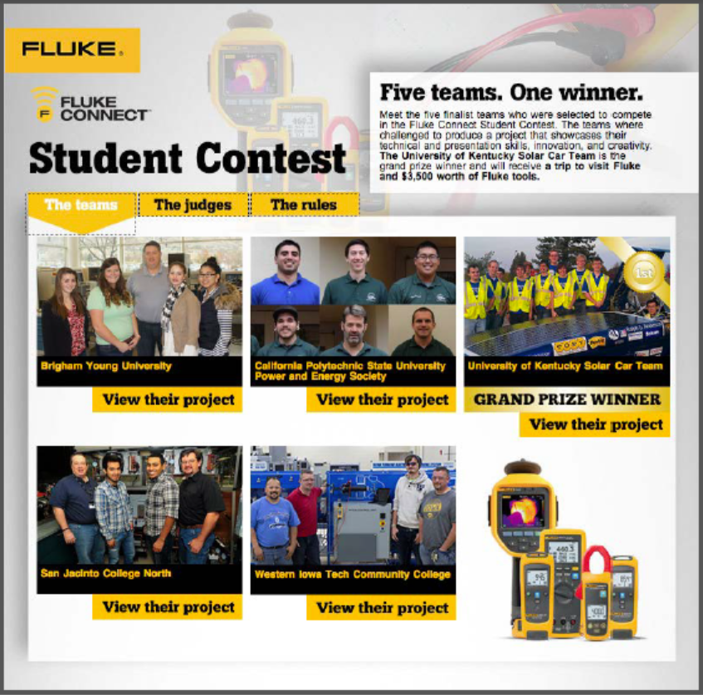
Collaboration between industry & skills

Slide 6
Thank you

