Slide 1
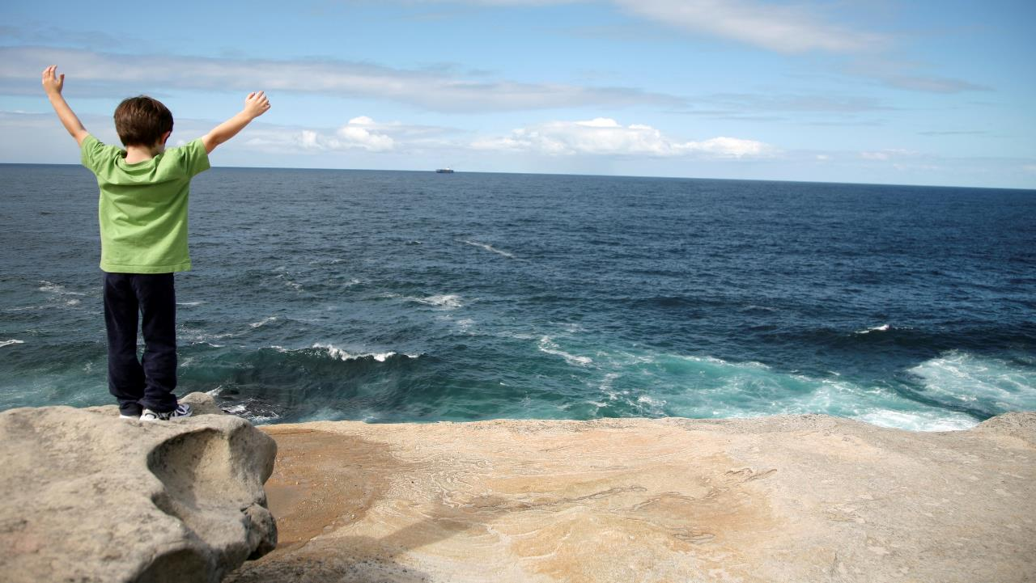

Future Skills & Technologies – offering an innovative and sustainable approach
Rich Miles
Sustainability Director - Europe
August 14, 2015

Slide 2
Who we are
1902
Improving lives since

Slide 3

15 percent culture: creativity needs freedom.
Since 1948, 3Mers have been encouraged to use 3M resources, to build up a unique team and to follow their own insights in pursuit of problem-solving – and to spend
15 percent of their working time to do it.
Notes:
A core belief at 3M is that creativity needs freedom. That’s why, since about 1948, we’ve encouraged our employees to take our resources, to build up a unique team and to follow their own insights in pursuit of problem-solving — and to spend 15 percent of their working time to do it.
That initiative is alive and well today, and has led to some of our most ingenious inventions, including:
Multi-layer optical film, which reflects 95 percent of all light. It’s likely in your laptop, smart phone and big-screen TV … making the screen brighter, while reducing energy use.
Automobile window treatment films … which enhance comfort, security and privacy in your vehicle.

Slide 4
46 core technology platforms
Ab
Abrasives
Ad
Adhesives
Fi
Films
Md
Medical Data Management
Am
Advanced
Materials
Fl
Fluoro-materials
Ec
Energy
Components
Mf
Mechanical Fasteners
Ce
Ceramics
Nt
Nano-technology
Ac
Acoustic Control
Fe
Flexible
Electronics
Mi
Microbial Detection
and Control
Co
Advanced
Composites
Nw
Nonwoven
Materials
Mo
Molding
Pe
Predictive Engineering
& Modeling
Rp
Radiation Processing
An
Analytical
Fc
Flexible Converting & Packaging
Pr
Process Design & Control
Bi
Biotech
Fs
Filtration, Separation, Purification
Op
Opto-electronics
Do
Dental &
Orthodontic Materials
Po
Porous Materials & Membranes
Mr
Micro-replication
Pm
Polymer Processing
Su
Surface Modification
As
Application
Software
In
Inspection & Measurement
Se
Sensors
Dd
Drug
Delivery
Im
Imaging
Tt
Track and Trace
Em
Electronic
Materials
Sm
Specialty Materials
Pd
Particle & Dispersion Processing
Pp
Precision Processing
Vp
Vapor Processing
Es
Electronics & Software
Is
Integrated Systems & Design
We
Accelerated Weathering
Di
Display
Lm
Light
Management
Wo
Wound
Management
Materials
Processing
Capabilities
Applications
Notes:
Many other companies have adopted our 15 percent rule. Yet what remains unique to 3M is the breadth and diversity of our technology pool … which reflects our uncommon approach to R&D.
At 3M, we do R&D a bit differently: we separate the R and the D.
Scientists in our central laboratory are free to focus on pure research … looking for unscripted, unexpected opportunities for breakthroughs.
3M development teams within each of our five business groups then draw upon those core technologies to develop products for targeted markets and geographies.
These are our 46 core technology platforms … which range from adhesives and abrasives, to sensors and electronics materials.
Our team has the uncanny ability to combine and use the technologies in creative ways.
That’s how a mixing technology originally created for dental crowns made its way into automotive applications, too.
Another example is our all-weather paint used to mark pavement … part of 3M’s legacy of making roadways safer. Our scientists combined three technologies to make this highly reflective paint that’s visible even in rain … Abrasives, Adhesives and Nonwoven Materials.

Slide 5
3M technology platforms and market diversity
Adhesives
Automotive and aerospace
Abrasives
Consumer and office
Ceramics
Electro and communications
Electronic Packaging
Microreplication
Home and leisure
Integrated systems design
Manufacturing and industry
Light management
Healthcare
Specialty materials
Safety and security
Fibres
Polymeric smelting
Display and graphics
Notes:
We’ve become pretty adept at taking a technology that has been developed to provide solutions for one market and then applying it elsewhere, to create often quite different solutions in totally unrelated markets.
We call that ‘technology transfer’.

Slide 6
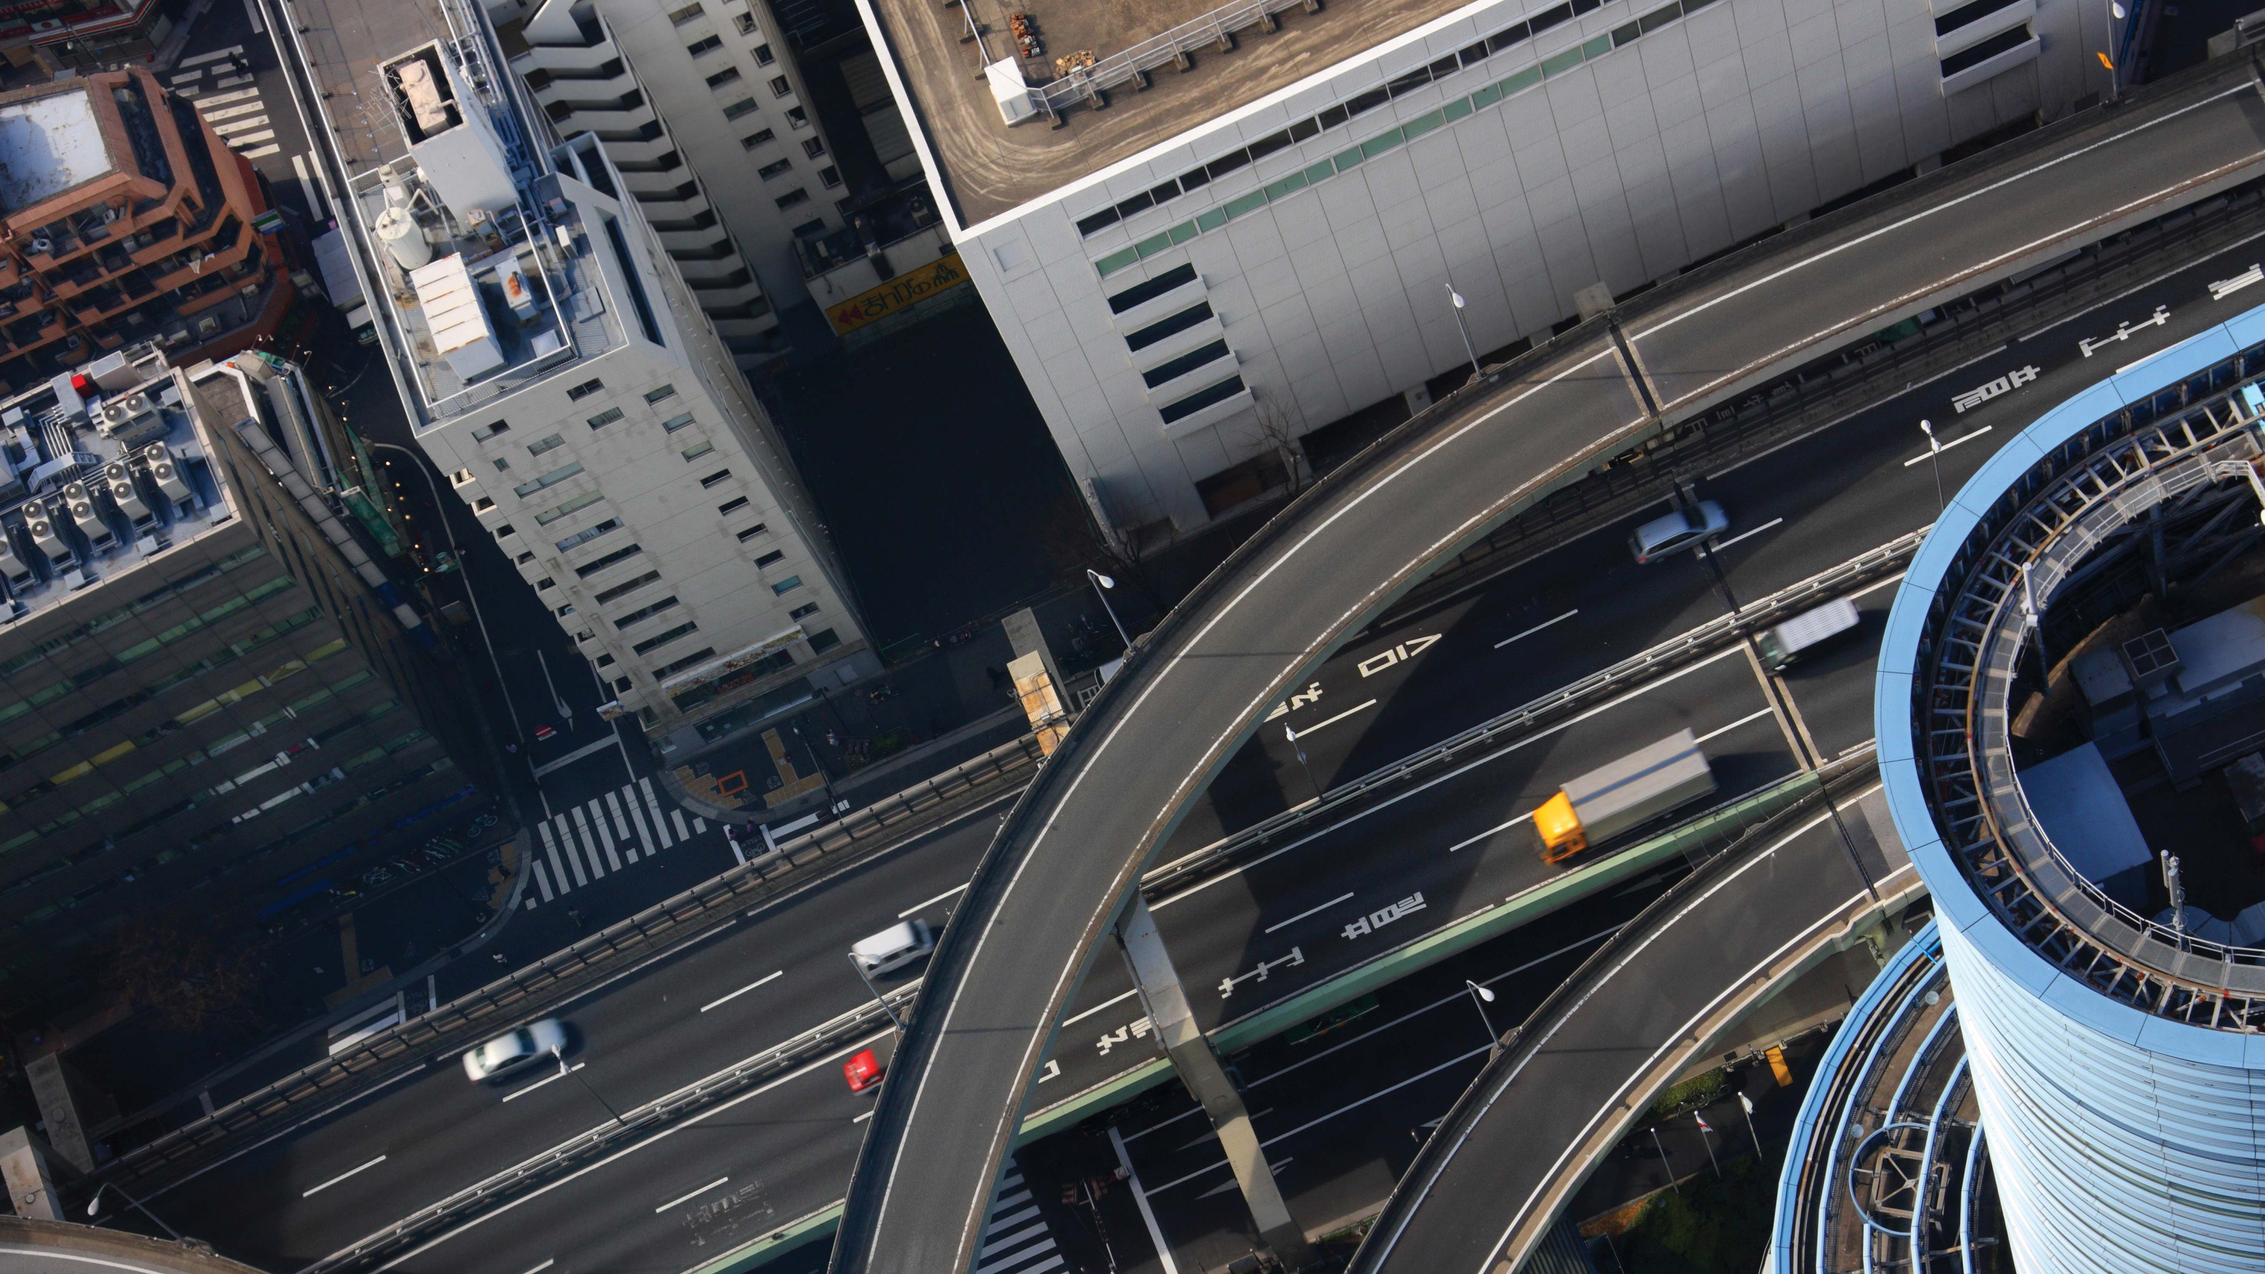
100,000
patents
Notes:
In May 2014, 3M achieved an innovation milestone: we received our 100,000th patent.
This is a testament to our scientific strength.
Yet the real power of 3M is our ability to apply science to life.

Slide 7
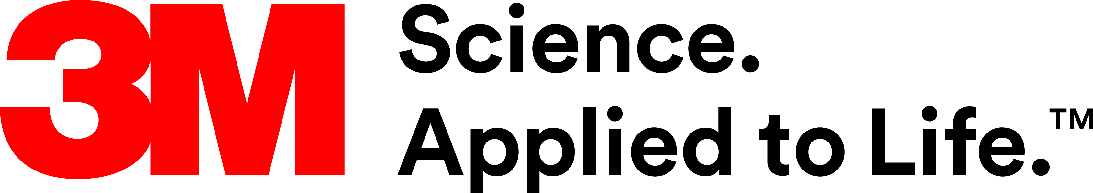
Notes:
We believe that science is just science. Until you make it improve the world.
That is what 3M strives to do every day.
We use science to improve lives and solve problems by working closely with our customers … and with each other.

Slide 8
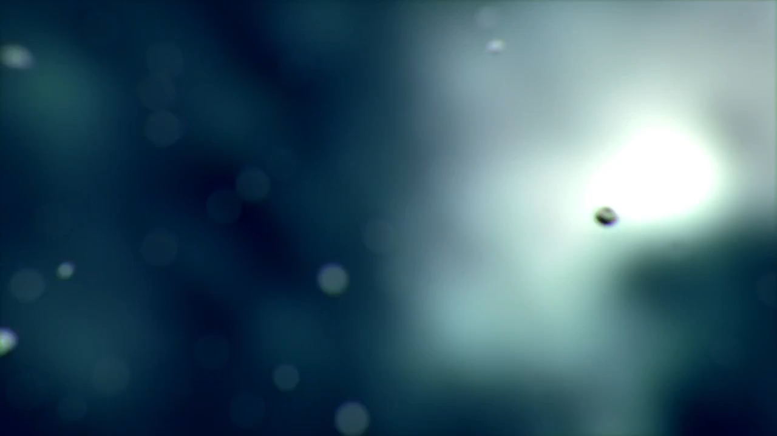
Notes:
We believe that science is just science. Until you make it improve the world.
That is what 3M strives to do every day.
We use science to improve lives and solve problems by working closely with our customers … and with each other.

Slide 9
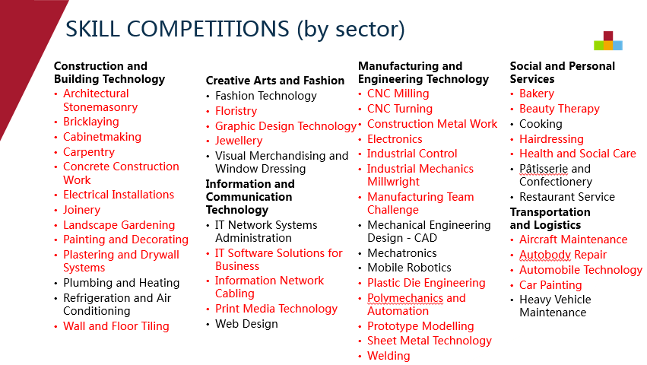

Slide 10
Slide showing the WS skills list – indicating where 3M products play a role ….then focus on 3 areas
1. Personal Protective Equipment – slide to illustrate the depth and breadth – RM to provide a slide showing the breadth and breadth of the Personal Safety Range
- specific focus on the Noise Induced Hearing Loss
Partnership with WS Foundation
2. Paint Preparation System – a physical sample to show/tell
3. Car wrapping – a YouTube video
https://www.youtube.com/watch?v=EgFlEKwNeOQ
Video is 1 minute long
Notes:
Across the 50+ skills areas 3M has a part to play.
None more so than in the area of Personal Protective Equipment (PPE)
From Active welding shield that switch from light to dark in a micro-second so protecting a welder’s eyesight from the ultra bright welding ‘flash’ through the widest array of Respiratory protection devices – some disposable to some that protect users from to the highest levels of contamination and on to the protection of worker’s hearing – the biggest global industrial epidemic affecting
More than 120 million workers across the globe are exposed to dangerously high noise levels (over 85 dB)
Prolonged or repeated exposure to high levels of noise can irreversibly damage hearing – leading to Tinnitus or permanent hearing loss.
Make sure you visit our hearing booth at Stand XXX where we have partnered with WS Foundation to jointly expose this problem.
Our Paint Preparation System is a simple way of reducing waste paint during the automotive paint spraying process. Unused paint can be retrieved via the sachet held within the disposable paint pot. Cleaning time is reduced and the use of solvent to clean the equipment is significantly reduced (in fact only the spray gun nozzle requires cleaning – faster…cheaper…safer ….and better for the environment!
And lastly something to compete with our spray paint system !!!! – how about if we introduced a more ‘customisable’ system for colouring your car? …heard of car-wrapping!
Perhaps a Worldskill skill for the future! …… play the car wrapping YouTube video (Final vid to be decided)

Slide 11
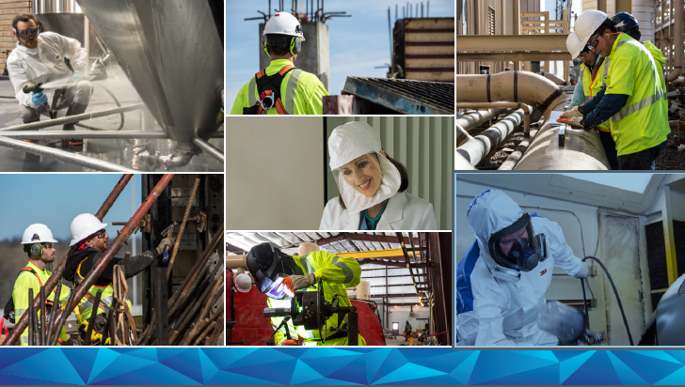

Slide 12
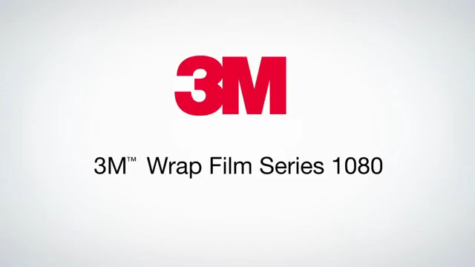

Slide 13

Thank you
3M.com/Sustainability
#LifeWith3M

