Slide 1
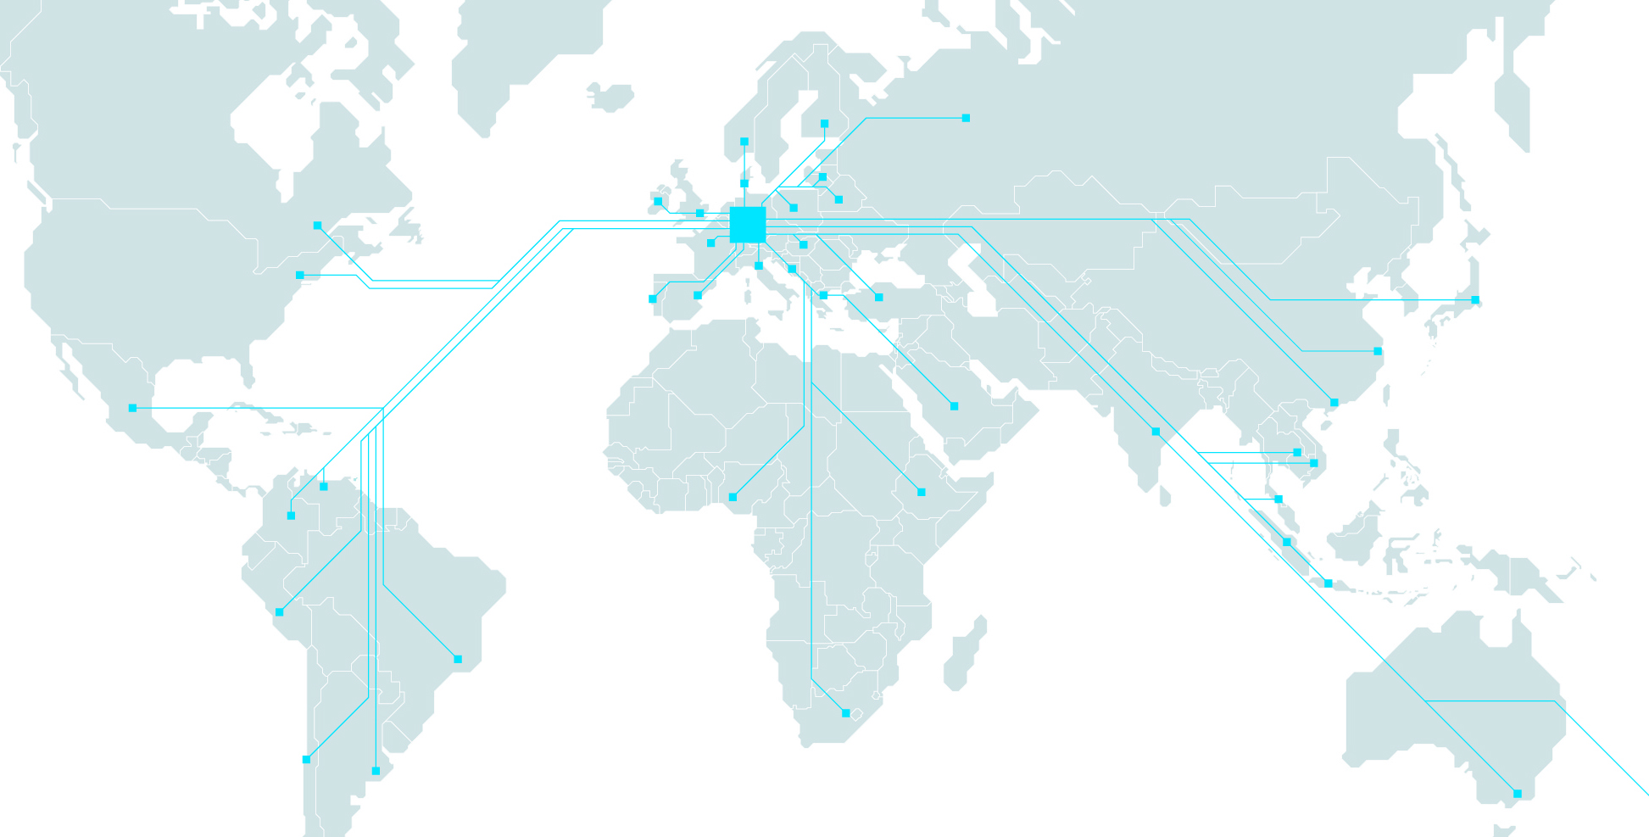
A glimps at industries future skills and technologies
Festo Didactic @ WorldSkills International Competitions, Sao Paulo, August 2015
Aquatronics - Green industrial skills for the development of urban regions
Dr. Nader Imani Head of Business Field Education, Festo Didactic SE, Germany
CEO Festo Didactic Inc. USA, Festo Didactic Ltée./Ltd. Canada

Slide 2
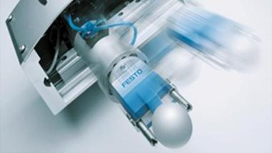
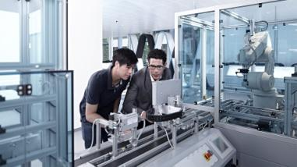
Festo - We are the engineers of productivity and employability
Symbiosis of industry and education
Automation
Productivity
Education
Components
Systems /
Solutions
Machines/
Systems
Training /
Consulting
Learning Systems
Learning Center / Managed Training Services
People /
Organization
Increasing the productivity of over 300.000 clients worldwide

Slide 3
Technical Education & Qualification - The Foundation Stone for Development
Knowledge and Skills
Create
Didactic
Qualification and HR Development
Innovation and Jobs
Economic
Growth/Development
Trends in Labor Market

Slide 4
GreenING Skills
Water & Aquatronics for the development of urban regions
Soon 8,0 Bil. towards 11,0 Bil.
Over 50% world population in urban regions
Increase of Water by 85% in between 2010 and 2035
Higher demand of water both in per capita and abs. in Latin America (+350%) & Asia (+350%), Africa (+500%) by 2050
Finite water resources
Strong tight in between water and energy leading to an environment protection
Water as part of Post 2015 MDGs

Slide 5
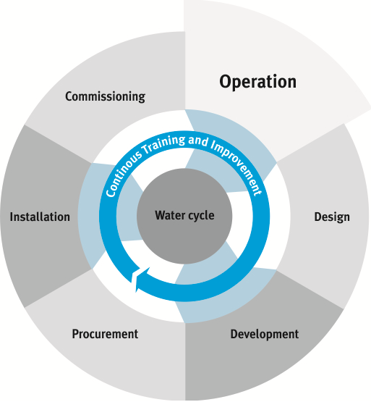
Objectives of Aquatronics
Aquatronics aims to become the universal common qualification framework for all professions related to Water and Wastewater management
Curriculum Development in Aquatronics
From Operating to Design of
Water and Wastewater Facilities
Subject contents Subjects
 | Technician | Master Technician | Bachelor
Mechanical | 20.00% | 20.00% | 20.00%
Automation & IT | 25.00% | 20.00% | 20.00%
Electrical & Electronics | 20.00% | 20.00% | 20.00%
Chemistry & Physics | 15.00% | 10.00% | 15.00%
Biology | 7.50% | 7.50% | 10.00%
Commercial & Economics | 2.50% | 5.00% | 7.50%
Environmental, Health & Safety Management | 10.00% | 17.50% | 7.50%
Total | 100.00% | 100.00% | 100.00%
Qualification spans over 7 semesters of education,
Pathways for Technicians to become Master Technicians and Master Technicians to become Engineers in the case of further education.

Slide 6
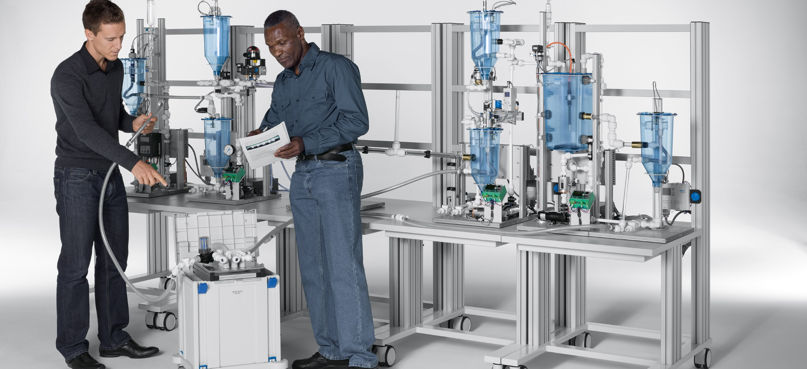
EDS – Water Management
Learning systems for basic and advanced education

Slide 7
Video
EDS - Water Management, 30 sec.

Slide 8
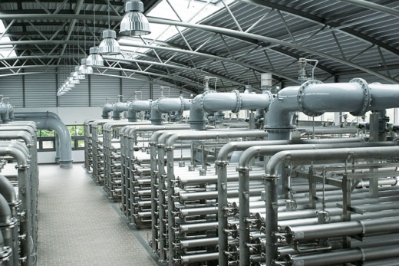
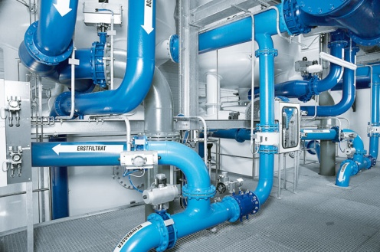
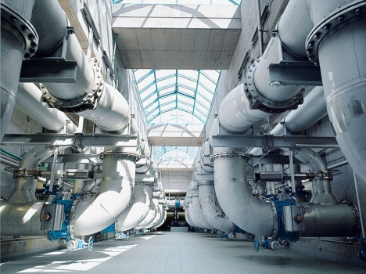
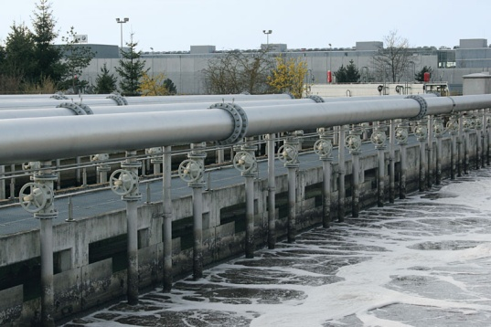
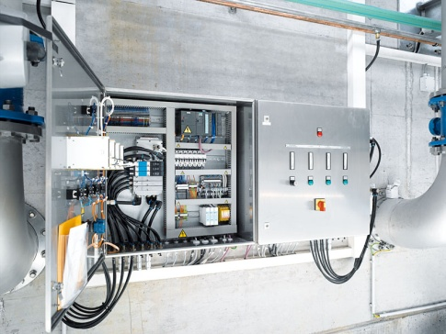
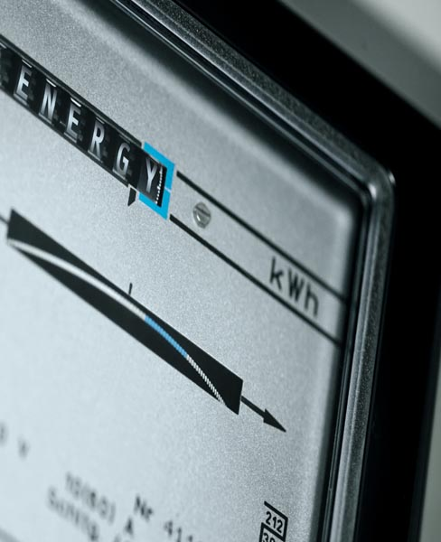
Learning Modules:
Module 1:
Water purification
Module 2:
Water supply
Module 3:
Waste water transport
Module 4:
Waste water treatment
Module 5:
Monitoring, controlling
and optimising
Module 6:
Energy optimisation in water and wastewater treatment plants

Slide 9
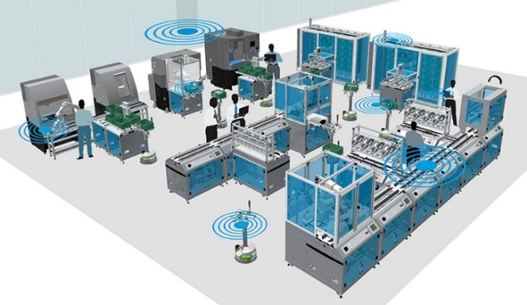
Mechatronics & Aquatronics
Establishment of dualistic education for essential skills
Companies
Schools, Universities
and Learning Centres

Slide 10
Thank you for your attention!
Modular Learning / Green Industrial Skills

