Slide 1
A Glimpse at Industries Future Skills and Technologies
SAMSUNG’s
Skills-related Activities
for Youngsters
Ji Oh Song
Secretary General, Samsung Skills
14 August, 2015

Slide 2
SAMSUNG Skills
Supporting SKILLED YOUNGSTERS
to make their DREAMS and HOPES come true
through SKILLS EXCELLENCE

Slide 3
How to do it?
Successful
Role Model
Providing
Quality Job Opportunity
Promoting
Skills Excellence

Slide 4
Providing
Quality Job Opportunity
Promoting
Skills Excellence
Hiring skilled youngsters through Korea National Skills Competition
Hired 842 persons
since 2007
Sponsoring Korea National Skills Competition & WorldSkills Competition
Training Competitors for WSC (e.g. Sao Paulo 2015)
Hosting SAMSUNG Skills
Competition

Slide 5
Skills-related CSV activities
Samsung Skills
CSV Activities
Member countries
Overseas
Operations
Corporate Citizenship(CC)

Slide 6
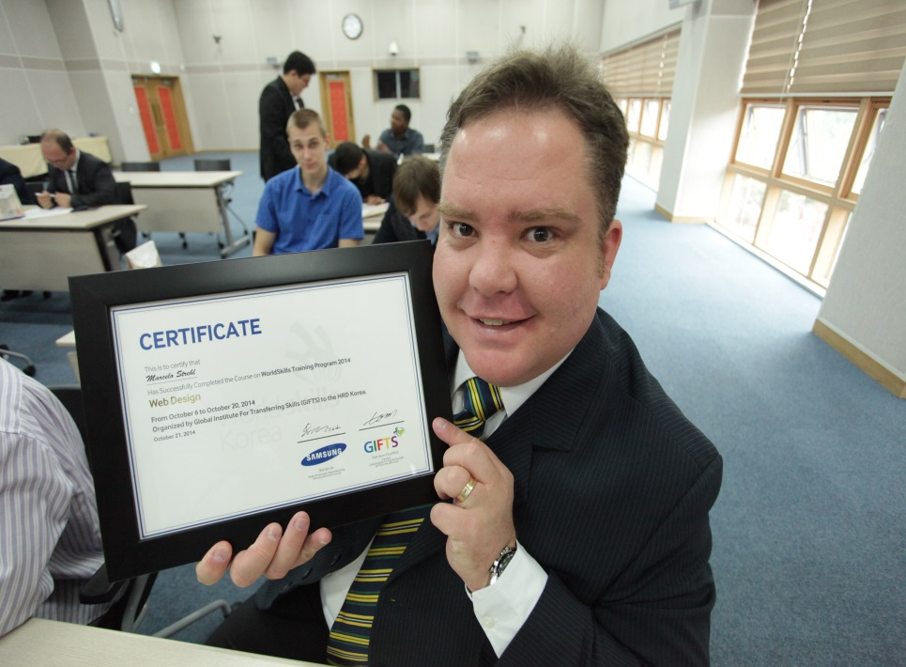
CASE Ⅰ.
Global Skills Training Program
SAMSUNG - WorldSkills Korea - 6 WSI member countries
Training 21 Competitors and Experts in 3 ICT Skills
Corporate Citizenship
6 Overseas Operations
Samsung Skills
WorldSkills Korea
Brazil (6)
Guatemala (1)
Mexico (2)
Morocco (3)
Russia (6)
South Africa (3)

Slide 7
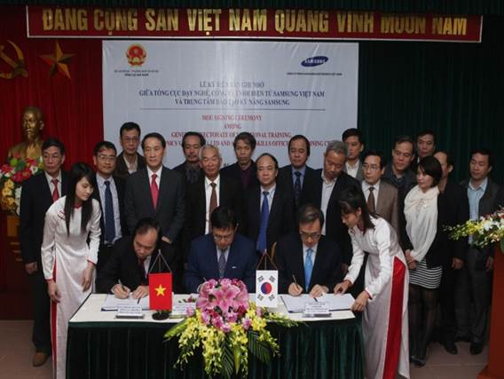
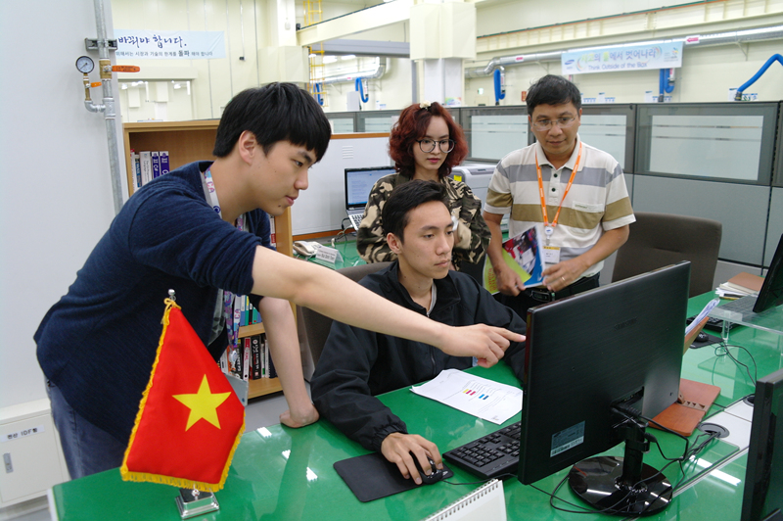
CASE Ⅱ.
Samsung Vietnam Project
WS Vietnam(GDVT) - Samsung Vietnam - Samsung Skills
Training Vietnamese Competitors for WSC Sao Paulo 2015

Slide 8
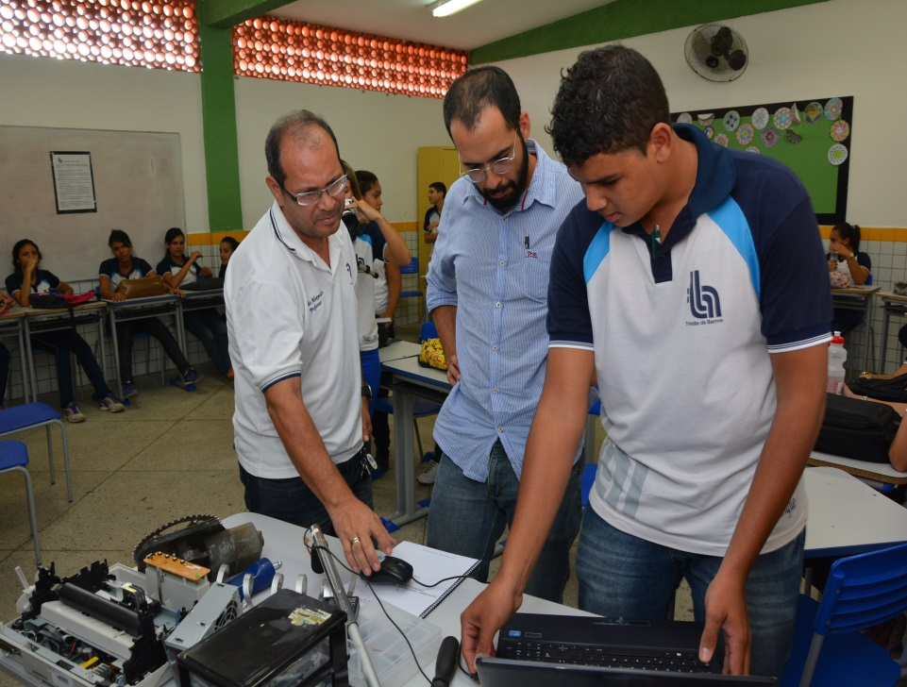
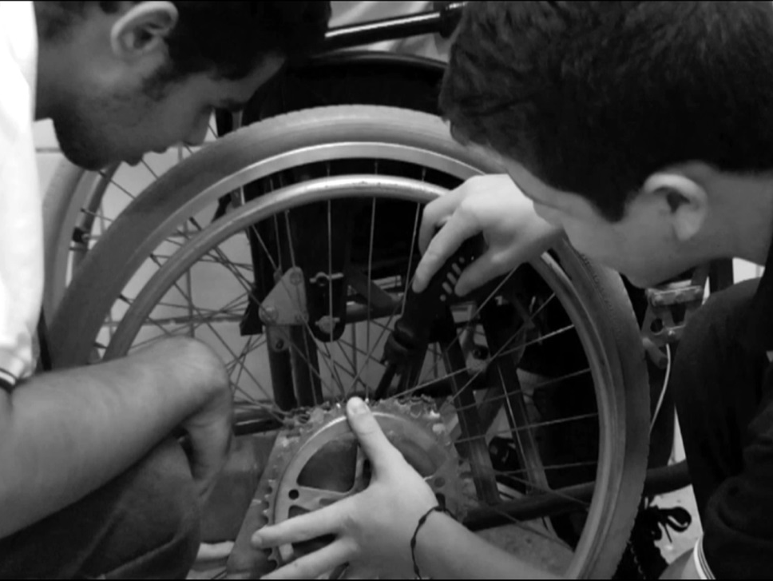
CASE Ⅲ.
Solve for Tomorrow
Samsung HQ(CC) - Overseas Operations in 14 countries
Innovative solutions for their community using STEM
※ STEM : Science, Technology, Engineering, Mathematics

Slide 9
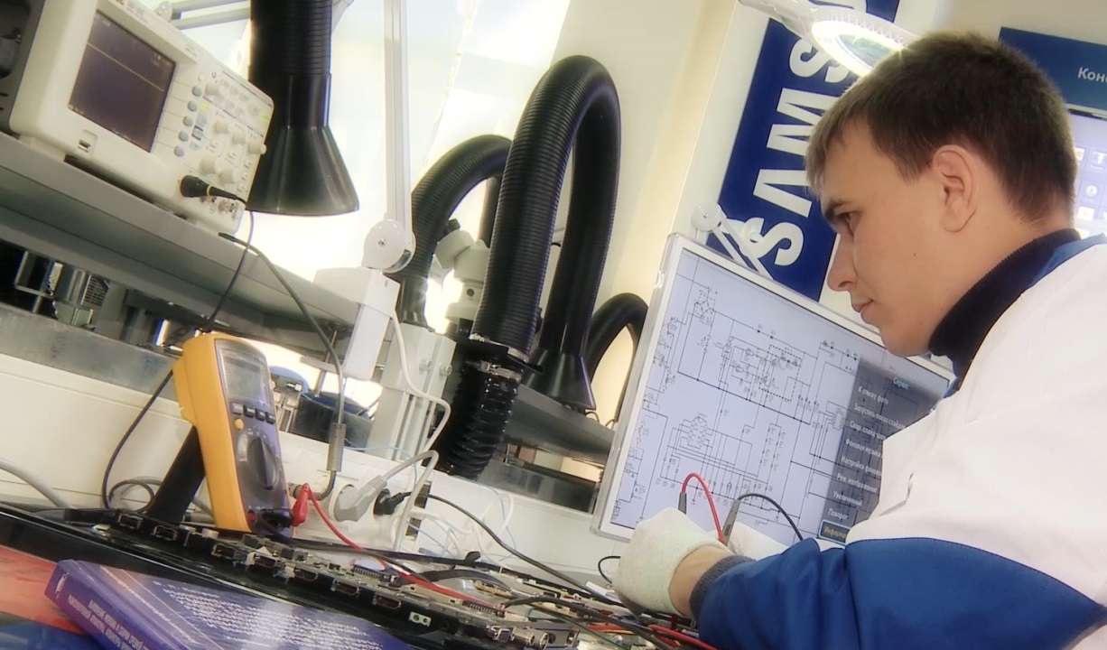
CASE Ⅳ.
Samsung Tech Institute
Samsung HQ(CC) - Overseas Operations in 49 countries
123 S-TIs cooperating with colleges & government for VET
Argentina
Austria
Bangladesh
Belgium
Brazil
Bulgaria
Cambodia
Chile
China
Colombia
Croatia
Czech Republic
Estonia
France
Germany
Greece
Hungary
India
Indonesia
Iran
Italy
Japan
Jordan
Kazakhstan
Lao People Democratic Republic
Malaysia
Mexico
Myanmar
Netherland
Nigeria
Philippines
Poland
Portugal
Romania
Russia
Saudi Arabia
Serbia
Singapore
Slovakia
South Africa
Spain
Sweden
Switzerland
Taiwan
Tunisia
Turkey
Ukraine
United Kingdom
United States

Slide 10
We have more things to do for our skilled youngsters.
SAMSUNG will continuously cooperate with WorldSkills members and partners.
Thank you
Samsung Skills

