Slide 1

Cooperation to increase vocational and practical education based on the German technical education system
Siemens Automation Cooperates with Education (SCE) | 08/2015

Slide 2
Agenda
Siemens facts
German Technical Education System
Siemens Automation Cooperates with Education (SCE)

Slide 3
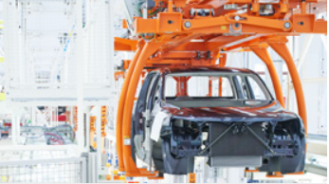
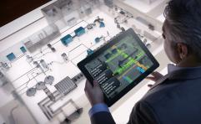
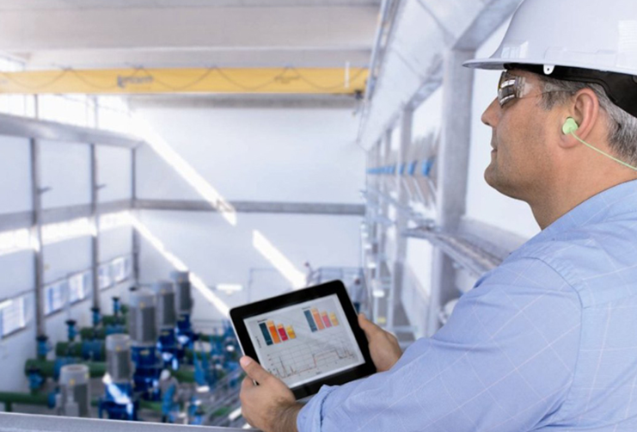
Siemens at a glance
Core competencies – Electrification, Automation and Digitalization
Key figures Siemens FY 2014
Revenue by industrial business
Power and Gas 18%
(continuing operations; in millions of €, except where otherwise stated)
 | FY 2014 | FY 2013 | % Change¹
Volume
Orders | 78,350 | 79,755 | 1%
Revenue | 71,920 | 73,445 | 1%
Profitability and capital efficiency
Return on capital employed (ROCE) | 17.2% | 13.7%
Net income² | 5,507 | 4,409 | 25%
Liquidity
Free cash flow² | 5,201 | 5,328
(in thousands) | Sep. 30, 2014 | Sep. 30, 2013
Employees
Total (continuing operations) | 343 | 348
Germany | 115 | 117
Outside Germany | 229 | 231
Healthcare 16%
Process Industries
and Drives 13%
Wind Power and
Renewables 8%
Energy
Management 15%
Digital Factory 13%
Building
Technologies 8%
Mobility 10%
Not included: Financial Services (SFS)
Revenue by region
Asia, Australia 20%
Europe, C.I.S.*, Africa,
Middle East (without
Germany) 39%
1 Comparable, excluding currency translation and portfolio effects.
2 Continuing and discontinued operations.
Americas 26%
Germany 15%
* Commonwealth of Independent States
Notes:
3
3

Slide 4

Siemens is one of the largest vocational training organizations in Germany
1194%
1032%
Apprentices per year
Number of Apprentices: 7,052 (30 Sept. 2014)
Technical professions | 5,476
Commercial professions | 1,230
Siemens technical academies | 346
1,980 hired in 2014
Commercial apprentices incl. 178 dual degree students
371
(19%)
Education for external companies
1,442
(73%)
167
(8%)
Students at Siemens
technical academies
External apprentices | 2,794
Technical apprentices
incl. 574 dual degree students
Notes:
4

Slide 5
Agenda
Siemens facts
German Technical Education System
Siemens Automation Cooperates with Education (SCE)

Slide 6
A high degree of flexibility and practical elements are the trademark of the German education system
Gymnasium General university qualification track
(Mittl. Reife)
Gymnasium - Upper Level
General university qualification
(Abitur / Allg. Hochschulreife)
University
(Bachelor, Master, PhD)
Dual Degree Programs
University & University of Applied Sciences
(Bachelor, Master)
Realschule
Upper intermediate level certificate
(Mittl. Reife)
Vocational School
(Fachoberschule / FOS )
FOS 13 BOS 13
Elementary school
Vocational Abitur
University of
Applied Sciences
(Bachelor, Master) Fachhochschule / FH
Hauptschule
Lower level
(Quali)
Extra Year
Dual Vocational Education and Training
( Dual VET- Work based)
(Berufsschule)
BOS
Voc. Abitur
Vocational Academies
Berufs- / Fachakademie,..
(Bachelor / certified Engineer)
Work- experience
Primary 6-9 YO
Secondary Level I 9-15 YO
Secondary Level II 15-18 YO
Tertiary Level

Slide 7
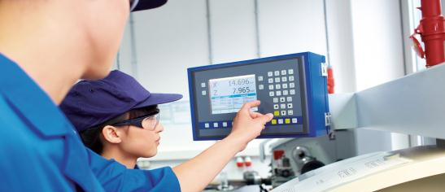
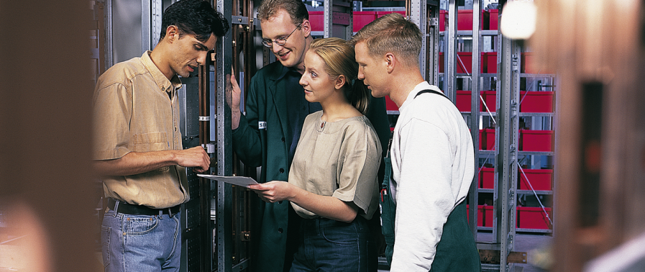

Model of VET (Vocational Education Training) – Programs (3 – 3 ½ years)
Dual Training
Practical skills
Theoretical skills
  3-4 days per week
  Based on training regulations
  Within the framework of a training contract
  Mainly at the workspace
  1-2 days per week
  Based on a curriculum framework
  General and vocational knowledge is taught within the compulsory education system

Slide 8
A high degree of flexibility and practical elements are the trademark of the German education system
Gymnasium General university qualification track
(Mittl. Reife)
Gymnasium - Upper Level
General university qualification
(Abitur / Allg. Hochschulreife)
University
(Bachelor, Master, PhD)
Dual Degree Programs
University & University of Applied Sciences
(Bachelor, Master)
Realschule
Upper intermediate level certificate
(Mittl. Reife)
Vocational School
(Fachoberschule / FOS )
FOS 13 BOS 13
Elementary school
Vocational Abitur
University of
Applied Sciences
(Bachelor, Master) Fachhochschule / FH
Hauptschule
Lower level
(Quali)
Extra Year
Dual Vocational Education and Training
( Dual VET- Work based)
(Berufsschule)
BOS
Voc. Abitur
Vocational Academies
Berufs- / Fachakademie,..
(Bachelor / certified Engineer)
Work- experience
Primary 6-9 YO
Secondary Level I 9-15 YO
Secondary Level II 15-18 YO
Tertiary Level

Slide 9
University of Applied Sciences (FH: Fachhochschule)
Structure
Electrical Engineering
Sep
Oct
Nov
Dec
Jan
Feb
Mar
Apr
May
Jun
Jul
Aug
Selected FH’s with mandatory pre-internship between 8 and 12 weeks
Year 1
1st semester –
academic studies
2nd semester –
academic studies
Year 2
3rd semester –
academic studies
4th semester –
academic studies
Year 3
5th semester –
practical phase at company
6th semester –
academic studies
Year 4
7th semester – academic studies
bachelor thesis
bachelor thesis
Exam period
Notes:
Dauer des Praxissemesters
Das Praxissemester umfasst mind. 20 Wochen (höchstens 26 Wochen). Die Mindestdauer des Praxissemesters beinhaltet keine Urlaubszeiten. Das Praxissemester ist grundsätzlich zeitlich zusammenhängend bei einem Unternehmen oder einer Institution durchzuführen.
Im 7. Semester wird begleitend zur Vorlesung gearbeitet
Man hat 4 Monate und auf extra Antrag auf 6 Monate verlängert werden
Kann auch extern erstellt werden
Leistungsschwachen Stundeten wird nahegelegt, ein extra 8. Semester anzustarren!

Slide 10
Agenda
Siemens facts
German Technical Education system
Siemens Automation Cooperates
with Education (SCE)

Slide 11


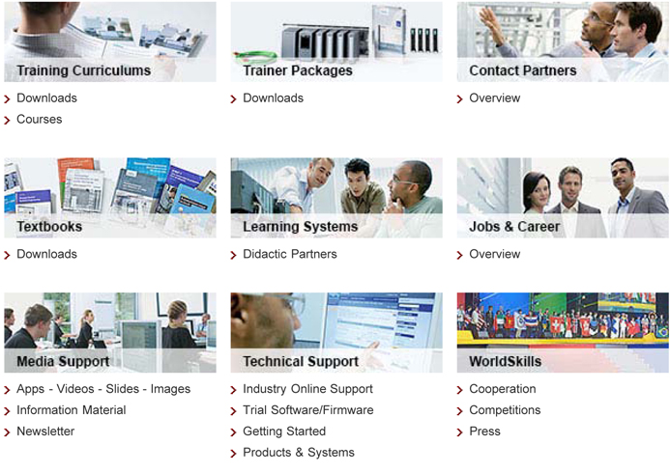




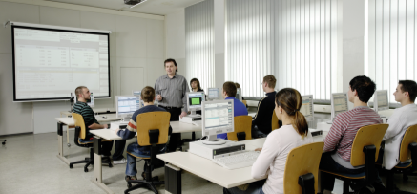
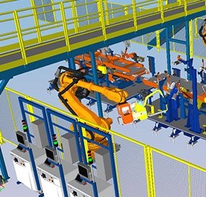


Siemens Automation Cooperates with Education (SCE)
Support for educational institutions related to INDUSTRIAL AUTOMATION
Megatrends
EDUCATION CHALLENGE
to keep abreast of
industrial innovation cycles
SCE Support
climate change
and
digitalization
lead to shorter INNOVATION CYCLES
 www.siemens.com/sce
Education is the future

Slide 12
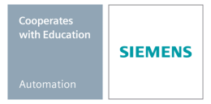
Thank you for your attention
Siemens Automation Cooperates with Education (SCE) | 08/2015

