Slide 1

WorldSkills Leaders Forum – JeJu
Jaine Bolton
15 May 2012

Slide 2

A new home for WorldSkills UK…
In December 2010 the work of WorldSkills UK became part of the remit of the National Apprenticeship Service.
The National Apprenticeship Service is an ‘arms-length’ government department which is jointly owned by the Department for Education (schools and vocational education up to the age of 18) and the Department for Business Innovation and Skills (business support and vocational education and training from the age of 19)
Why the National Apprenticeship Service?
WorldSkills UK Competitions reward real talent and drive up levels of expertise in further education, skills and Apprenticeships.

Slide 3
An overview of Apprenticeships in England…
Long history of Apprenticeships in England
Successive government support for reinvigorating the programme
Major government investment - £1.5bn in 2012
An expanding programme, over 450,000 starts in 2010/11
Modern, online application, matching employer and apprentice
A programme for all ages and at all academic levels
Over 25 new Higher Level Apprenticeships (levels 4 to 7) in development
We have come a long way but must do more in order to become
‘world class’

Slide 4
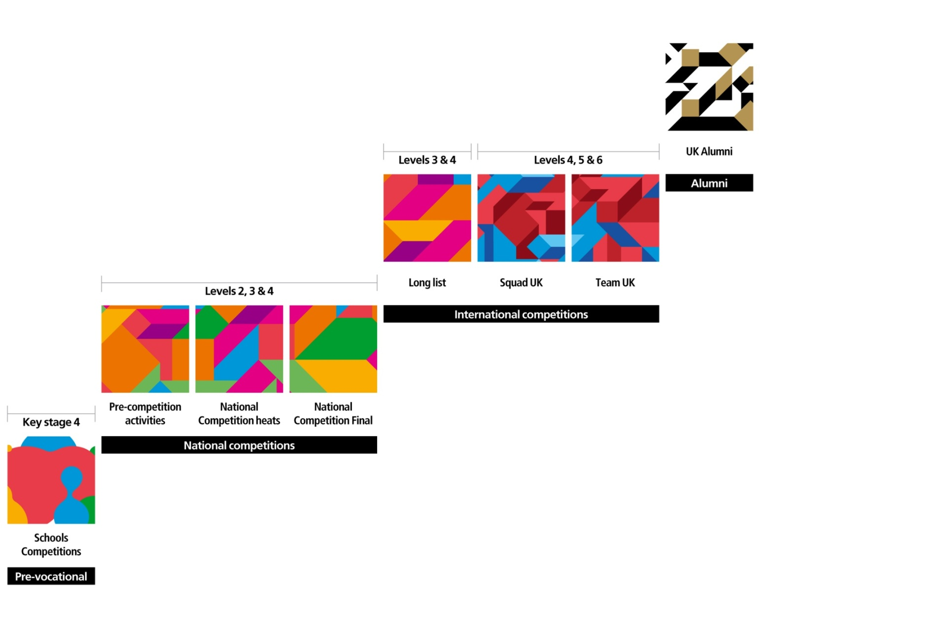

The four main elements
of WorldSkills UK…
15 - 17 November 2012

Slide 5

The story of our Alumni…

Slide 6

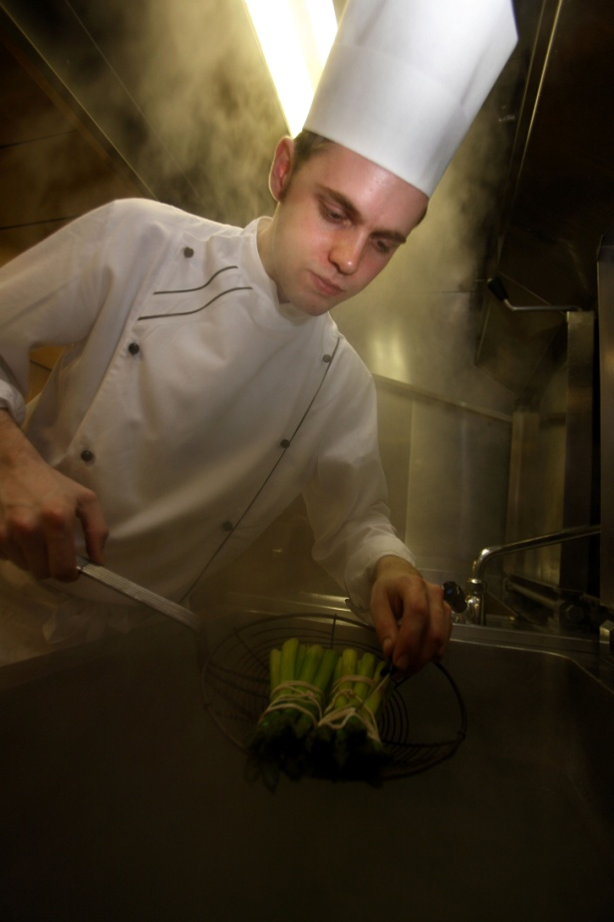
Alumni History…
1953 - 2007
Past competitors had no means of staying engaged
WorldSkills, UK Alumni launched in 2007
Although past competitors now had a way of staying engaged with us the Alumni never really got off the ground.
Re-energised in 2009
A strategy to re-energise the network was developed
and implemented. We appointed a dedicated Alumni
Co-ordinator and secured much needed sponsorship
from The Edge Foundation.

Slide 7
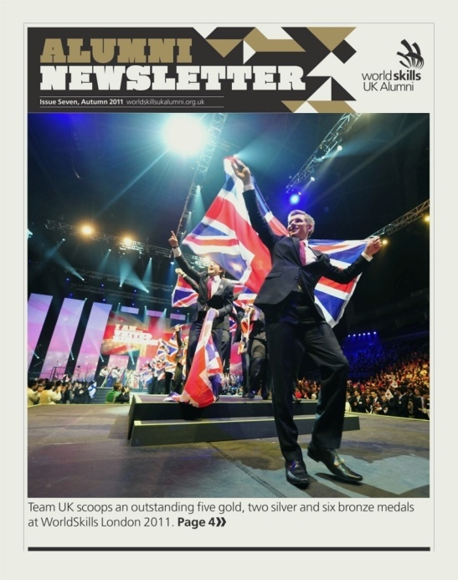
London 2011
Administration of WorldSkills UK Alumni is
vastly improved
Improved database administration
Appointment of a skilled Alumni Co-ordinator
Improved communications with alumni members
313 members actively engaged
Improved Programme
Competition performance and support
Competitor mentor scheme
WorldSkills London 2011 involvement
Engagement with education and industry
Improved Offer
Regular communications
Online community, Events and Awards

Slide 8
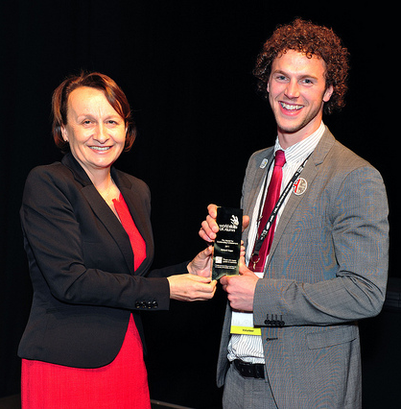
  Alumni highlights at WorldSkills London…
  Alumni presence at 36 events reaching over 100,000 people
  375 days contributed to the development of Team UK 2011
  Alumni stories helped secure high profile coverage on national TV (BBC), radio
  and print reaching 15 million and
  worth £350K.
  Volunteered £100K worth of time at WorldSkills London 2011

Slide 9
Original Alumni Plan for 2012
(developed before WorldSkills London 2011)
Alumni recruitment campaign to increase engagement using
WSL2011 event
WorldSkills, UK Alumni ‘Thank You’ campaign for highly
engaged members
A suite of regular communications using social media, websites
and quarterly print based and online newsletters
2012 Alumni Awards
2012 Alumni Event
Continue to increase the collection of case studies and update periodically
Ongoing support for competition performance and preparation

Slide 10
Good… But not good enough…

Slide 11
  The process…
  With support from NAS the Alumni Activists have:
  Reviewed their experience of involvement to-date including WorldSkills London – including SWOT
  Sought and listened to views from across the whole
  Alumni community
  Developed a new Ambition and Mandate for the Alumni
  Created a new Alumni Development Plan
  Mapped Alumni activities onto the competition cycle
  Secured support – from NAS and sponsors who provide bursaries

Slide 12
Skilled, passionate, ambitious and motivated Diverse network with great geographic spread
In tune with current developments in the trade
First hand knowledge of competitions
Strong network of people with a common aim
Wealth of knowledge, experience & talent Inspirational stories
Great role models
Infrequent meetings & activities
Disorganised & passive
Intermittent communications
Employer engagement / ability to attend
Ownership of roles
Lack of clarity and narrow offer
Limited membership
Capturing the Alumni activity
S
W
W
Clearly defined roles, opportunities and options
Opportunity to be mentors, coaches and trainers
From ‘Youth’ to being a serious voice
Less ‘Parental’ run and self-owned
Programme of events - yearly plan
International collaboration and exchange Empowered and enabled
Harnessing the power of NAS
Employer networks
Lack of self management
Negative attitudes of other stakeholders
Firm time commitment
Perception as being the ‘Youth’
Lack of obvious benefit (Alumni impact)
Lack of clarity – objectives
Geographic spread - long distance
T
O
T

Slide 13
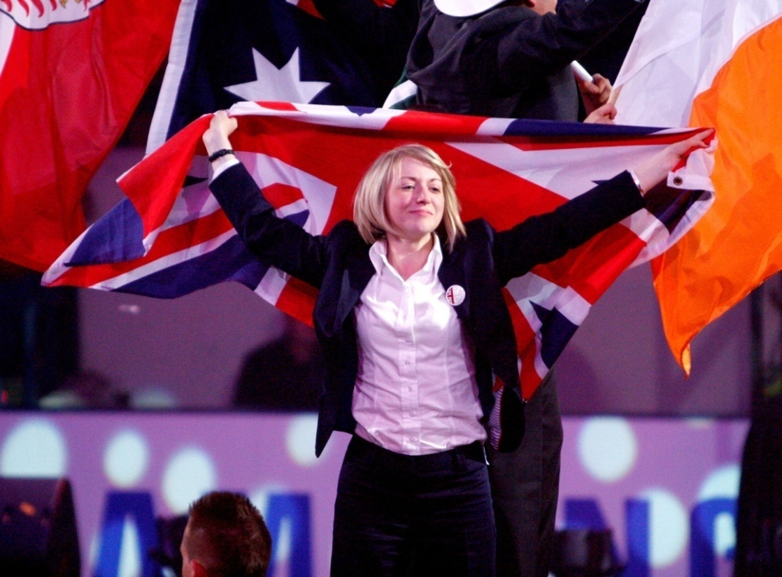
  A new ambition and mandate…
  Member led and managed
  WorldSkills UK Alumni Advisory Board
  Refined framework for Alumni engagement
  Developing Excellence
  Promoting Excellence
  More opportunities
  Clear and transparent
  Professional development, training and qualifications
  Annual programme of activities
  More involvement
  Totally embedded in to the competition journey and the competitor experience
  Tangible opportunities to influence NAS and actively engage in the wider Apprenticeship programme
= More Impact = More Recognition

Slide 14
Alumni Plan 2012 - 2013
11. Employer engagement
12. School, college & training provider engagement
13. Actively support The Skills Show
14. Develop and share international best practice
15. Competition engagement
7.Present all opportunities
‘welcome pack’
8. Training–
including ‘training expert’ qualification
9. Develop regional Alumni teams
10. Media and PR Plan - more use of social media
4. Board
Invite applications and ballot
5. Set Targets and Key Performance Indicators
6. Build work plan
- annual programme
2. Communicate the changes to all Alumni
3. Establish robust database of interests & skills
1. Board Structure, roles and responsibilities

Slide 15



Alumni activities mapped against the UK competition cycle
School competitions
National competitions
International competitions
Speaking in schools
Careers advice
Have a Go
Mini-Competitions
Mentors and performance coaches
Competition design & delivery
Competition judges
Employer engagement
The Skills Show
Workshop supervisors
Mentors & performance coaches
Training Experts
Workshop supervisors
VIP Employers
Influence WS Europe & WSI
AMBASSADORS, MEDIA & PUBLIC RELATIONS

Slide 16
The Alumni are busy drafting the next chapter… NAS is there to support and coach… their immediate plans are to:
    Increase the number of active Alumni – from all years and all skills – and from Squad as
    well as Team
    Elect the board – finalise the plan and co-ordinate Alumni activity – a clear plan with objectives, milestones, targets and key success measures
        Introduce structured training and development – enabling Alumni to be actively engaged
        and represented in every aspect of skills competitions in the UK – mentors, performance coaches, training experts
        Ensure they are fully integrated into the Government’s wider plans for raising standards and the reputation of Apprenticeships and the skills system
        Increase employer awareness and understanding
        Be able to demonstrate real progress by the time of the UK’s first “Skills Show” in
        November 2012
Owned and managed by the Alumni themselves

Slide 17
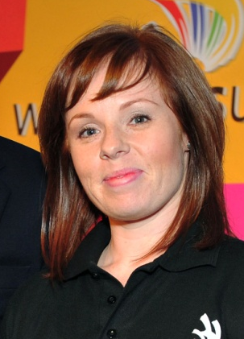
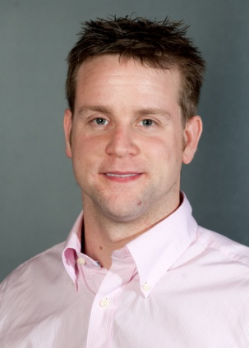
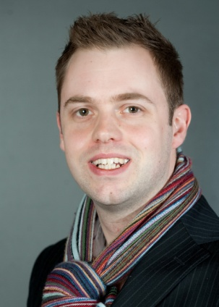
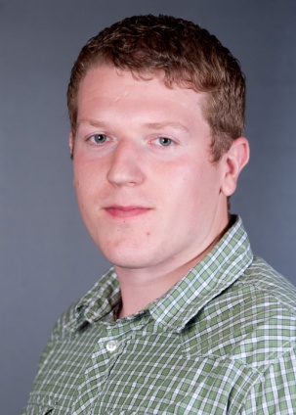
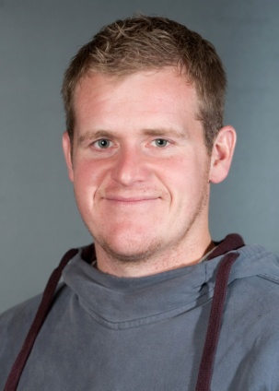
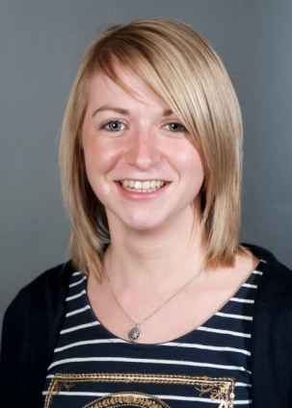
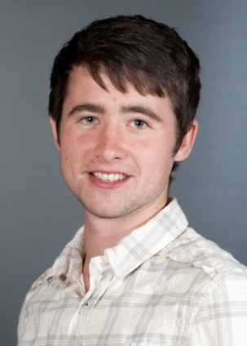
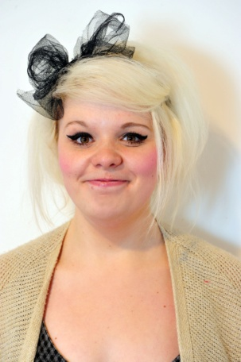
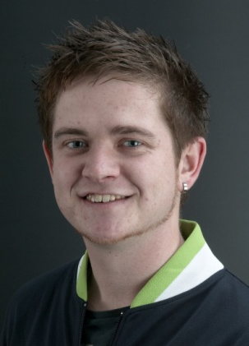
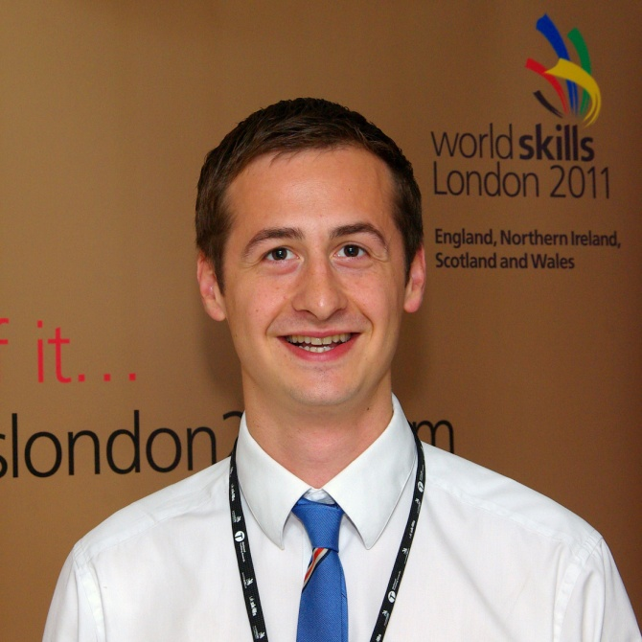
WorldSkills UK Alumni Activists
Jenna Bailey
Richard Talman
Adam Peirson
Alex Bellini
Keith Chapman
Katie Kyrousis
Luke Griffiths
Kirsty Hoadley
Jonathan Cleave
Harry Smith
Co-ordinator

Slide 18
Return on Investment for NAS and WorldSkills UK
Increased involvement in skills competitions at all levels (schools, colleges and employers of all sizes)
Higher quality standards in national and international skills competitions and an increased pool of training experts, mentors and coaches
Improved recognition and celebration of competitor success – including those who are Apprenticeships
A positive and measurable impact on the quality of Apprenticeships and on the wider skills system
A strong legacy of improved awareness and recognition of Further Education, skills and Apprenticeships across the UK
Solid performance by Team UK at WorldSkills Leipzig 2013
= increased skills = increased GDP

Slide 19
Contact us for more information
Harry Smith
WorldSkills UK Alumni Coordinator
National Apprenticeship Service
harry.smith@apprenticeships.gov.uk
Jaine Bolton
UK’s Official Delegate to WorldSkills and WorldSkills Europe
National Apprenticeship Service
Jaine.bolton@apprenticeships.gov.uk

Slide 20
“Since meeting up with the WorldSkills, UK Alumni, I have realised there is much more to experience after the Competition has finished. But the next step is to start getting more people involved and start branching out to old team mates so that WorldSkills doesn't just have to be a 2 week event it can last a life time. I feel that the Alumni is going forward in the right direction.”
Alex Bellini, Cabinet Making, Team UK 2005
“For me the WorldSkills, UK Alumni offers real tangible benefits to its members as well as being a great way to stay informed about the work of skills competitions and the progress of future teams. It would be great to see more of my former team mates involved so that they can make the most of the ongoing benefits and opportunities that I receive as an active member”
Jenna Bailey, Beauty Therapy, Team UK 1999

Slide 21
“My WorldSkills experience was so amazing that I was determined after it was over to stay involved in any way I could. Being part of the WorldSkills, UK Alumni has allowed me to do this - not only have I been able to stay in touch with my past team mates and meet other past competitors but it has also given me the opportunity to inspire and train the next generation of competitors. When I was training, being put into contact with Gary Tuddenham, cabinet maker from 2007, was invaluable and
I hope that sharing my experience with others inspires them to go on to
achieve great things.”
Luke Griffiths, Cabinet Making, Team UK 2009
“Being part of the WorldSkills, UK Alumni has many benefits like keeping you connected with old team mates and providing chances to meet competitors from other competitions with different experiences. Staying involved means you can pass on the positive experiences you had to new competitors and presents a wide range of possibilities for the future.”
Katie Watson, Restaurant Service, Team UK

