Slide 1


SENAI: Increasing the competitiveness of the Brazilian Industry
RAFAEL LUCCHESI
Director General of SENAI
Director of Education and Technology of the Brazilian National Confederation of Industry (CNI)
Notes:
1

Slide 2
Brazil in the Global Competitiveness
2009
Economy based on factors of production
Economy based on efficiency
Economy based on capacity for innovation
Transition
Transition
0
2.000
3.000
9.000
17.000
GDP Per capita (US$/year)
38 Countries
25 Countries
29 Countries
15 Countries
32 Countries
India
Angola
Brazil
Chile
Australia
USA
Bolivia
Paraguay
Mexico, Russian Federation
Taiwan
Canada
France
Nigeria
Venezuela
Poland
Germany
United Kingdom
China South Africa
Source : 2010 World Economic Forum - The Global Competitiveness Report 2010 – 2011
Notes:
Brazil is at the stage of economy based on efficiency and is about to enter the transition stage - however, still lags behind their peers in most of the pillars of competitiveness.

Slide 3
Brazil in the Global Competitiveness (BRICS)
Source : 2010 World Economic Forum - The Global Competitiveness Report 2010 – 2011
Notes:
Brazil is at the stage of economy based on efficiency and is about to enter the transition stage - however, still lags behind their peers in most of the pillars of competitiveness.

Slide 4
Brazil in the Global Competitiveness
Source : 2010 World Economic Forum - The Global Competitiveness Report 2010 – 2011
Notes:
Brazil is at the stage of economy based on efficiency and is about to enter the transition stage - however, still lags behind their peers in most of the pillars of competitiveness.

Slide 5
Global Context for Training Index
Canada
USA
Germany
Japan
Russian Federation
Brazil
China
South Africa
India
8º
9º
19º
20º
50º
58º
60º
75º
85º
Source : 2010 World Economic Forum - The Global Competitiveness Report 2010 – 2011

Slide 6
Technical and Vocational Training in the World
Enrollment in technical and vocational training per capita
Enrollment/ 100.000 per capita
4.873
2.256
Australia
Chile
Germany
France
Mexico
Turkey
China
Russian Federation
United Kingdom
Korea
Japan
Brazil
South Africa
India
Source: Unesco Statistics.

Slide 7
Global Context for Innovation
Index Innovation
USA
Japan
Germany
Canada
China
India
Brazil
South Africa
Russian Federation
1º
4º
8º
11º
26º
39º
42º
44º
57º
Source : 2010 World Economic Forum - The Global Competitiveness Report 2010 – 2011

Slide 8

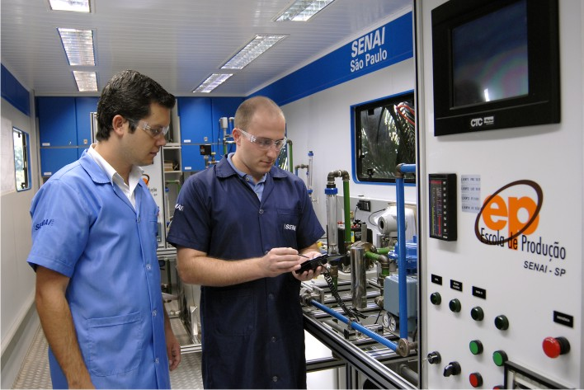
SENAI’s Mission
"To promote vocational and technological education, the innovation and transfer of industrial technologies, contributing to increase the competitiveness of Brazilian industry."
Notes:
8

Slide 9
Creation
Founded in January 1942 to support Brazil’s industrial development based on import substitution and supply the need for qualified labor
Part of Brazil’s Industry Confederation

Slide 10
Facts & Figures
797 operational units
200 laboratories
Over 20.000 employees
28 areas of expertise
Over 2,3 million enrollment per year in technical and vocational education and training
Over 120.000 technological consultancy services supported annually
48 international partners in over 29 countries
A WorldSkills International member since 1981
Notes:
10

Slide 11
Areas of Expertise
Metal mechanics
Graphics Arts
Metrology
Mining
Nonmetallic Minerals
Oil and Gas
Polymers
Chemistry
Refrigeration and Air Conditioning
Work Safety
Information Technology
Telecommunication
Textile and Clothing
Environment
Food and Beverage
Automation
Automotive
Pulp and paper
Construction
Leather and Footwear
Electro-Electronics
Energy
Gems and Jewelry
Management
Woodworking and Furniture
Notes:
11

Slide 12
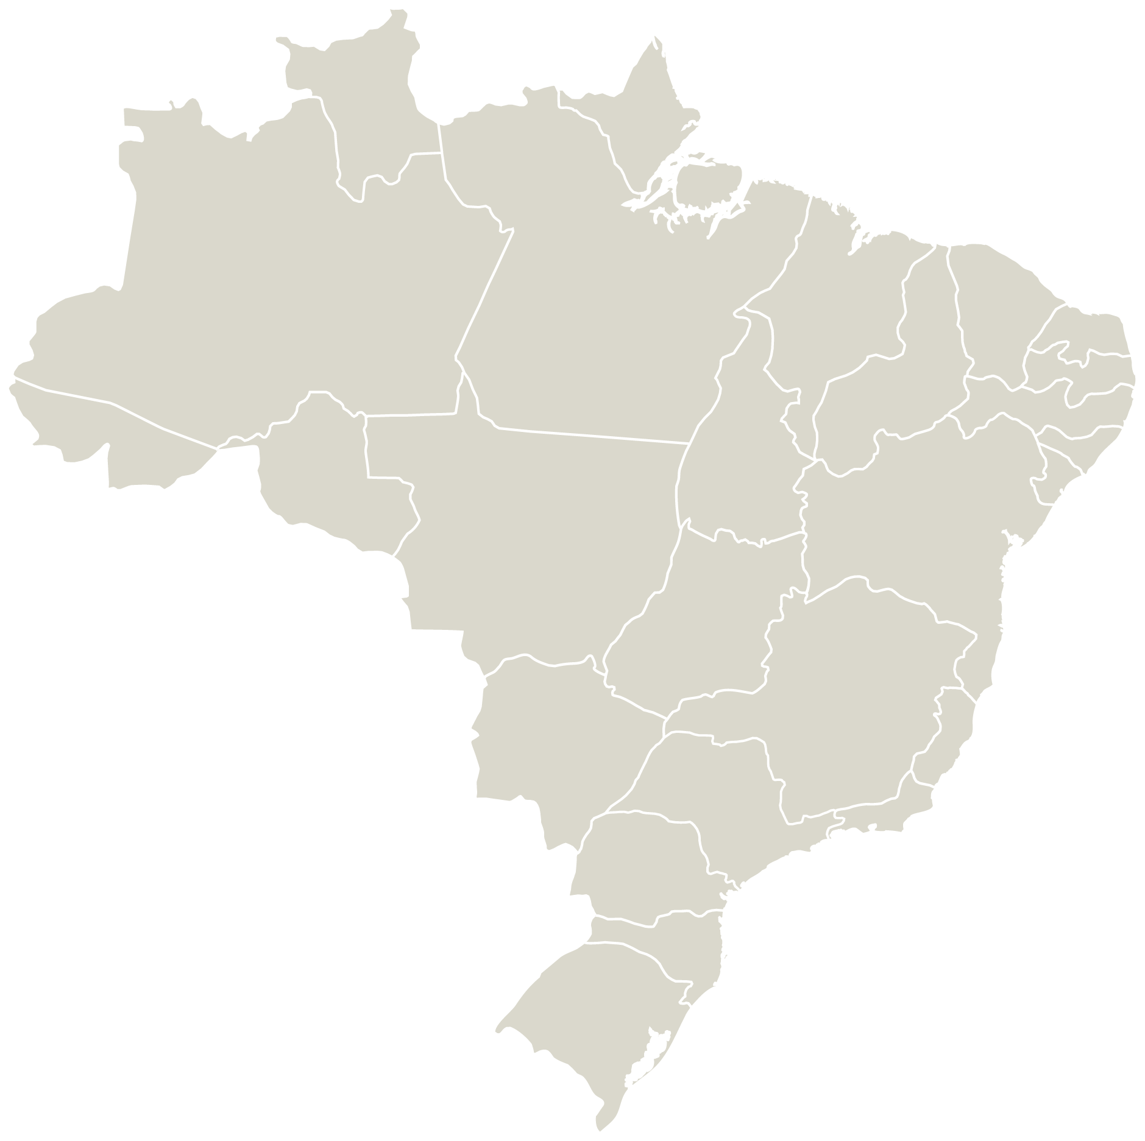
Distribution of Enrollments
Regional Department | Total
Acre | 6.470
Alagoas | 16.186
Amapá | 9.529
Amazonas | 37.632
Bahia | 78.836
Ceará | 41.177
CETIQT | 7.124
Distrito Federal | 31.991
Espírito Santo | 80.481
Goiás | 113.516
Maranhão | 26.896
Mato Grosso | 60.283
Mato Grosso do Sul | 19.903
Minas Gerais | 148.930
Pará | 39.766
Paraíba | 36.543
Paraná | 214.344
Pernambuco | 48.680
Piauí | 9.868
Rio de Janeiro | 139.421
Rio Grande do Norte | 32.489
Rio Grande do Sul | 134.822
Rondônia | 20.022
Roraima | 6.528
Santa Catarina | 99.105
São Paulo | 867.013
Sergipe | 22.581
Tocantins | 12.176
SENAI
Total of Enrollment
2.362.312
Source: SENAI - National Department

Slide 13
SENAI’s Program for Industrial Competitiveness
Notes:
13

Slide 14
Contributions from institutions such as SENAI for Competitiveness
Training
High School
Technical and vocational education
Higher education
Training in companies
Technological Readiness
Speed of latest technologies adoption
Availability of latest technologies
Firm-level technology absorption
Innovation
Spending in R&D
    Quality of scientific research institutions
Institutional research collaboration
Intellectual property protection
Training
Competitiveness
Technological Readiness
Innovation
Source : 2010 World Economic Forum - The Global Competitiveness Report 2010 – 2011
Notes:
Institutions such as SENAI can act directly on three pillars of competitiveness - Brazil lags behind developed countries in all dimensions.
Fazer somente framework no docto vertical

Slide 15
Adherence of SENAI's mission to the Pillars of Knowledge Economy
Training
Competitiveness
Technological Readiness
Innovation
"To promote vocational and technological education, the innovation and transfer of industrial technologies, contributing to increase the competitiveness of Brazilian industry."

Slide 16
SENAI’s Program for Industrial Competitiveness
Doubling the supply of enrollments for Professional Education until 2014
To create Network of Technological Centers High Performance for promotion and practice of innovation
Vocational and Technological Education
Increasing the supply of sustainable technical and technological services to the expansion of the Reference Centers
SENAI's Modernization Programme for Industrial Competitiveness
Technical and Technological Services
Innovation

Slide 17
Model of Technology Center for High Performance
Centers focused on innovation and applied research aimed at solving technological bottlenecks to increase the competitive standing of the industry.
Focused on specific areas of knowledge with additional network performance, internally and externally, nationally and internationally.
Advanced training of personnel, including through programs of postgraduate studies (stricto sensu).
They act as the national hub of expertise within the framework of the SENAI

Slide 18
Expected Result
Isolated work
Networking
1942
2010
2024

Slide 19
Thank you!
SENAI. A Partner to Industry. A Partner to Development.
Rafael Lucchesi
Director General of SENAI
Director of Education and Technology of the Brazilian National Confederation of Industry (CNI)
SBN Quadra 1, Bloco C, Ed. Roberto Simonsen, 5º andar
70040-903 Brasília/DF - Brazil
Tel.: +55 61 3317-9041
Fax: +55 61 3317-9400
lucchesi@cni.org.br
www.senai.br

