Slide 3
Amanda Brady
HR Director
Creating a Learning Culture
Notes:
Whitbread was established in 1742 by Samuel Whitbread and has experienced significant transformations over the years.
I am here today to share our more recent journey with you on how we are creating a learning culture. In strategic partnership with operations, the Whitbread HR team has transformed resourcing, learning, development and progression to unlock the talent, energy and ambition in our future facing teams.
Whitbread was established in 1742 by Samuel Whitbread and has experienced significant transformations over the years.
I am here today to share our more recent journey with you on how we are creating a learning culture. In strategic partnership with operations, the Whitbread HR team has transformed resourcing, learning, development and progression to unlock the talent, energy and ambition in our future facing teams.

Slide 4
Our Business
35,000 team members – 65% of our team work part time – welcoming over 10 million customers into our business every month
Premier Inn has over 43,000 bedrooms in more than 600 locations, on average 322,000 guests stay with us every week
211 million cups of coffee sold a year in over 1,800 Costa Stores worldwide
840,000 meals per week sold in our restaurants
Notes:
So, who is Whitbread...... We are the UK’s largest hotel and restaurant group operating in the market-leading budget sector. Over 35,000 people work in our brands, Premier Inn, Beefeater, Table Table, Brewers Fayre, Taybarns and Costa. This is an overview of what we do now ...........but what are our future plans??........

Slide 5
Creating a legendary place to work for our employees
Living the Whitbread Values – Walk the talk
Championing our team members’ voice – Listen hard and act on what you hear
Leaders who focus on people – Treat people as you would want to be treated yourself
Tell the story: what we are doing and why we are doing it: to connect people
Notes:
Our business has over the past two years made further connections of how our leadership behaviours are critical to driving team engagement and creating a legendry place to work for our employees.
We know that engaging our people has a direct correlation with delivering the best customer experience and putting smiles on our customers faces
The way employers treat employees has a direct effect on how employees treat customers. Customers, vote with their feet depending on the quality of the interaction they experience with any given business.
Quality customer and employee interactions are, over the long run, the lifeblood of any business.
These quality interactions ensure brand loyalty, advocacy and can give an organisation a competitive edge, which if rooted in their ‘culture’ can be hard if not impossible to replicate”.
‘Engagement predicts earnings per share’. Seventy per cent of engaged employees indicate they have a good understanding of how to meet customer needs; only 17 per cent of non-engaged employees say the

Slide 6
The Leadership Framework
Our aim is to build the best large-scale hospitality brands in the world by becoming the most customer focused organisation there is. Anywhere.
Create Whitbread’s Future Set ambitious goals Create space to think, plan & learn Shape & outpace the market | Make bold decisions Act on sound analysis Focus ruthlessly on what is vital Take risks, and learn from setbacks
Deliver Great Results Turn strategy into action Embrace accountability Fight to win | Inspire confidence & belief Paint a compelling picture of the future Recognise & celebrate success Connect with people
Act with Authenticity Be yourself with more skill Believe in your value Consistent in words and deeds | Build exceptional teams Select, support & stretch great people Create conditions for all to flourish Raise the bar with ‘tough love’
Notes:
Whitbread has an audacious goal to build the best large scale hospitality brands in the world by becoming the most customer focussed organisation there is. Anywhere. We’ll do this by providing outstanding value and making everyday experiences feel special – so that our customers come back time and time again. This goal will drive Whitbread forward and we recognise that our people are truly central to our success, the HR team and senior leaders have been sharing this meaningful and powerful vision across the whole business. As a result we developed and define the leadership behaviours and skills that we would need to become the most customer focused organisation. Any where.
It is a stretching model and describes the ‘how ‘for leading Whitbread today and into the future.
It gives us a clear focus on areas of individual and collective development and also allows us to understanding where we have strengths and who we should learn and share from.
We have all been our own leadership journey since a leadership development workshop acknowledging we needed to look at the Directors and senior leaders, so we know it is our behaviours that will make the biggest difference to change the culture. You will note from this slide that Inspire & Conf and Belief, Act aucthenticity and build exceptional teams demonstrated that without investing, stretching, growing and coaching in our people we will never deliver our ambition

Slide 7
The Leadership Framework
Our aim is to build the best large-scale hospitality brands in the world by becoming the most customer focused organisation there is. Anywhere.
Create Whitbread’s Future Set ambitious goals Create space to think, plan & learn Shape & outpace the market | Make bold decisions Act on sound analysis Focus ruthlessly on what is vital Take risks, and learn from setbacks
Deliver Great Results Turn strategy into action Embrace accountability Fight to win | Inspire confidence & belief Paint a compelling picture of the future Recognise & celebrate success Connect with people
Act with Authenticity Be yourself with more skill Believe in your value Consistent in words and deeds | Build exceptional teams Select, support & stretch great people Create conditions for all to flourish Raise the bar with ‘tough love’
Notes:
Let me pull out of here painting a compelling picture of the future?
We, knew we were not leveraging the strength of learning and development across the organisation, we were reactive and not strategic. Brand aligned HR teams disconnected from the business. Aggressive growth agenda with no manpower plan 3 years out, external recruitment – fire fighting . Plus over spending and no measure on our ROI. No direct link to the business plan and what organisation design, skills gaps and succession planning.
We knew the leadership were now thinking and we knew engagement would unlock potential. We needed to paint this picture to our teams by unlocking learning and development, this would gives us the competitive advantage and signal our investment in our people
So how do we create this learning culture and align the HR team aligned to the business strategic direction? By creating a vison of creating a legendry place to work for our people.
We needed a systematic approach to recruitment, induction, core skills training, management and leadership development
Future facing internal talent pipeline created by designing a clear progression pathway from team member upwards.
Clear about how we measured our success and return on investment.

Slide 8
The Leadership Framework
Our aim is to build the best large-scale hospitality brands in the world by becoming the most customer focused organisation there is. Anywhere.
Create Whitbread’s Future Set ambitious goals Create space to think, plan & learn Shape & outpace the market | Make bold decisions Act on sound analysis Focus ruthlessly on what is vital Take risks, and learn from setbacks
Deliver Great Results Turn strategy into action Embrace accountability Fight to win | Inspire confidence & belief Paint a compelling picture of the future Recognise & celebrate success Connect with people
Act with Authenticity Be yourself with more skill Believe in your value Consistent in words and deeds | Build exceptional teams Select, support & stretch great people Create conditions for all to flourish Raise the bar with ‘tough love’
Notes:
Build exceptional teams:
Let me take back to 2008 this was the beginning of the journey:
We needed to raise the bar so we restructured and set up regional HR managers, working cross brand, to raise the people agenda. This was our first signal in how we were going to raise the bar in this area.
We stopped recruiting by external agencies and established an internal resourcing team.
Established a central Whitbread Academy to support all training interventions
Launched an engaging induction process for the business and introduced consistent innovative core skills training tools to enable and support management taking accountability for training and developing their own teams.
Succession roles and a career pathway directly linked to our performance review process aligned with personal development

Slide 9
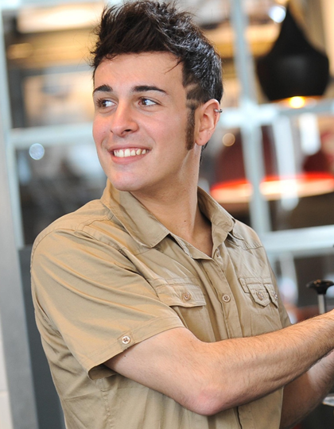
Creating a Learning Culture in Action

Slide 10
Insert
Pre 2007 VT

Slide 11
The Leadership Framework
Our aim is to build the best large-scale hospitality brands in the world by becoming the most customer focused organisation there is. Anywhere.
Create Whitbread’s Future Set ambitious goals Create space to think, plan & learn Shape & outpace the market | Make bold decisions Act on sound analysis Focus ruthlessly on what is vital Take risks, and learn from setbacks
Deliver Great Results Turn strategy into action Embrace accountability Fight to win | Inspire confidence & belief Paint a compelling picture of the future Recognise & celebrate success Connect with people
Act with Authenticity Be yourself with more skill Believe in your value Consistent in words and deeds | Build exceptional teams Select, support & stretch great people Create conditions for all to flourish Raise the bar with ‘tough love’
Notes:
Giving people the permission to bring all of themselves to work, reveal more about you linked to our values, Genuine, Confident and Commited
We needed to measure our bench strength in light of growth as well as driving a high performing culture, what skills would we require in the future introduce talent matrices and calibration for consistency
Believe in your own value by introducing a more interactive learning journey by way of level 2 Apprenticeships and they were embedded into
our own core skills training solutions which have in our business for a year
Developed Skills For Life literacy and numeracy programmes which are completed in the workplace
Earn while you learn attraction campaign externally to attract talent into the business
We set up technical and management leadership programmes, so we now have 6 programmes ( Bronze, Steel, Garaphite, Silver Gold and Platinum to demonstrate career progression so a TM can move through organisation since it’s launch 1,240 people have attende dthese courses and our internal succession has risen from 42% TO 81%
We have also achieved over 3,000 qualifications.

Slide 12
Creating a Learning Culture
2010
Notes:
Introduce Talent dashboard to track people our measures, we treat this dashboard as importantly as our Customer dashboard and financial results
Set up regional field based resourcing team, recruiting for attitude and enabling internal growth
Aligned field based Learning & Development specialist to complete the set of HR functions supporting each region
Revitalized our ‘Your Say’ team engagement survey collated twice a year
Introduced a L&D project manager role to co ordinate central and operational training requests
Clearly defined manpower plan, established and reported

Slide 13
Key Strategic Levers 2011
Created a single recognisable brand image for HR ‘Get on Your Whitbread Journey’
Introduced work based learning skills modules, flexible, cost efficient and accessible
Set up a pilot for work inspiration programmes
Ready to launch work inclusion ‘Get into Hospitality’
Level 3 & 4 Apprenticeships mapped into development programmes
Resourcing social media initiatives
Strategic plan aligned to growth agenda up to 2015
Notes:
Paint a compelling picture about the exciting plans and projects that are strengthening the HR proposition. These initiatives have taken a lot of time and energy to embed in the business but given the strong foundation and relentless motivation to succeed Whitbread has achieved its ambition to enable existing and new employees to develop and grow. The calibre of talent has been raised in line with the aim to create the best place to work in hospitality, now and in the future.

Slide 14
What have been our Challenges?
Partnering with the business to drive the people agenda
Reactive not proactive, tactical not strategic
Significant operational restructures
Changes to Apprenticeships
Managing within restrictive budget whilst increasing output
Economic climate – downturn

Slide 15
Insert
Now VT

Slide 16
Success
Strategic 5 year HR plan
80% internal promotion with over 1200 managers completing development programmes
Clearly defined and valued people measures
Cross brand movement enabled by regional calibration
Clear manpower/succession plan
Induction embedded at every level
3,000 qualifications achieved
Skills in the Workplace Award winner 2009-2011
Increased engagement scores by 12%
Notes:
In line with budget

Slide 17
Leading and supporting our customer facing teams
Customer Facing Teams
Leadership Forum
How are we:
Living the Whitbread Values?
Championing our team members’ voice?
Enabling a culture of opportunity and development?
Notes:
This slide links back to the CEO Andy Harrison Heartbeat slide which puts the customer at the heart of everything we do ......... as an HR team we are keeping our customer facing teams in mind with everything we do – and these key questions provide a great reality check in keep ourselves on track.
How are we:
Living the Whitbread values?
Championing our team members’ voice and are we truly enabling a culture of opportunity and development right across our business for our 35,000 team members ??
These are some of the questions we continue to ask ourselves ........... Let’s just summarise the key points and then I am sure you have some questions for me .......

Slide 18
In Summary
Today
No Apprenticeships
No credible management development
No formal learning
No external support for young people
3,000 qualifications
7 award winning programmes
Skills Academies platform
Work Inspiration and Inclusion
Today
Today
Today
Notes:
Over 3 past few years
Management training Director down
Developed an online with e learning or simulation at the academy's
You will see how we have connected and aligned everything that we do to encourage our leaders to grow, stretch, support, reward our people this all aligned to our future direction of our business, to deliver our vision and underpinned by our values

Slide 21
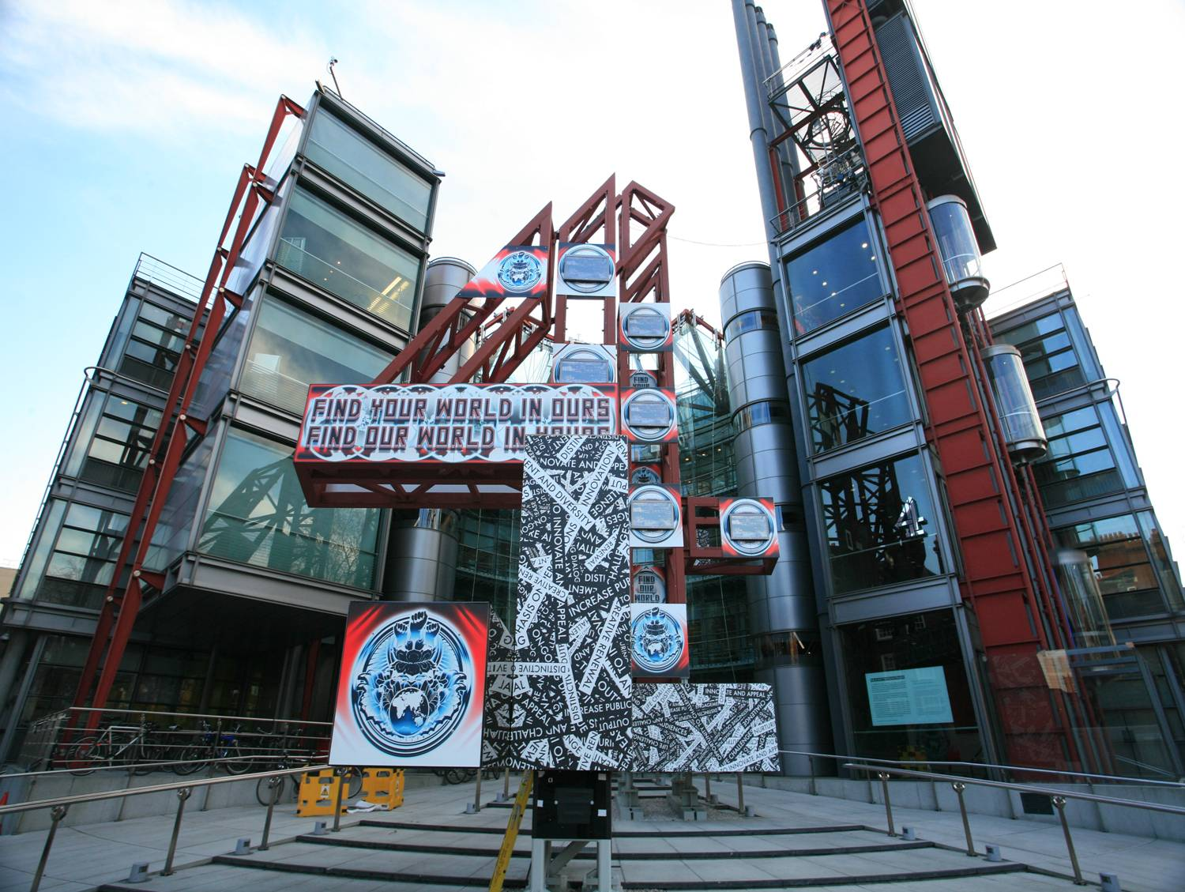
Inspiring Home-grown Talent
Channel 4 Television

Slide 22
What are we going to talk about?
4Talent – What’s it all about?
Why we do what we do
Kickstart
Outcome and stories
Lessons learnt

Slide 23
Why?
What you Know NOT Who you Know
Pathways demystified
Diversity
Talent
Innovation
Notes:
4Talent’s aims are to provide inspiration and aspiration to young people who want to work in the media; by creating opportunities for them to understand the skills, experiences and attitudes needed to work in our sector. The programme has a specific focus on young people from underrepresented and disadvantaged backgrounds.
Encourage Aspiration and Inspiration of the variety of roles available not only at Channel 4 but across the media industry. We believe by informing young people of the skills, experience and attitudes online through our website and on the ground through the programme we will create a lasting legacy by developing the next generation of talent.

Slide 24
Kick Start
On the Ground
Online
YAP
Internships
Apprentices
Inspiration on the Road
Work Experience
Twitter
Facebook
4Talent Website
Mentoring

Slide 25
Outcomes
Brand Creation
98% felt 4Talent was accessible to a diverse range of people
Average 20,000 hits on website per week
96% felt that they had an increased understanding of roles in the media
Over 1500 for 4Talent Open Day
43% secured further work experience
Over 7000 for Production Trainee Scheme
17% gained employment
Internship applications average 1,000 per role
Over 30% have remained at C4
Over 13,000 online followers
Notes:
the scale and significance of the impact of your programme or business practice both on society & business.

Slide 26
Real Life experiences
I spoke to a series producer while a show was in development - when it went into production she asked me to come and work on it - and there I stepped into a role of researcher rather than runner.
I now have a work experience placement at a production company after the advice I got at 4Talent.
As a result of the Inspiration Day North last February, I was inspired and informed enough to think about searching for work experience. I subsequently got work exp at the BBC, the Guardian, the Sunday Times, The Times and Sky News. This was all in the summer of 2010!
Notes:
the scale and significance of the impact of your programme or business practice both on society & business.

Slide 27
Lessons Learnt . . .
Simplicity of message
Regular Communication
Online presence
Adopting a variety of approaches
Regular evaluations

