Slide 2
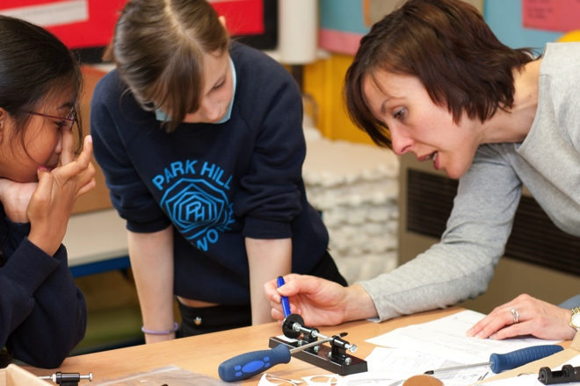
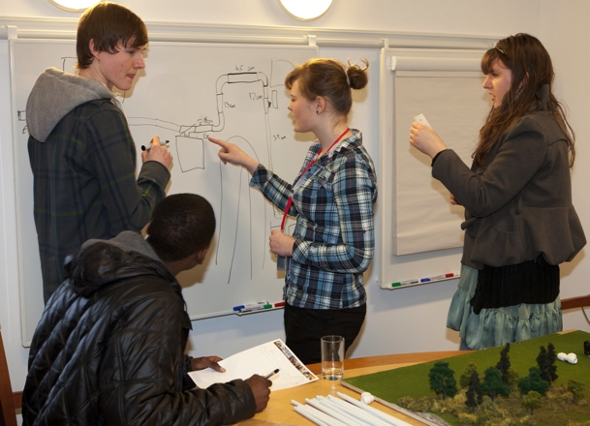
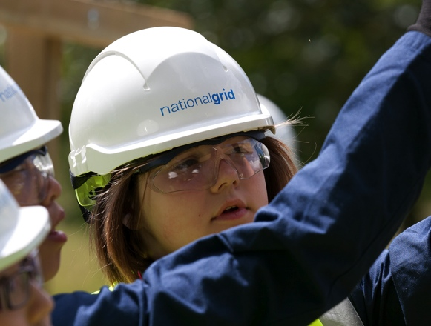
Inspiring Tomorrow’s Workforce
National Grid’s Experience in Schools
Richard Earp, Education & Skills Manager, National Grid
WorldSkills, 05 October 2011

Slide 3
Agenda
1 | Background – National Grid
2 | Why are we interested?
3 | What have we been doing?
4 | Lessons learned
5 | Comments and Questions

Slide 4


Who are we?
4

Slide 5




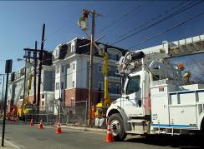
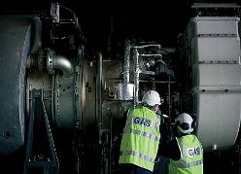
National Grid.
50:50
UK
US
Transmission
Distribution
Electricity
Gas
Notes:
5

Slide 6
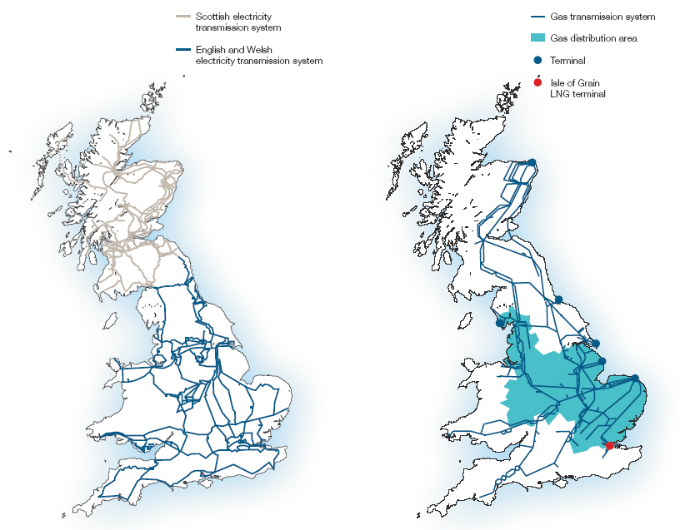


National Grid - UK

Slide 7





What’s Happening in Energy?
Decline of North Sea Gas
Asset Replacement
Sustainability and Climate Change

Slide 8
The future …
Wave & Tides?
Carbon Capture & Storage?
Smart Meters?
Biomass?
Electric Vehicles?
Hydrogen Networks?
Wind Farms?
Nuclear: fission or fusion?
Solar energy from the Sahara?

Slide 9

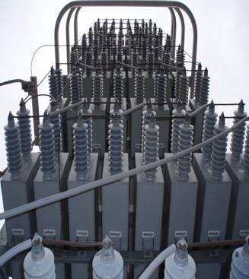
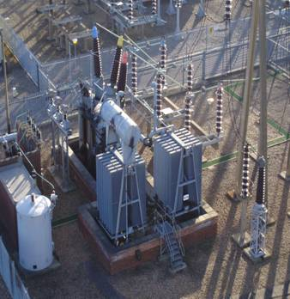
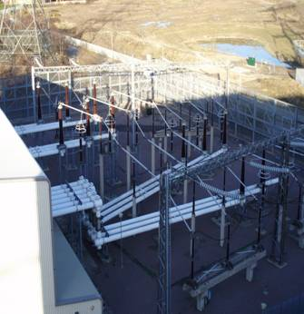

It’s a £200 billion Engineering Challenge . . .

Slide 10

. . . and it Matters

Slide 11

Engineering as a Profession
This research told us …
Young people cannot visualise what an engineer does
Teachers too often don’t know enough to recommend engineering as a career
Work experience is the intervention most likely to change perceptions & choices

Slide 12
Some Quotes …
Isn’t it like a higher end of builder?
(Young People,
STEM academic,
London)
“Why would I recommend engineering? All the factories are closing.”
(Teacher, W.Mids)
“A Silent Industry. You don’t know about it & it’s very hard to find out about it?
(Parent, London)
When you say
‘I’m an engineer’,
people think you fix photocopiers or lifts or something
(Engineers, Warwick)

Slide 13
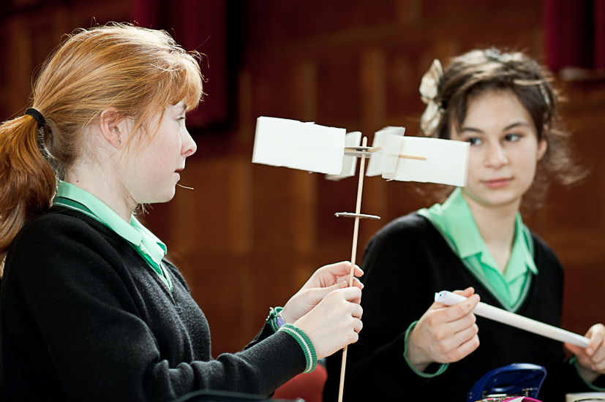
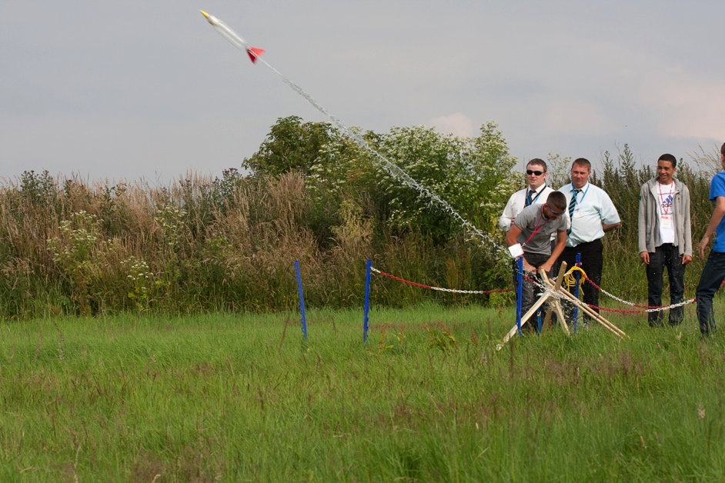
So, What did we do?

Slide 14










‘Just do it’ (Our portfolio of engagements, UK, 2010/11)
Teachers’ CPD
Open House
Ambassadors
Project Ladder
Work Experience Week
Interest &
‘enthuse’
4 - 11
Choose
STEM!
11 -13
Nurture
talent
14 - 19
Secure
talent
Develop
*
* Programmes actively being developed

Slide 15
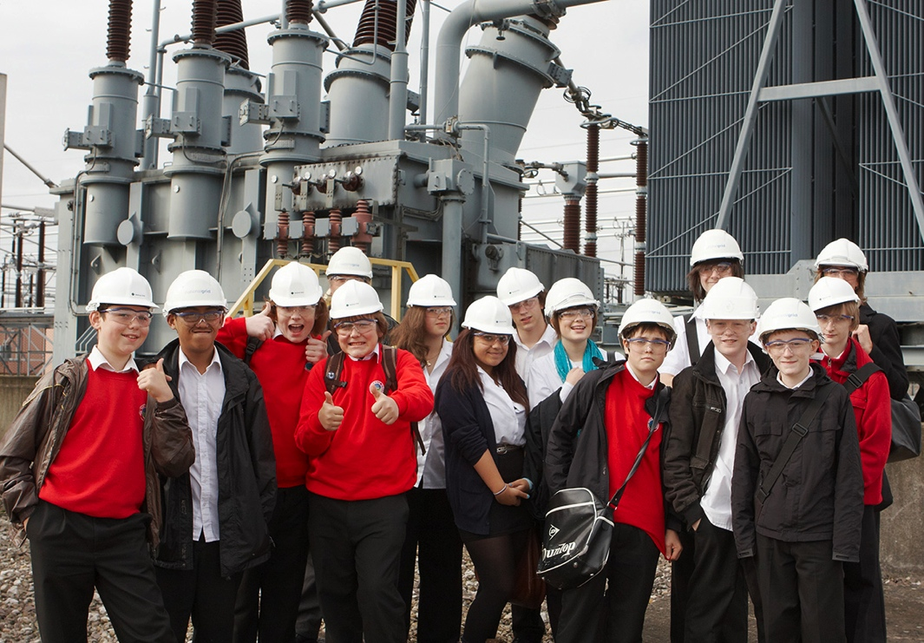
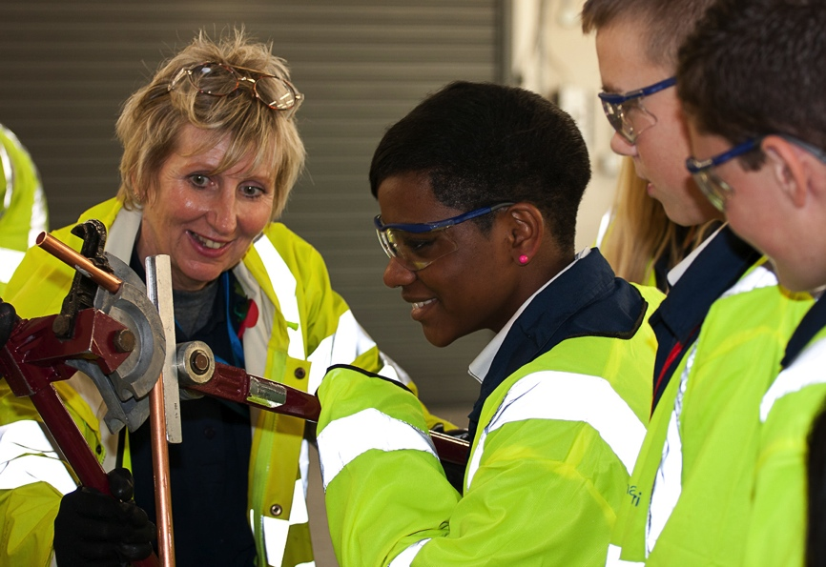
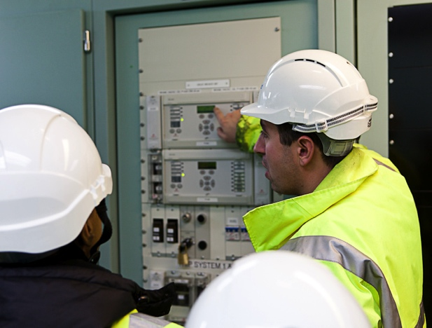
Open House - Visits to National Grid Sites.
22 Events last year, 400 students.
Content around four themes:
  Engineers & their jobs
  National Grid ‘kit’
  The future of energy
  Career pathways.

Slide 16
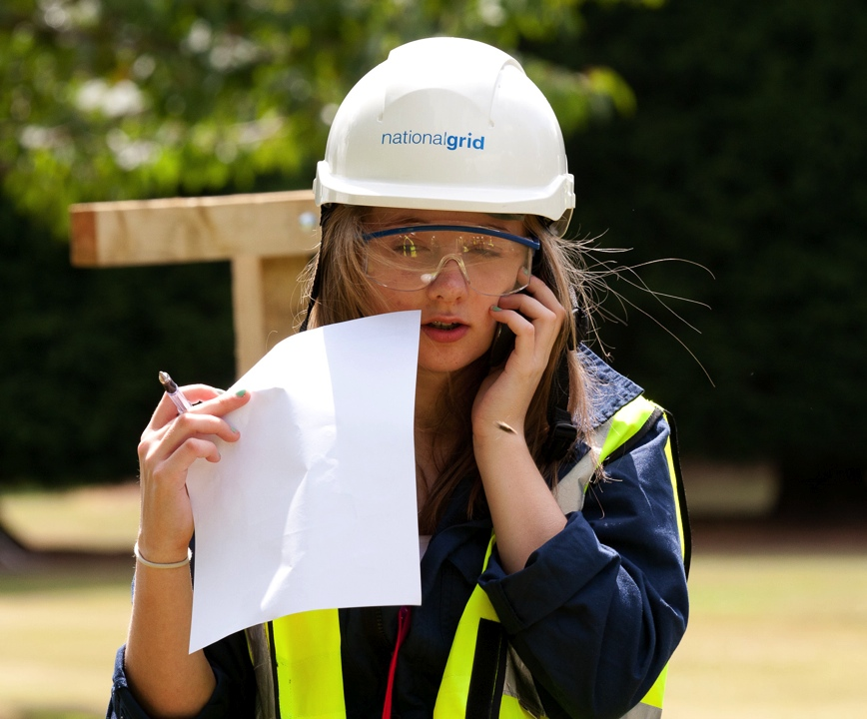

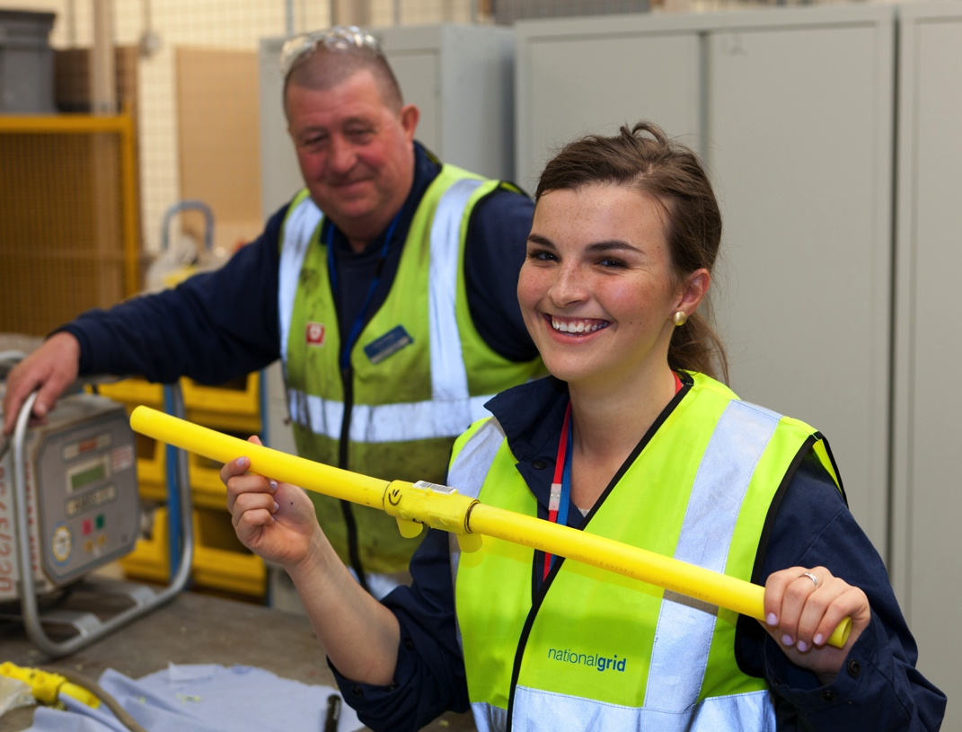
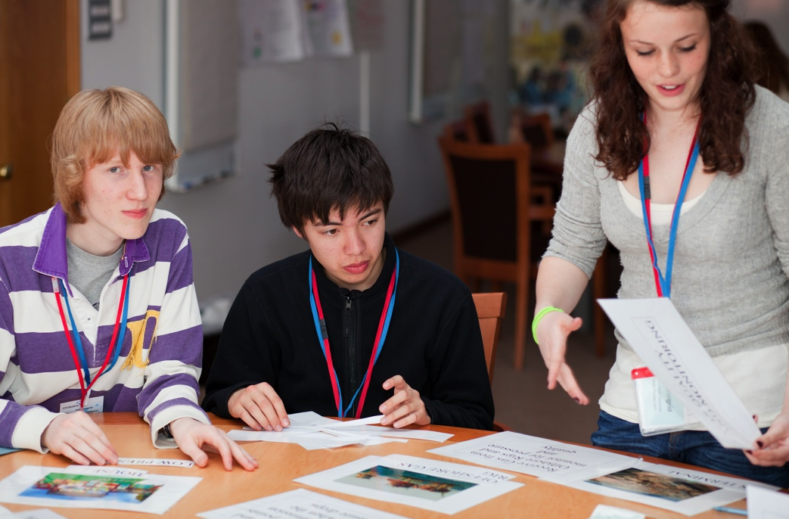
National Grid Work Experience Week
Residential courses designed to give a taster. 100 Students.

Slide 17
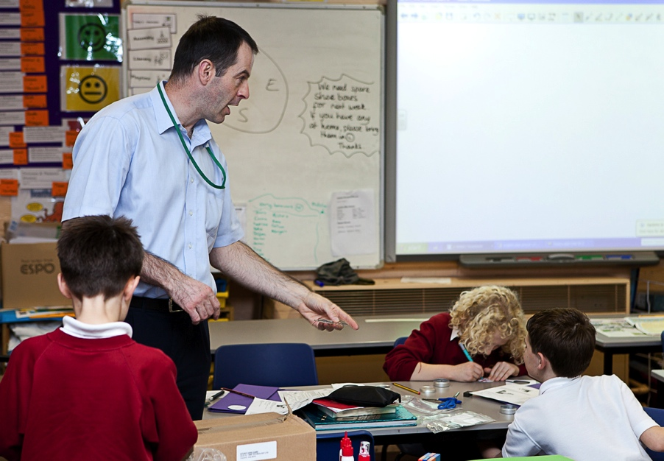
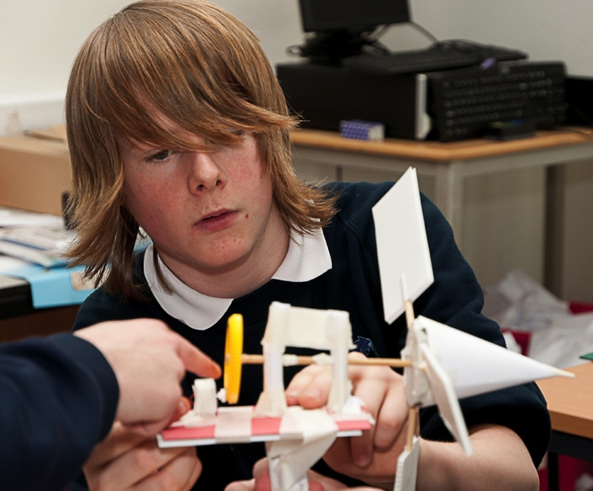
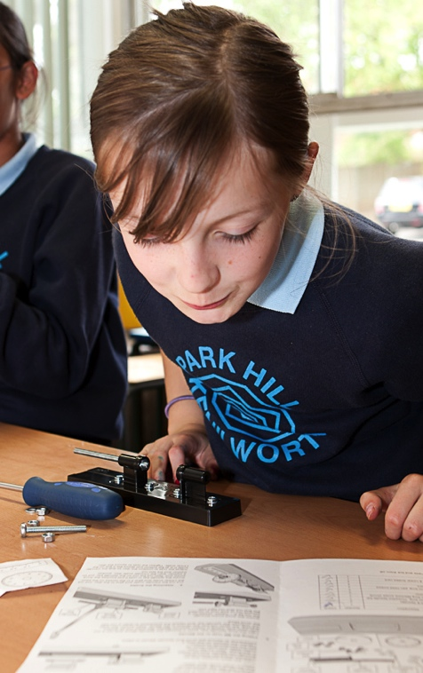
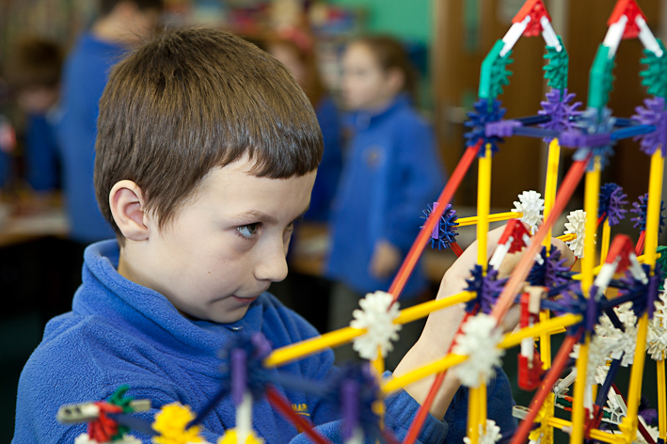
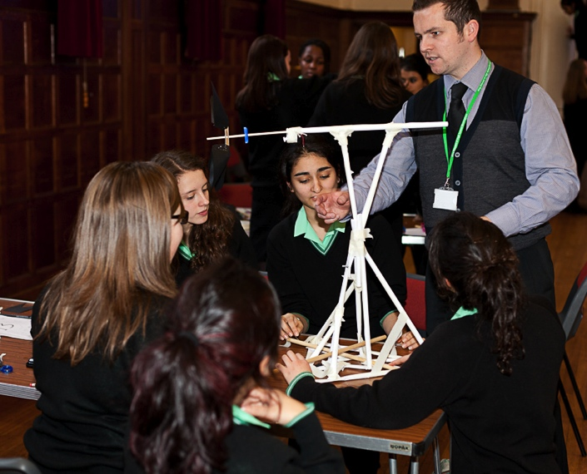
Ambassadors

Slide 18
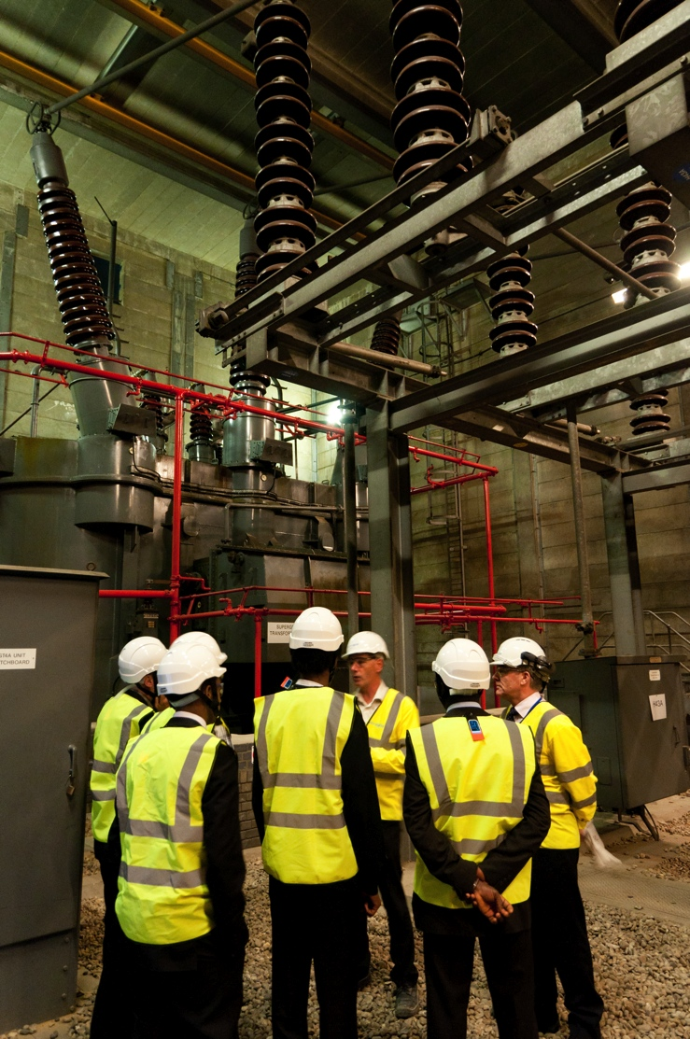
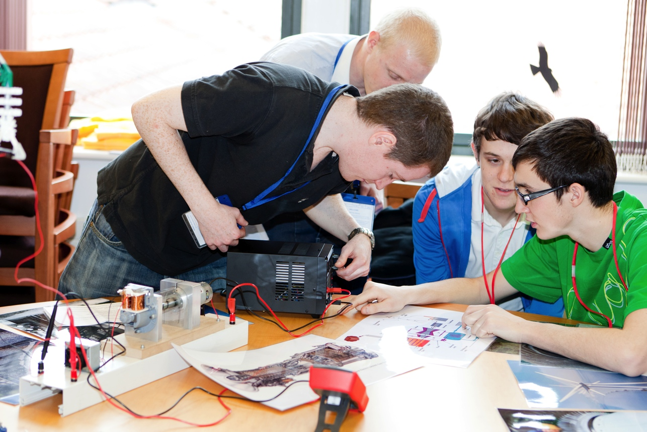
What’s Been Our Experience?

Slide 19
Lessons
What has gone well?
Scope for improvement?
Reached >3000 students last year
Feedback from students and teachers is good – we have opened eyes and minds
Great working relations with delivery partners
Internal staff engagement
Targeting the right students
Schools’ priorities are not always the same as ours. We took time to really understand
Engaging material & delivery

Slide 20
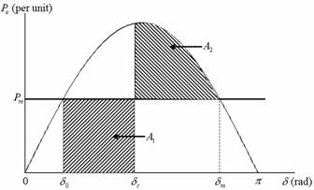
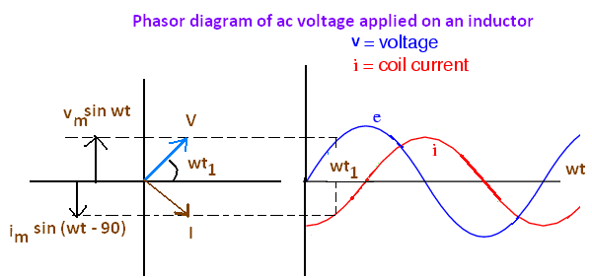
Educational Issues for us.
Students’ appreciation
of modern engineering

Slide 21
Educational Issues for us.
‘Vocational’ Qualifications
Students’ appreciation of modern engineering
D&T not joined up with Science?
Physics teaching – volume & quality
Narrow curricula = barriers to engagement

Slide 22
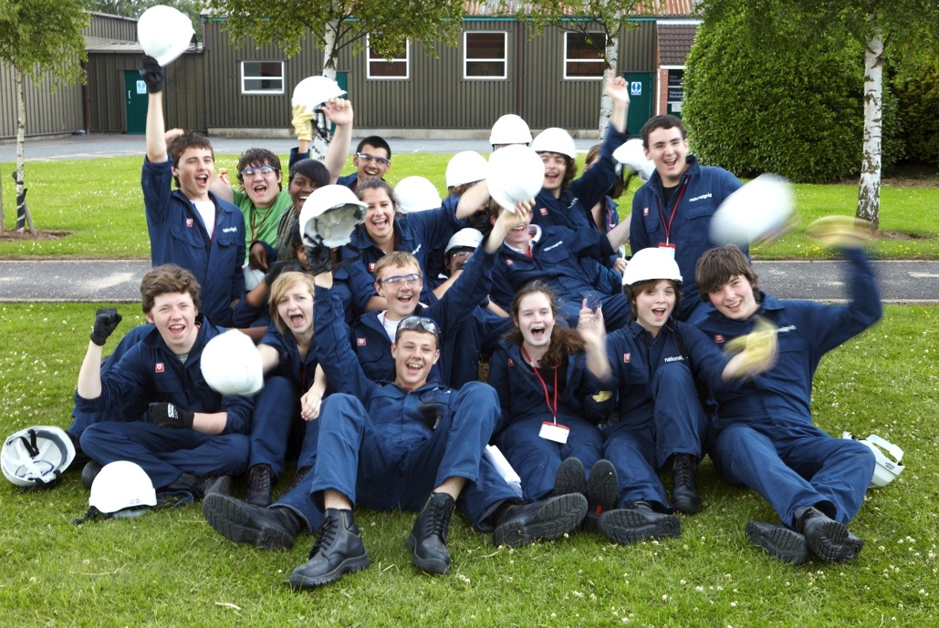
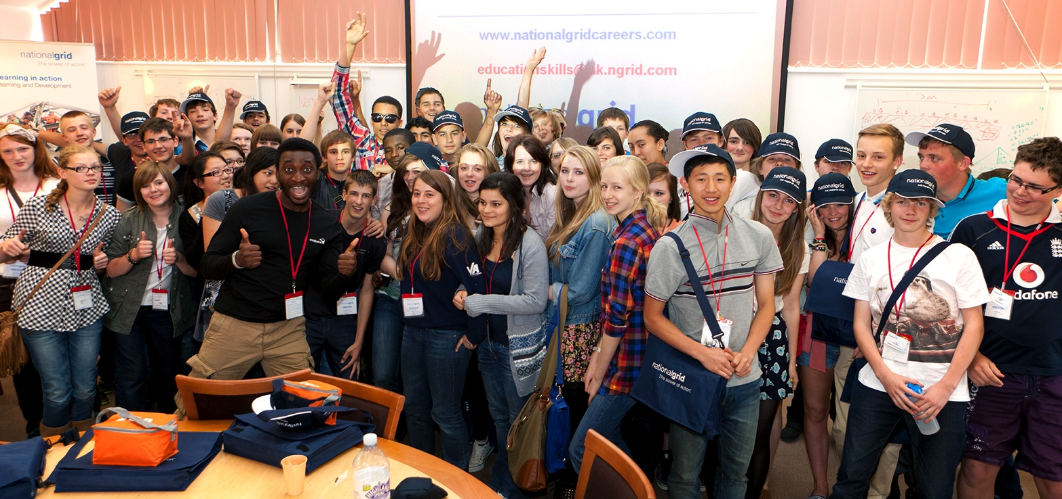
Our main advice . . .
Get involved!

Slide 23

Questions and Comments?

Slide 24
EducationSkills@uk.ngrid.com

Slide 26
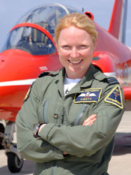
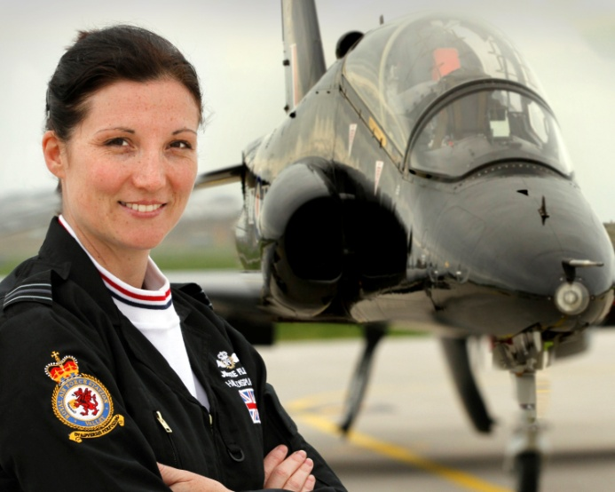
Busting the Gender Stereotype:
The RAF Journey
Squadron Leader Glyn Dean
Squadron Leader Janet Adams

Slide 27
Scope
Who are we?
The Journey?
The Programme
Impact
Link between Recruitment and Retention
The Future

Slide 28



Who Are We?
Public sector organisation of 38,000
personnel
Brand Identity
Diversity
  Times Top 50 Employee of Women 2011
  Opportunity Now Gold Standard 2011
  Stonewall Top 100

Slide 29
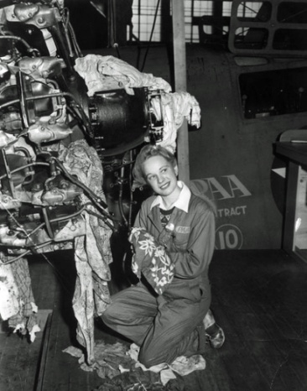
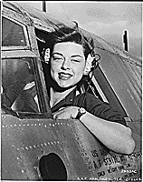
The Journey
Circa 50% employed in technical occupations
40% of annual vacancies require technical competence
Changing demography
More women in workplace

Slide 30
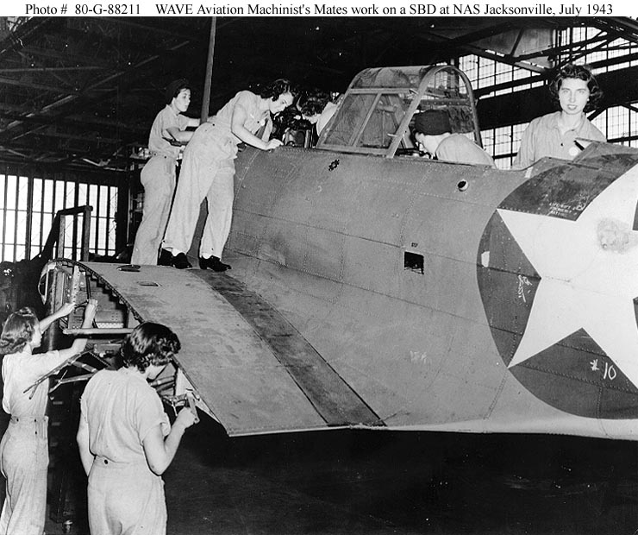
The Journey
Girls outperforming boys in school
Forecast shortages of STEM skills
Increasing global competition for STEM trained personnel

Slide 31
The Journey
2007 Gender Diversity paper
recommendation:
  To improve female representation in the branches and trades (mostly technical) in which they are currently under represented
Strategy development:
  Focus on early engagement
  Underpinned by Diversity Business Case

Slide 32




Developing the Programme
  Needed help
  External contacts/partners
    BAE Systems
    UKRC/WISE
    Opportunity Now/STEMNet
    Professional bodies
    e.g. IET
  Internal buy-in

Slide 33
Key Elements of the
Programme
Work experience
Schools road show
Targeted Educational Sponsorship
Mainstreaming
All of above based on early engagement:
  Challenging gender & other stereotyping
  Enthusing target audience about STEM subjects and possible future careers

Slide 34
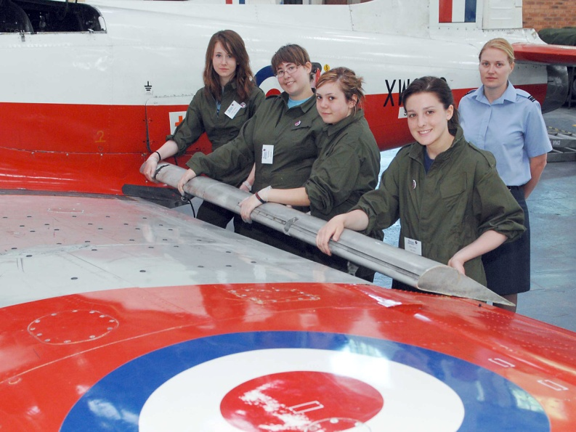
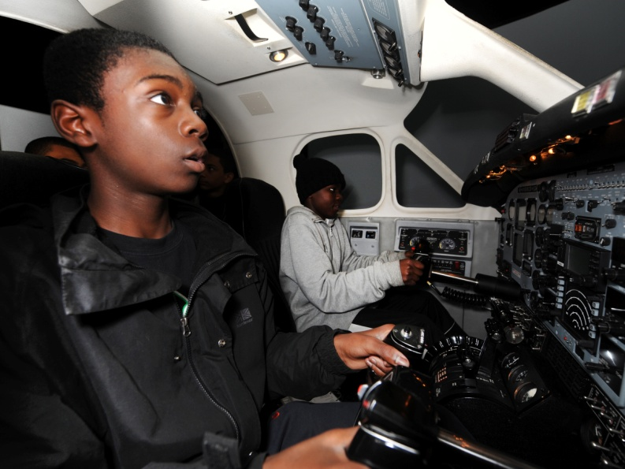
Work Experience

Slide 35

INSERT WISE 1.WMV
VIDEO HERE

Slide 36
Work Experience
First course in 2009 for 24 Year 10 girls
  Engineering hands-on programme
  Residential
  Team building
  Personal development training
  Team presentations on final day
Involved parents, teachers and internal audience
Workbook created

Slide 37
Work Experience Evaluation
Independent evaluation:
“The RAF engineering week was overwhelmingly successful in meeting its objectives, both strategic and operational, in employing successful approaches to engaging girls in exploring engineering as a potential career.”
Liz Russo
Kiaros Solutions Ltd

Slide 38
Work Experience
2010 and 2011 courses improved to include CREST Awards
Model used successfully for:
  Logistics work experience (also for girls)
  High Achieving African-Caribbean Boys (Generating Genius)
Workbook developed to support each course

Slide 39

INSERT
WOMEN IN SCIENCE BFBS
VIDEO HERE

Slide 40
Work Experience
Next steps:
  Continue with Engineering/Logistics and Generating Genius Courses
  Introduce additional course for Generating Genius girls
  Pilot partnership work experience with BAE Systems and Education Business Partnerships

Slide 41
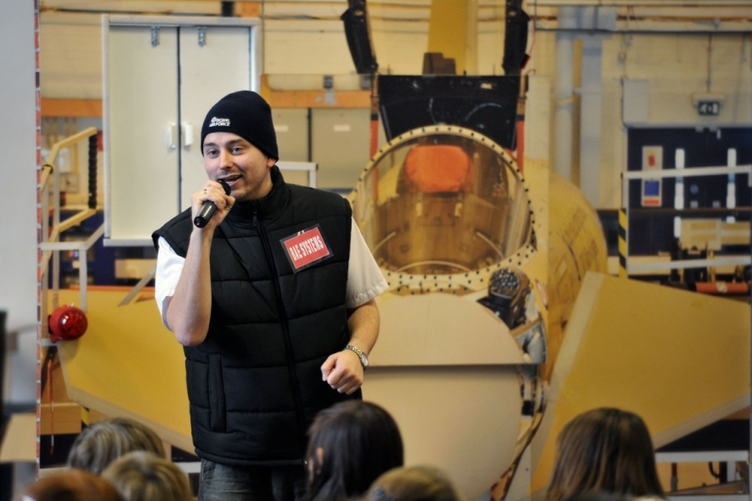
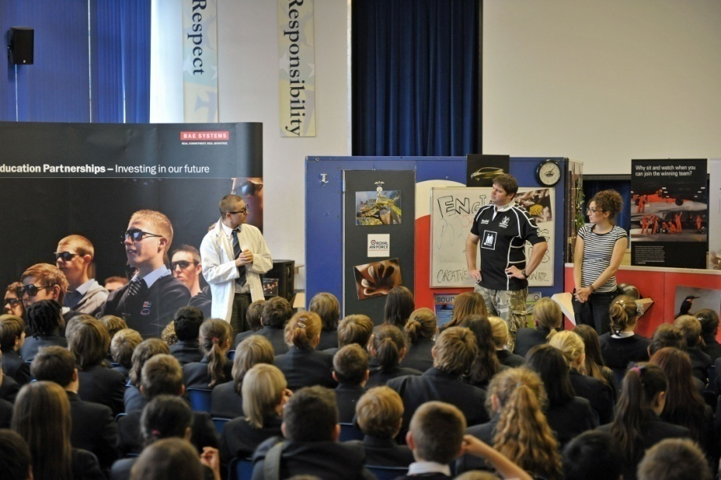
BAE Systems/RAF Roadshow

Slide 42
BAE Systems/RAF Roadshow
Collaboration since 2009
Aim:
  To enthuse pupils for STEM subjects and careers
  To challenge perceptions that Engineering is just for boys or is a dirty occupation
  To assist teachers in developing STEM skills

Slide 43
BAE Systems/RAF Roadshow
Innovative drama based engineering
theatre show
Supplemented by 2 interactive workshops, teacher resource pack and on-line engineering competitions.
Delivered to late primary/early secondary audiences pan UK
To date collaboration has resulted in early engagement to over 53 000 young people

Slide 44
BAE Systems/RAF Roadshow
In 2010 Diversity Engineering Challenge introduced
Joint representation at:
  Big Bang Science and Engineering Fair
  Presentation of seminars
All promoting STEM and diversity key messaging

Slide 45


Targeted Educational Sponsorship & Mainstreaming
DTOEES
Bursaries
Arkwright Scholarships
IET Young Female Engineer of the Year
Mainstreaming

Slide 46


Impact
Work experience
RAF/BAE Systems schools road show
Defence Sixth Form College
Outreach activity
Altitude
Air Cadet Organisation

Slide 47
Impact
Gender imperative in high level plans
Early engagement accepted as a principle
Events planning:
  Big Bang
  Clothes Show
Outreach Teams – STEM priority
Increased internal support – role models

Slide 48
Value of Partnership
Shared learning
Best practice
Economies of scale
Force multipliers
Shared ideas – creative thinking
Could not have done this/or without them

Slide 49
Link Between Recruitment and Retention
Equality & Diversity policy targeted to complement and follow-on from recruitment initiatives
Research indicates that women place more importance than men on diversity and job factors
Policies are inclusive and apply equally to all personnel irrespective of their Protected Characteristics
Notes:
Target Practice: An organisational impression management approach to attracting minority and female job applicants.

Slide 50
Diversity Initiatives
Committed to improving Lived Experience
and work/life balance for all personnel
  Member of ‘Working Families’
  IVF Markers
  Assisted Fertility Policy (Same sex couples)
  Sexual Harassment Surveys
  Female BAME Promotion Research
  Maternity Booklets
  RAF Mentors
  Parenting Network Study
    Carers’ Leave
    Adoption Markers
    Non-Standard Working Conditions
Notes:
14% RAF – female. Recognise that TCOS fit one model and are not flexible, so not bend with different stages of an individual’s life. Need to adapt and make changes where possible.
Stability an issue, especially where both parents serving in RAF. Parenthood an issue:
RAF
The proportion of RAF female officers not returning to work after their maternity
leave has increased from 0% in 2000 to 2.5% in 2009. The proportion decreased in
2009 from 5.1% in 2008
The proportion of RAF female other ranks not returning to work after their maternity
leave has decreased from 23.1% in 2000 to 6.8% in 2009. The proportion decreased in
2009 from 8.0% in 2008
High numbers leave within 2 years of returning from maternity leave – why? Exit Leavers survey site family reasons.
The future – NEM? Greater geographical stability. part-time?

Slide 51
Successes
RAF Leader in field of Diversity
GOLD award ‘Opportunity Now’
– 2009 & 2011
The Times Top 50 Employers for
Women Award – 2011
Only Organisation in UK to have achieved both awards
Other Benchmarking Successes with Stonewall (Top 100) and Race for Opportunity

Slide 52
The Future
Continuing high level support
Existing partnership work extended
New external partnerships
More work experience weeks
Increased mainstreaming

Slide 53
Summary
Early success
Work in progress

