Slide 2



International standards – global partnerships
Welcome to our Session:
Integrating WorldSkills International Standards into UK VET
VET in Australia
China and UK - Partners in Education Programme

Slide 3

Integrating WorldSkills International Standards into UK VET
Introduction
WorldSkills London 2011 Legacy Project
WorldSkills Standards
International Skills Standard Specifications
What project success will look like
Notes:
WorldSkills London 2011 Legacy Project (SM)
Based at North Warwickshire & Hinckley College, with funding from the UK Skills Funding Agency (SFA)/National Apprenticeship Service (NAS) and support from the Association of Colleges (AoC)
Core project team of three – introduction to self and Charles
A cluster of WorldSkills London 2011 Legacy Projects designed to collectively support the research and development of UK VET including research into models of excellence and master classes to support tutors/trainers
The aim of the ‘International Standards’ Project: to identify the high level skills embedded within the WorldSkills International Competition and present as ‘International Skill Standards Specifications’ to provide a potential platform for: vocational teaching, learning and qualifications, including apprenticeship programmes

Slide 4

WorldSkills Standards
Objectives:
A definition of the skills that underpin expert technical and vocational performance in a work role
Through its scope and range capturing international best practice
Acting as the only reference point for assessment in the WorldSkills Competition
A resource for member countries wanting to benchmark their own TVET systems

Slide 5

The International skill standards specification
Content Framework:
Work Organisation & Self Management
Problem Solving, Innovation & Creativity
Communication and Interpersonal Skills
Technical Skills
Rationale:
OECD and related research including MoVE
Notes:
The International Skill Standards Specification (CA)
Succint – provides a basis for curriculum development and facilitates regular up-dating
Identifies the characteristics of performance excellence in the skill
Relates to the ‘Models of Vocational Excellence’ (MoVE) research: three generic areas which stand-alone or are embedded
Drawing on the Organisation for Economic and Cultural Development (OECD), the WorldSkills Foundation’s Modelling of Vocational Excellence (MoVE) there is broad agreement on the higher level skills and attributes associated with individual and corporate success
Links knowledge with practical capabilities
Knowledge and understanding: comprehensive, specialised, factual and theoretical knowledge; awareness of boundaries of knowledge
Technical skills include new ways of working, technological change
Attributes: adaptability, persistence and resilience
Ethical: personal integrity, responsibility for oneself, a sense of justice and empathy
Weightings provide a basis for practical assessment
Examples of Specifications are available from Helen Garratt, Project Co-ordinator: helen.garratt@nwhc.ac.uk

Slide 6

What success will look like
Our Goals and Achievments:
Development of 20+ draft International Skill Standards Specifications
Support and endorsement from the WorldSkills International community
Positive response from UK employers
Contributing to UK VET policy
Notes:
What success will look like by October 2013 (SM)
The 20 International Skill Standards Specifications:
Hairdressing
Beauty Therapy
…………….
A unique feature of the Project is the close working relationship which has been established with WorldSkills International. One feature of this relationship was the access which was granted to the Chief/Deputy Chief Experts to take part in workshops and interviews to develop the content of the International Skill Standards Specifications.
From Leipzig 2013 we will have additional feedback as a result of the wider Experts consultation which is taking place.
We are currently in the process of conducting interviews with a sample of UK employers. The discussions cover ‘outstanding performance’, UK education and training programmes and international standards and assessment. The 40 interviews will be completed by the end of this summer.
The Project has contributed to a government review of apprenticeship programmes which is currently underway in England.
In the next phase (from October 2013 to September 2014) we will be piloting the standards across 10 skill areas from which case studies will be produced. Examples of the work we will be doing are:
The opportunity is also being taken to broaden the Project to explore the practical end tests in skill areas where such an approach could add value.
Overall the Project aims to support the continuous improvement of UK VET.

Slide 7

Next steps
Continue learning from WSC
Develop 10 case studies to illustrate introduction of high level international standards to UK VET
Explore UK government plans to enhance apprenticeship programmes e.g. practical end tests
Review the impact of changes on those delivering UK VET
Further develop established partnerships with member countries on parallel tracks

Slide 8
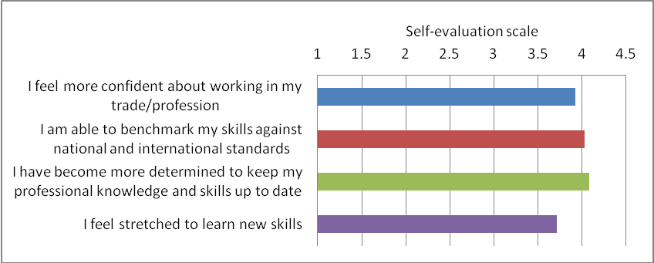
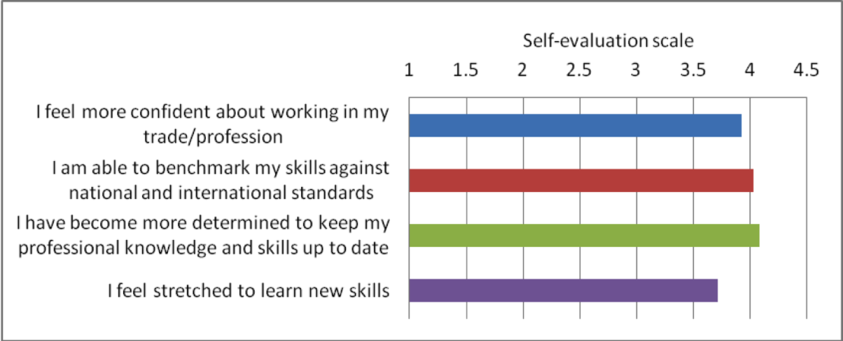
MoVE International
Findings from the MoVE International research project
Competitors
Increased confidence; motivation;
Enhanced sense of professional identity
Teamwork; motivation; perseverance were key points of difference between medal winners and other high performers
Experts
Increased sense of belonging to their profession
Enhanced commitment to excellence
8
Notes:
Surveys of competitors and experts collected information about:
- the personal experience of involvement in WorldSkills
- the individual characteristics of vocational excellence :
Valid data collected from:
- 413 WorldSkills competitors from 38 WorldSkills member countries, and from all six skill sectors at WorldSkills London
165 experts, from 38 WorldSkills member countries and from all six skill sectors.
Differences in domains of excellence between medal and non medal winners is small but statistically significant (as is .01 of a second at Olympic competition);
WorldSkills plays a role in the emergence of professional identify in competitors
WorldSkills contributes to the consolidation of professional identity in Experts
WorldSkills has the capacity to quite profoundly influence everyday vocational learning …
[focus on ‘team skills; motivation; perseverance; etc as point of difference between medal winners and other high performers]

Slide 9
MoVE International
Findings from the MoVE International research project
9
Notes:
Surveys of competitors and experts collected information about:
- the personal experience of involvement in WorldSkills
- the individual characteristics of vocational excellence :
Valid data collected from:
- 413 WorldSkills competitors from 38 WorldSkills member countries, and from all six skill sectors at WorldSkills London
- 165 experts, from 38 WorldSkills member countries and from all six skill sectors.
[focus on ‘team skills; motivation; perseverance; etc as point of difference between medal winners and other high performers]

Slide 10
VET in Australia
Competency standards in the Australian VET System
Australian Training Package units of competency express minimum occupational standards;
Minimum standards have become the default benchmark. However there is an increasing awareness amongst employers of the need for outcomes above minimum standards and demands for new models of trade training
10
Notes:
Note from Jenny
[Potentially a reference to the WS standards specifications removing the term “competency” since competency is a baseline and standards need to capture the range of performance from competency to excellence. This would emphasise the wider utility of the WS standards beyond their use for an elite within the WSC.]

Slide 11
Pursuing excellence
Strategies for excellence in apprentice training
An RMIT partnership initiative
AIM
To collaborate with WSI, WS member organisations and education providers, locally and globally for reciprocal benefit in the promotion and pursuit of excellence
KEY OBJECTIVES
Identify and document strategies to assist teachers and trainers to promote the concept of skills excellence;
Provide apprentices with opportunities to develop standards of performance above the minimum expressed in Training Package qualifications and to apply their skills to achieve leading edge workplace practice.
Develop tools and techniques to test the effectiveness of implemented strategies and report widely on outcomes.
11
Notes:
Focus on the use of WS competitions locally and internationally as a strategy to promote excellence
Forming partnerships and alliances to leverage opportunities and accelerate progress

Slide 12
Strategies and initiatives
(1) The Australian Industry Group Engineering Excellence project
Project Aim
To set a new benchmark for best practice by establishing strategies to enable the demonstration of competency through work performance;
To integrate ‘soft skills’ into work-based assessments;
To promote excellence in apprentice training.
Project Scope
Ten major vocational education and training providers; 3,500 apprentices
Key challenge
Development and implementation of higher quality assessment strategies which incorporate work organisation & self management; problem solving, innovation; communication and interpersonal Skills
12

Slide 13
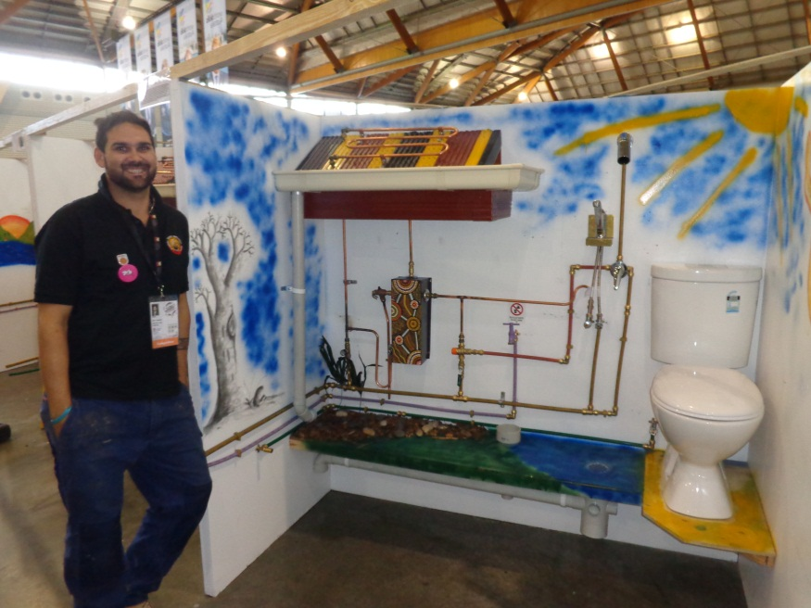
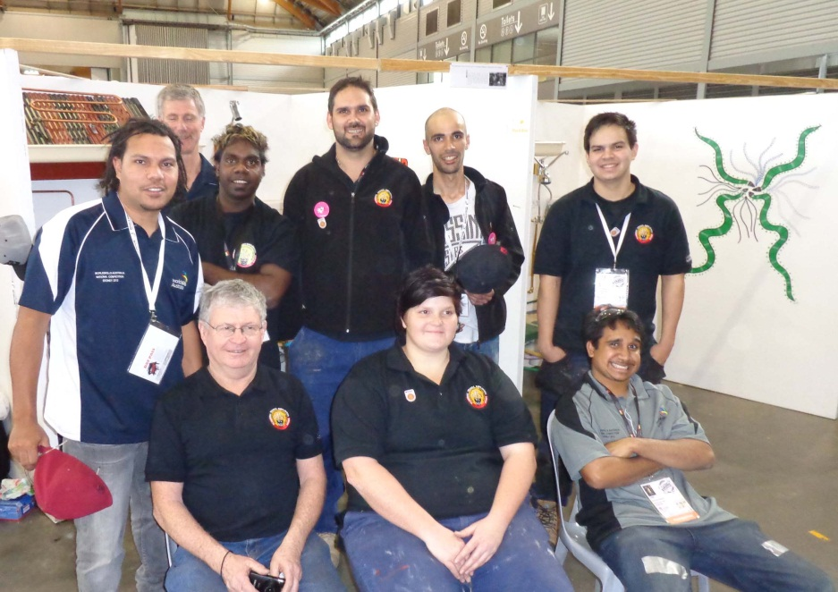
Strategies and initiatives
(2) Competition as an excellence strategy in the RMIT Apprentice program
Objectives
to use exhibition competitions to promote the concept of excellence;
to integrate competition into the apprentice curriculum as a mode of learning; and assessment.
13
Notes:
Examples:
2012 RMIT Open Day team-based competition event in plumbing; refrigeration and electrical;
2012 RMIT Indigenous Plumbing Program -sustainable plumbing for remote communities team exhibition event;

Slide 14
CHINA PARTNERSHIP
  The UK-China Partners in Education (UKCPIE) Programme for TVET between the Chinese and the UK governments supports a wide range of educational collaboration. Specifically, wide consultation with key sector stakeholders led to two Memoranda of Understanding underpinning joint strategic aims below.
  The UK Department of Business, Innovation and Skills (BIS) and the Chinese Ministry of Education ( MoE) plus the Chinese Ministry of Human Resources and Social Security ( MoHRSS). Areas for collaboration:
MoE | 2. MoHRSS
Principals shadowing programme | Apprenticeships and employer engagement
Apprenticeship pilot | Vocational standards and classification
Joint curriculum development | College partnerships
 | World Skills competitions
 | Vocational teacher training

Slide 15
Rationale for Skills
Competitions
To offer advantages to countries through collaborating with highly placed nations cultivating a highly skilled labour force
To build teacher/student internationalisation through outward mobility and sharing UK expertise in high level skills
Following China’s participation in 2011, for the first time, skills competitions have been identified by both countries as a means to improve standards and promote skills excellence
Collaboration on skills competitions, especially via the Roadshows, is seen as an excellent way in both countries to change perceptions of vocational education and training, to inspire young people (and their parents) to develop a given skill to a very high level

Slide 16
Activities IN CHINA
UK Skills champions Roadshows have been held in seven cities in China (Guangzhou, Qingdao, Yancheng, Shanghai, Chengdu, Chongqing and Xian)
- China-UK pressure test
- Joint skills competitions
- Master classes and workshops for trainers and competitors
Next steps
- Standards and assessment: connecting national with international standards of performance, with an orientation towards high level skills for future capability
- Techniques for capacity building for individuals
- Expansion of joint Roadshows to other countries/regions
- Global conference showcase

Slide 17


Contacts
For more information on the projects please contact:
VET in Australia
Dr Helen Smith
Senior Consultant, Learning and Teaching
Office of Director TAFE, RMIT
helen.smith@rmit.edu.au
Peter Canavan
National Manager Apprenticeship Project, AIG
peter.canavan@aigroup.asn.au
China and UK Partners in Education Programme
Kathleen Zhong
Director of Skills and Vocational Education,
Cultural and Education Section of the British Embassy
kathleen.zhong@britishcouncil.org.cn
Michael Houlgate
Project Manager, Skills for Employability,
Cultural and Education Section of the British Embassy
Michael.Houlgate@britishcouncil.org
Julia Smith, Education Consultant juliasmith25@btinternet.com

Slide 18

Contacts
International Standards:
Dr Sally Messenger, Project Director
sally.messenger@nwhc.ac.uk
Charles Anderson, Project Manager
charles.anderson@nwhc.ac.uk
Helen Garratt, Project Co-ordinator
helen.garratt@nwhc.ac.uk

Slide 19
Thank you

