Slide 1
The District of Tomorrow
European real life living lab
Ludo Kockelkorn
Zuyd University of Applied Sciences

Slide 2
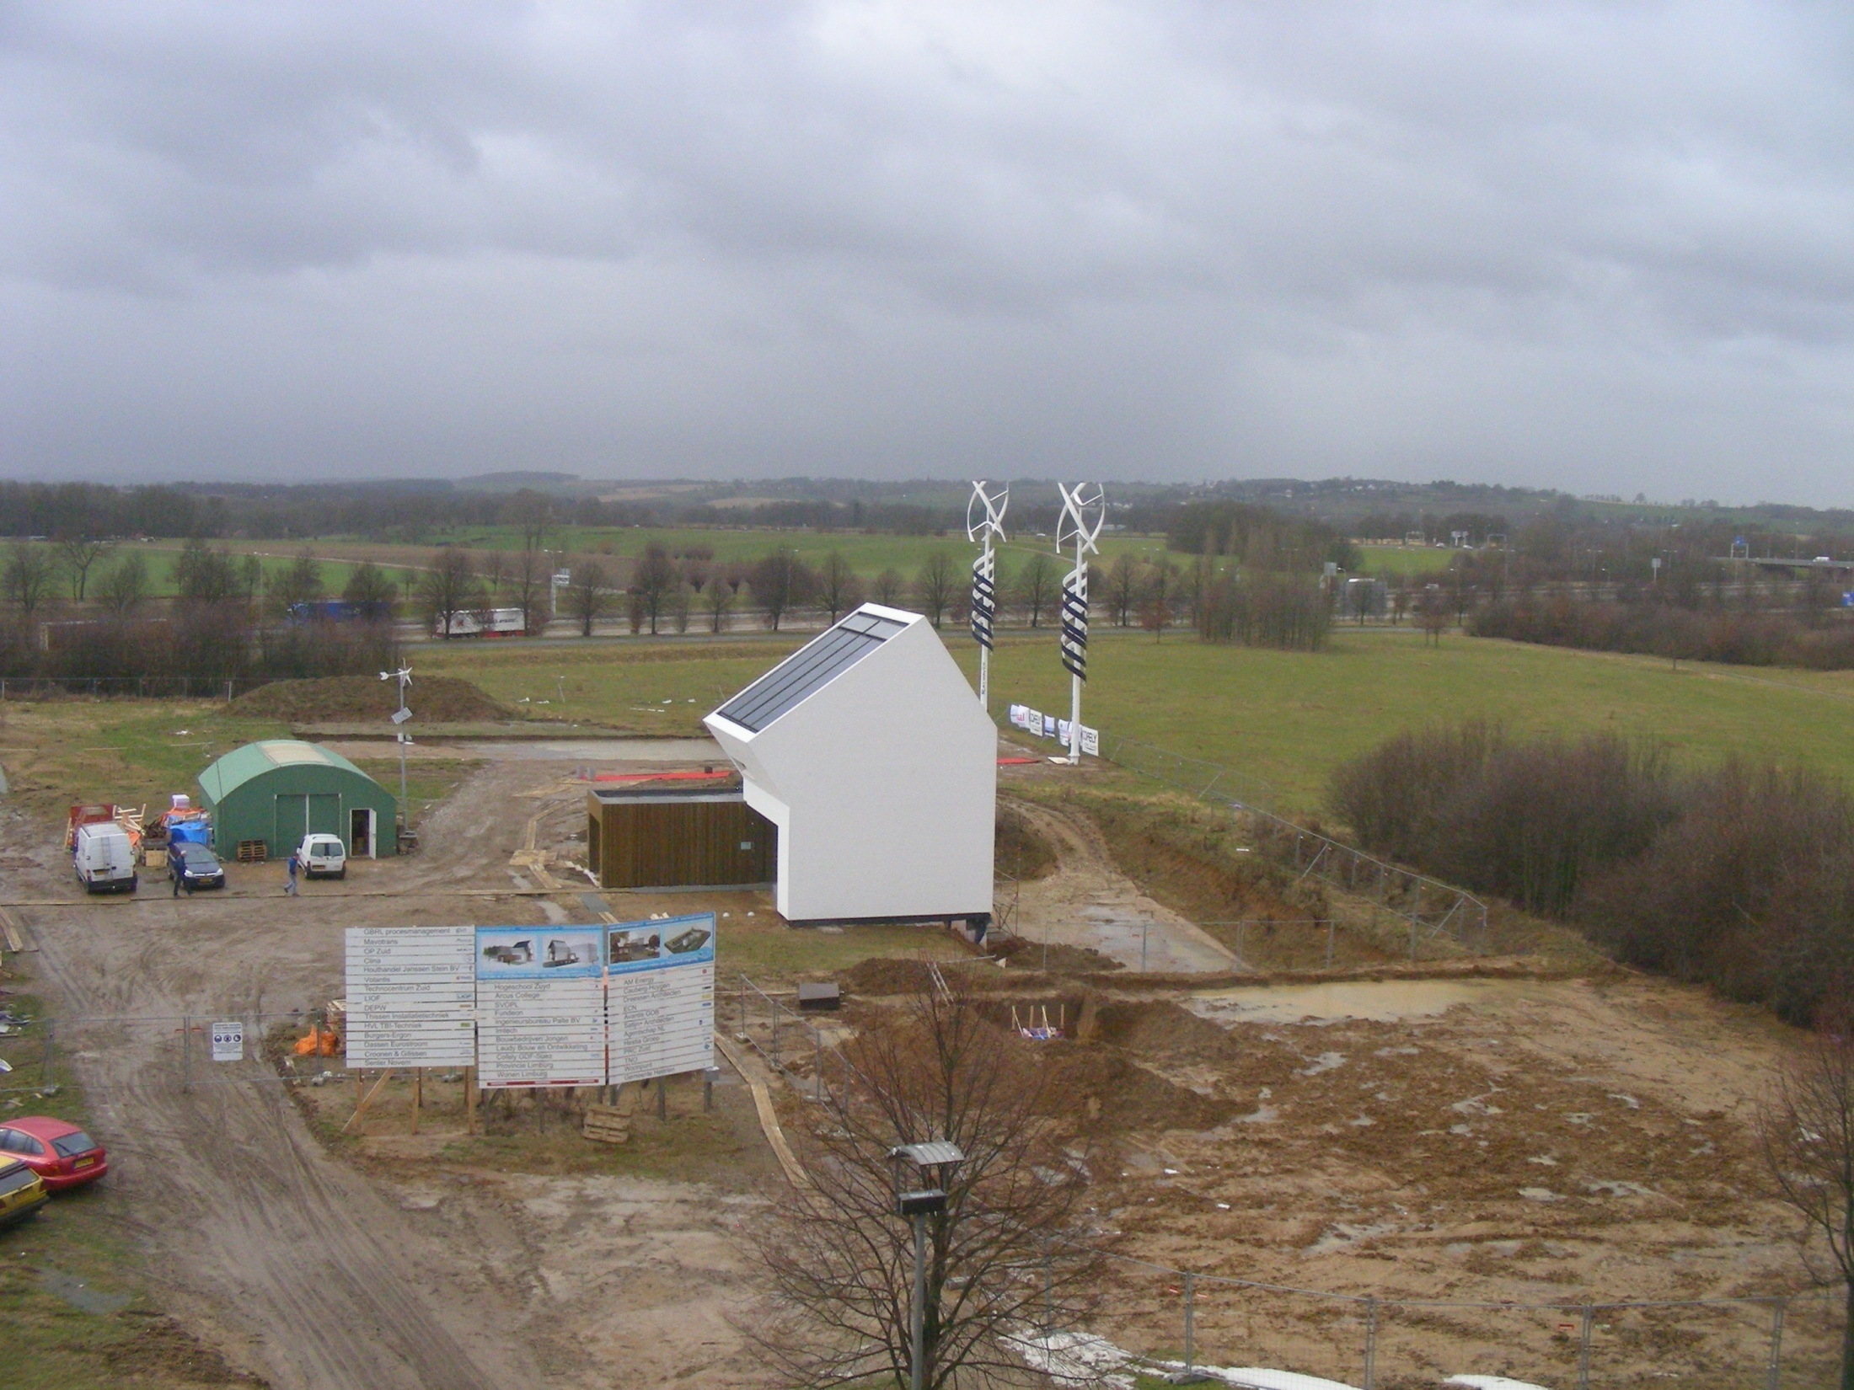
District of Tomorrow
De Wijk van Morgen
District of Tomorrow
Viertel von Morgen
Quartier de Demain
Wijk van Morgen

Slide 3
The district of tomorrow

Slide 4
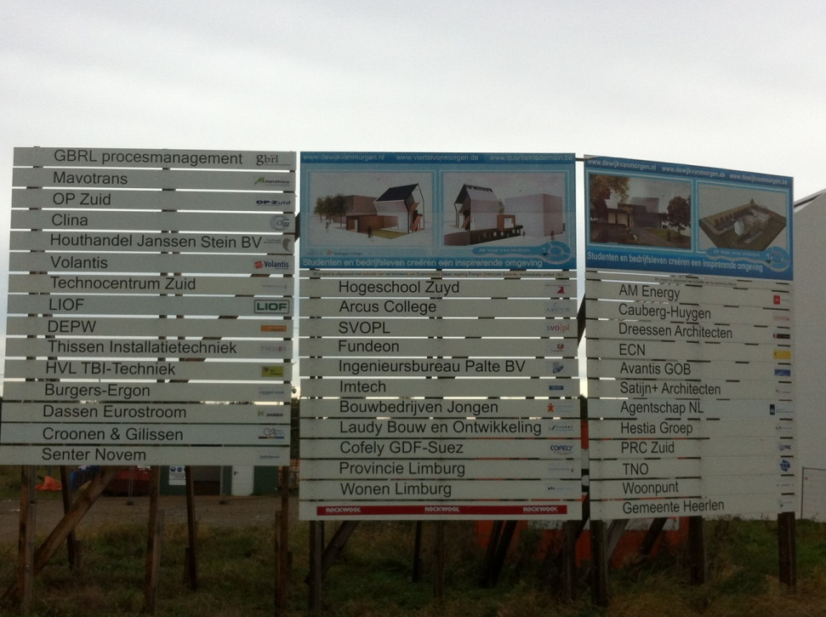
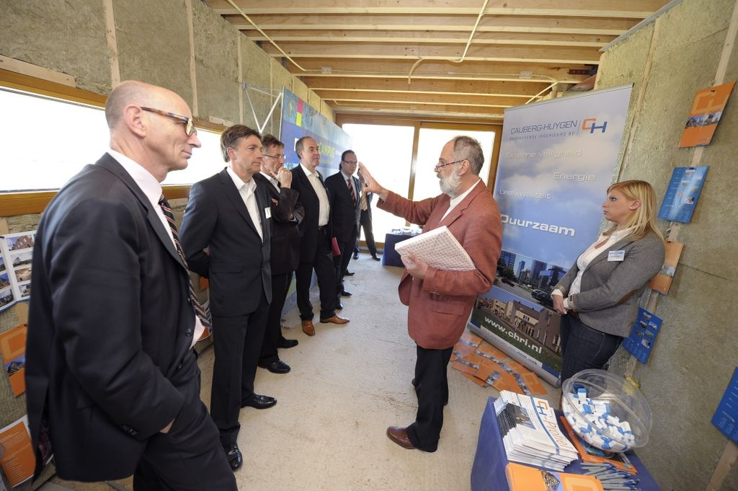
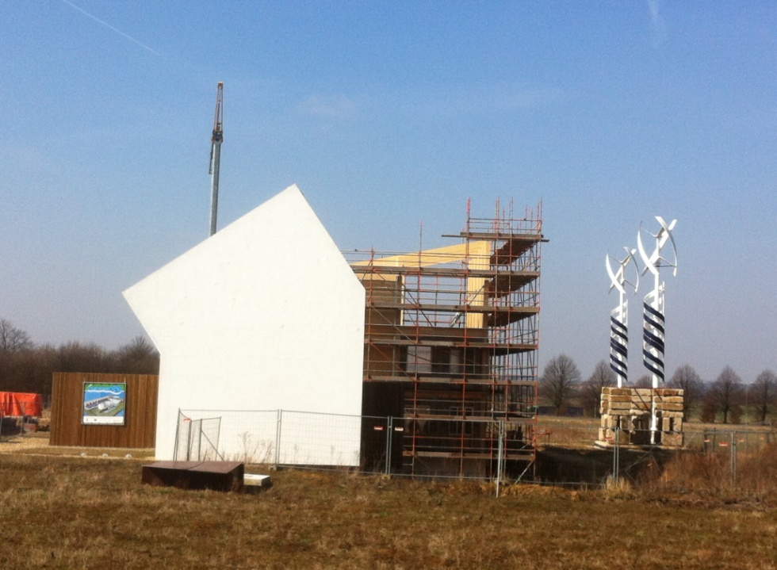
25 June 2013 Opening FlEx House

Slide 5
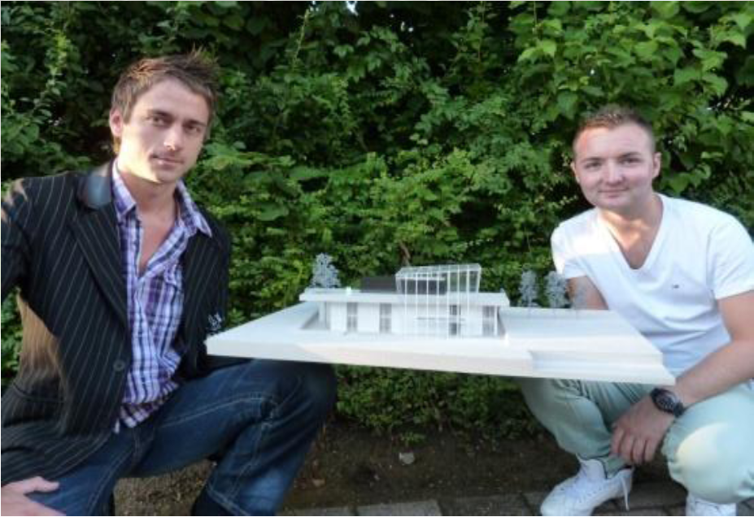
Gebouw 2; kantoor en expositie
Winnend ontwerp: “Eco/nnect”
Studenten; Roel Derkx, Leroy Merks

Slide 6
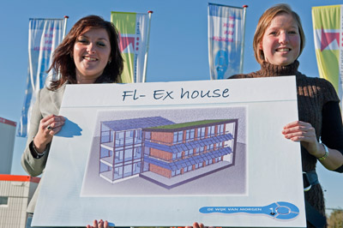
Gebouw 3; wonen en zorg
Winnend ontwerp 3: “Fl-Ex House”
Studenten; Nadine Huids, Marieke v/d Goor

Slide 7
Chill, Centre of expertise
The Netherlands
26 Centres of expertise (applied sciences)
15 Centres for innovative Skills (vocational level)
District of Tomorrow

Slide 9
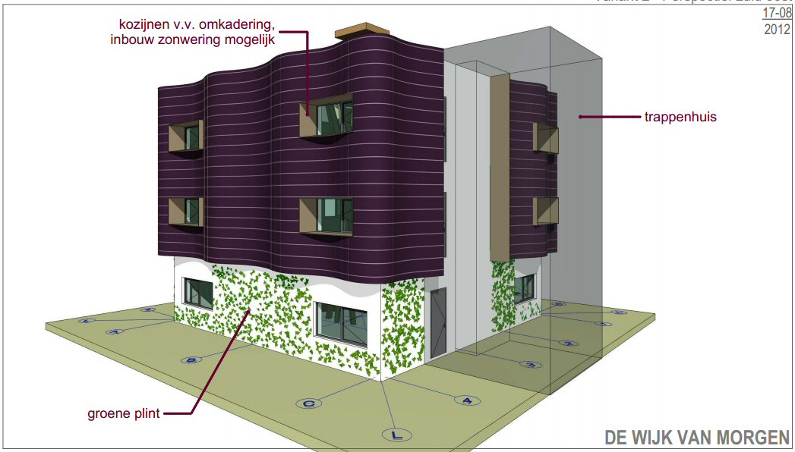

Slide 10
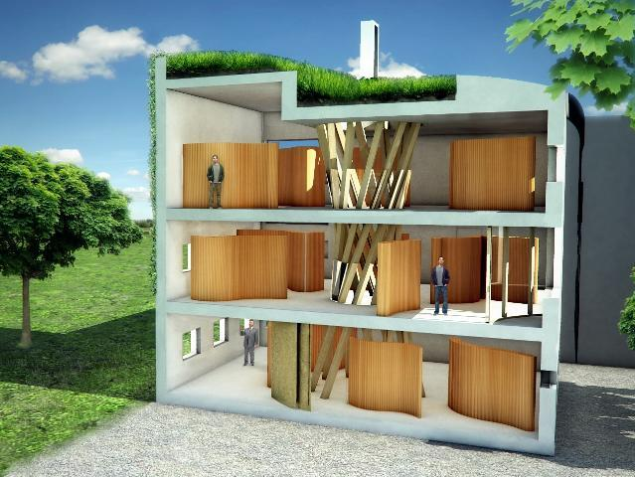
Gebouw 4; startersgebouw
voor duurzame ondernemers
Winnend ontwerp: “MAXergy House”
Studenten; I. Schoenmakers, Ruby Willems

Slide 11
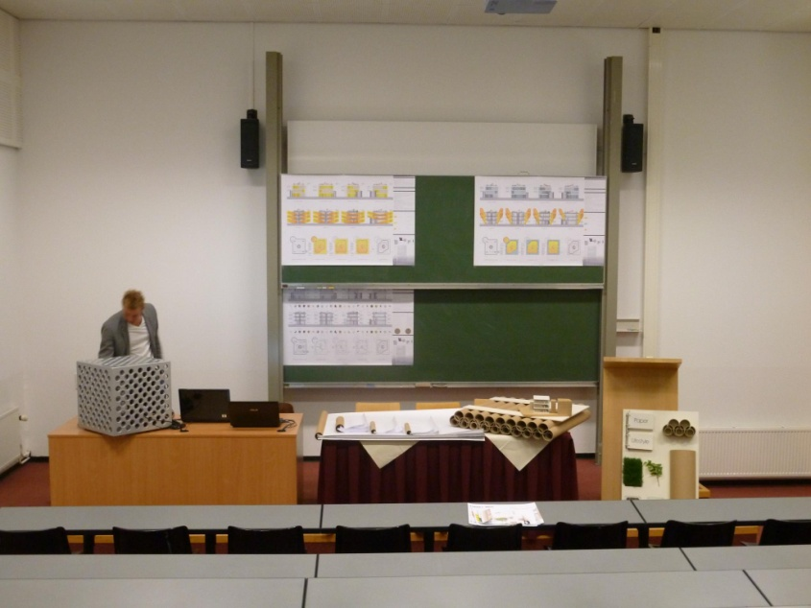
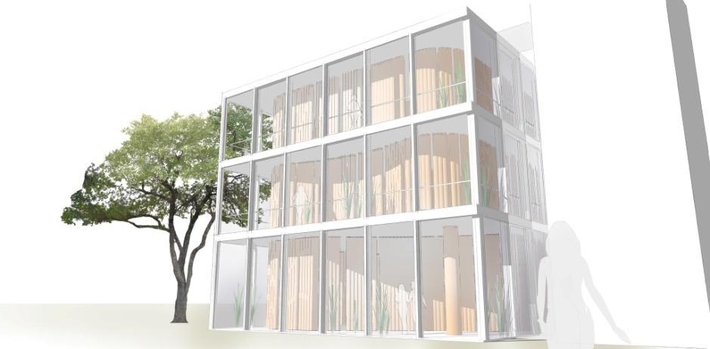
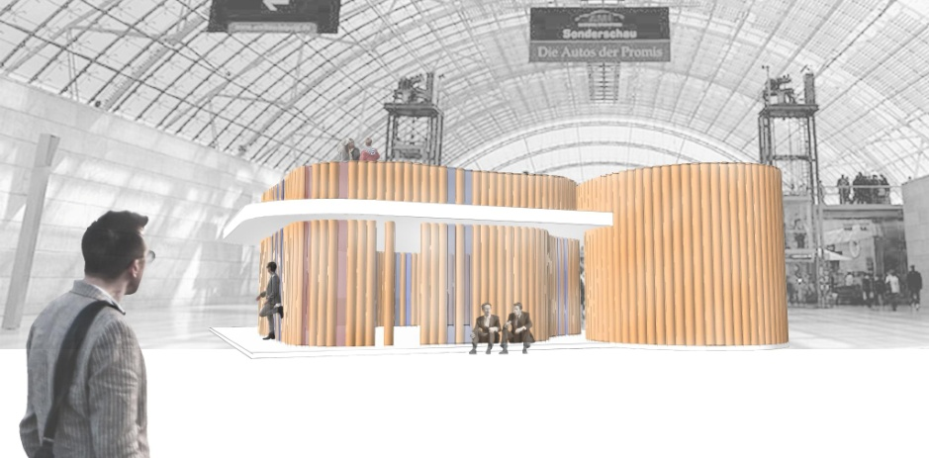
Think Paper >>> Sustainable Artistic Atelier

Slide 12
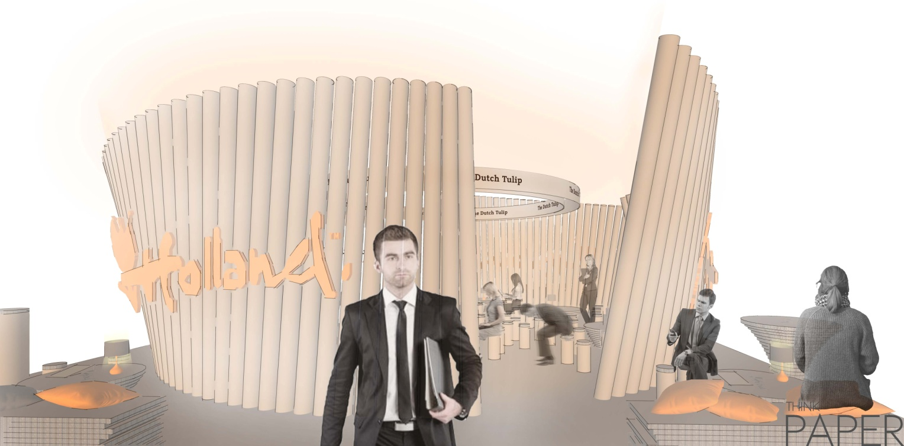
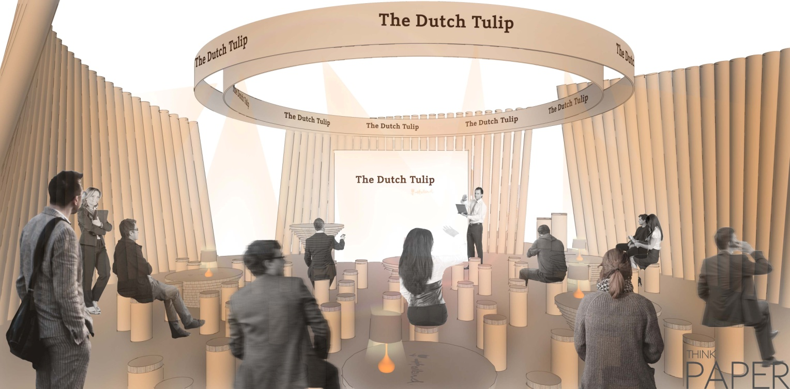

Slide 13
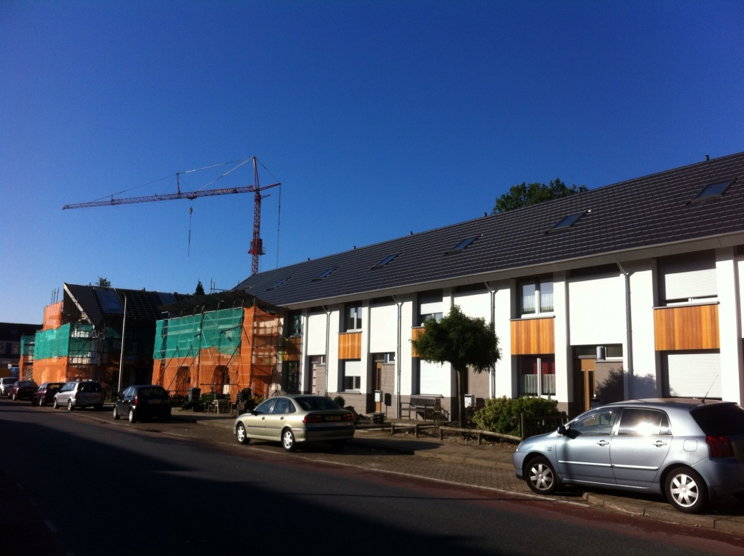
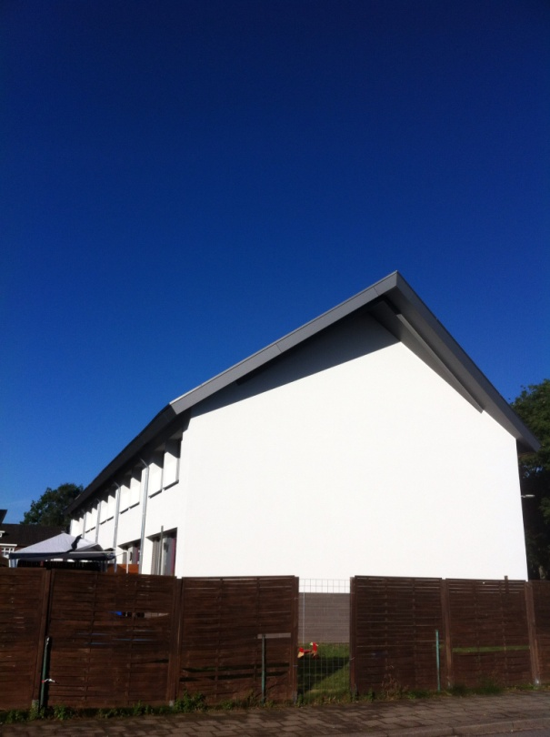
EURL³A European Real Life Learning Lab Alliance (Reference EAC-2012-0600)
Contribution to the real world
Kerkrade West

Slide 14
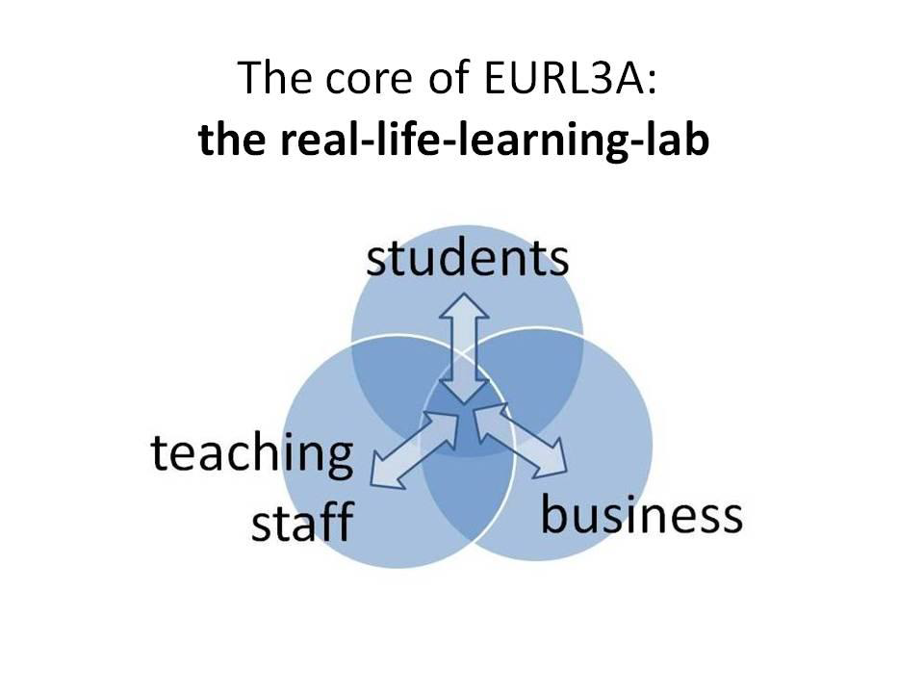
Recommendations: 1) show results (instead of reports) of cooperation and applied knowledge 2) create private/public cooperation by cross border “real life learning labs”

Slide 15
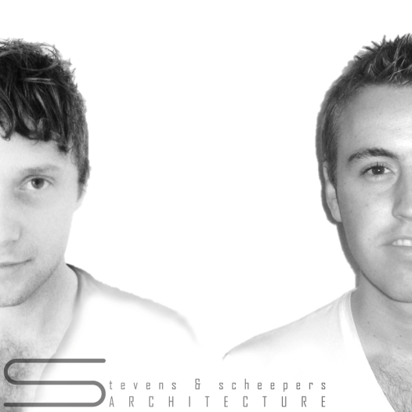
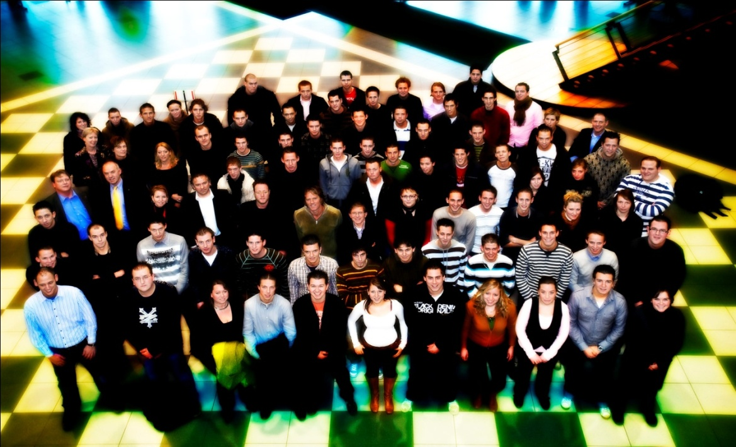
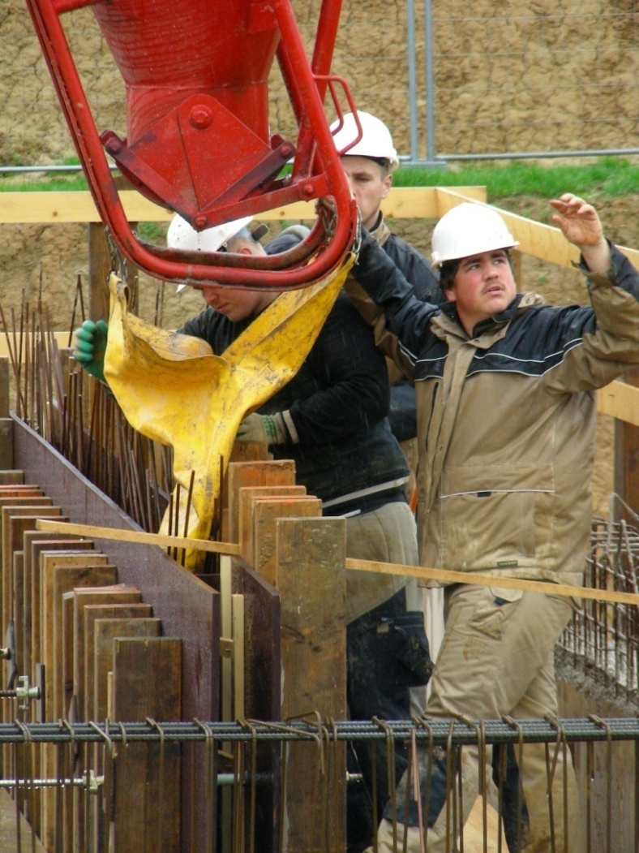
Thank you for your attention
The District of Tomorrow
Ludo Kockelkorn
Zuyd University of Applied Sciences

