Slide 1
Future skills and ways to train them
in Manufacturing and Technology
presented by Martin Williams Festo
Carl Peters Lincoln Electric
Christian Callegari Siemens
Notes:
My fellow Global Industry Partners
Skills profiles must be transparent to HR and employees. What level of which skills is necessary, what is the current status, what measures can be taken to close the gap. Examples only – does not claim to be exhaustive! Picked a cross section of solutions

Slide 2
What changes do you expect in your field
in the next 5 to 10 years?
Notes:
Skills profiles must be transparent to HR and employees. What level of which skills is necessary, what is the current status, what measures can be taken to close the gap. Examples only – does not claim to be exhaustive! Picked a cross section of solutions

Slide 3
Major changes coming our way
Faster-changing world, blurring of disciplines
Organisations made crisis-proof - agile processes and structures = more change
Customer focus will be become more intense
Jobs less secure than in the past
Companies expect trainees to hit the road running on completion of training
Complexity...
Notes:
Mention where these points come from …
Skills profiles must be transparent to HR and employees. What level of which skills is necessary, what is the current status, what measures can be taken to close the gap. Apparent or percieved complexity - complextity is increasing – user interfaces are improving …

Slide 4
Which new skills will be needed to cope?
... in Technology Keep pace with technical developments - adapt, be flexible, able to cope with change, constantly learn - manage cognitive load - discriminate and filter information for importance
Master diversity of technology need trans-disciplinary skills and knowledge to understand concepts across disciplines
Learn fast and hit the road running on completion of training, trainees have comprehensive knowledge & practical skills– a challenge primarily for training providers ...
Notes:
Skills profiles must be transparent to HR and employees. What level of which skills is necessary, what is the current status, what measures can be taken to close the ga
Keep pace with fast innovation cycles - adaptability, flexibility, able to cope with change, learn, manage load: need to discriminate and filter information for importance, and to understand how to maximize cognitive functioning using a variety of tools and techniques
Master diversity of technology trans-disciplinary skills and knowledge – e.g. Technician looking after manufacturing industry may need to know about process control, ability to understand concepts across multiple disciplines
Learn fast and hit the road running Graduates / trainees have comprehensive knowledge & practical experience - training providers must find solutions that offer this p.

Slide 5
Which new skills will be needed to cope?
... in Technology Keep pace technical developments - adapt, be flexible, able to cope with change, constantly learn, - manage flood of information - discriminate and filter for importance
Master diversity of technology - need trans-disciplinary skills and knowledge to understand concepts across disciplines
Learn fast and hit the road running - on completion of training, trainees have comprehensive knowledge & practical experience – a challenge primarily for training providers ...
Notes:
Skills profiles must be transparent to HR and employees. What level of which skills is necessary, what is the current status, what measures can be taken to close the ga
Keep pace with fast innovation cycles - adaptability, flexibility, able to cope with change, learn, manage load: need to discriminate and filter information for importance, and to understand how to maximize cognitive functioning using a variety of tools and techniques
Master diversity of technology trans-disciplinary skills and knowledge – e.g. Technician looking after manufacturing industry may need to know about process control, ability to understand concepts across multiple disciplines
Learn fast and hit the road running Graduates / trainees have comprehensive knowledge & practical experience - training providers must find solutions that offer this p.

Slide 6
Which new skills will be needed to cope?
... in the Organisation
Communication and team skills - ability to work productively & drive engagement in teams – including virtual teams via digital communication
Language and intercultural skills - ability to operate worldwide to serve customers effectively – operating with sensitivity in different cultural settings Act as an entrepreneur - ability to understand the big picture, identify opportunity and take the initiative From bolt-tightener to competent co-worker to entrepreneur Willingness keep learning and adapt to change - since employers will increasingly expect the individual to develop their skills themselves = maintain their employability
Notes:
The world will definitely become more complex, but user interfaces will probably mean that the percieved complexity does not increase.
Skills profiles must be transparent to HR and employees. What level of which skills is necessary, what is the current status, what measures can be taken to close the gap.
Team skills Ability to operate in (multiple?) global teams, company internal and with customers
Communication skills F2F and digital skills become even more important, ability to work productively, drive engagement, and demonstrate presence as a member of a virtual team, WorldSkills is a case in point! ability to critically assess and develop content that uses new media forms, and to leverage these media for persuasive communication
Language and intercultural skills Needed to service global markets and customers effectively, ability to operate in different cultural setting ... the need to keep learning and adapt to change Organisations will also require the individual to take responsibility for developing their skills. So individuals must be willing to develop their own skills profile...

Slide 7
More than ever, people will need
not only the
- the right skills
and
the right knowledge
but in order to continue developing their skills, work effectively in global teams and with customers they will need...
the Right Attitude
Notes:
Skills profiles must be transparent to HR and employees. What level of which skills is necessary, what is the current status, what measures can be taken to close the gap.

Slide 8
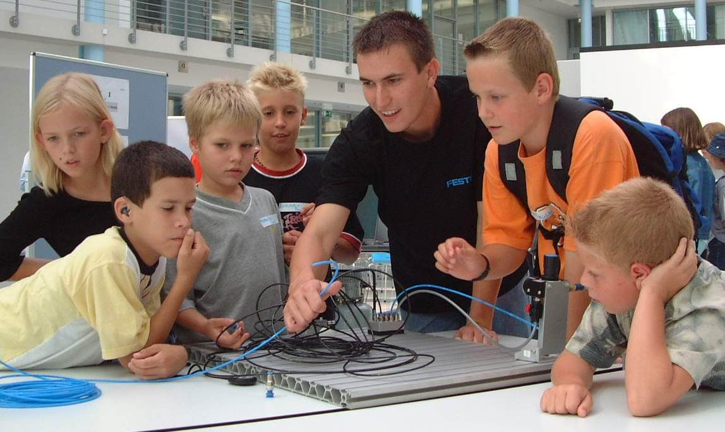
How can we train these skills and qualities
... affordably, safely and in good time?
8
Notes:
We have picked a varied set of examples
Skills profiles must be transparent to HR and employees. What level of which skills is necessary, what is the current status, what measures can be taken to close the gap.
Crossing a road when the pedestian traffic light is red.

Slide 9
Productivity Game
The Challenge People often get stuck in a rut and do not consider if there are better ways of doing things. The Solution In a Productivity Game participants set up a company and run it for an hour according to given processes.
Implement solution
Play game
Find solution
Identify weak points
9
9
Notes:
Skills profiles must be transparent to HR and employees. What level of which skills is necessary, what is the current status, what measures can be taken to close the gap.

Slide 10
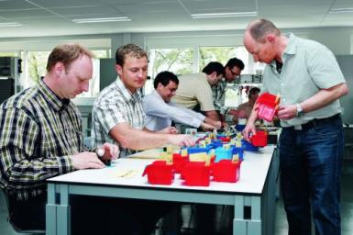
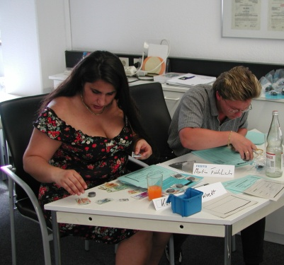
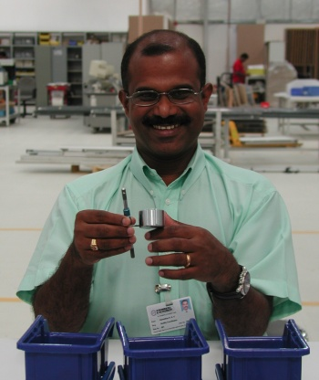
Productivity Game 2
Duration 1– 2 days Trainees 8 -15 Task optimise a given process Focus value creation, eliminate waste
Contents - Introduction / design value creation processes
Develop teamwork
Develop critical view
- Learn to think outside the box
The training
changes perception
create awareness
can rejuvenate “tired” production systems
Notes:
Skills profiles must be transparent to HR and employees. What level of which skills is necessary, what is the current status, what measures can be taken to close the gap.
Types of waste: Overproduction. Producing unnecessary products when they are not needed and in a greater quantities than required. Inventory. Material stored as raw material, work-in-process, and final products. Transportation. Material handling between internal sections. Defects. Irregular products that interfere with productivity, stopping the flow of high-quality products. Processes. Tasks accepted as necessary. Operations. Not all operations add value to the product. Inactivities. Machines with idle time or operators with idle time.

Slide 11
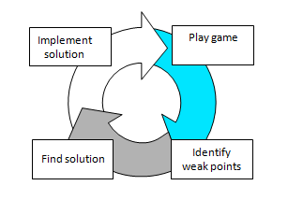
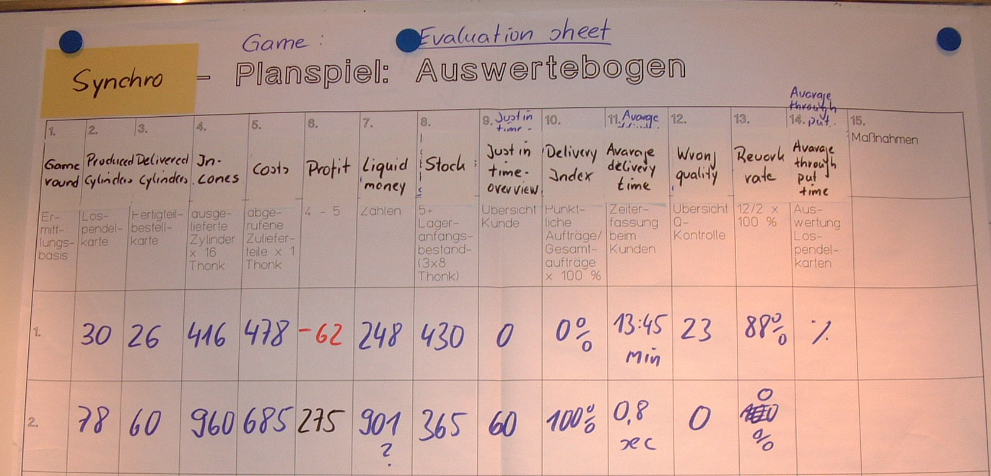
Productivity Game 3
Amazing improvements - and people work less!
They achieve astounding improvements to indicators like
Stock 430 to 365
Average delivery time 13.45 min to 8 sec
Rework rate 88% to 0% At the end – the process is much improved – and the participants have become critical questioners of “The Way Things Are Done”
Notes:
Skills profiles must be transparent to HR and employees. What level of which skills is necessary, what is the current status, what measures can be taken to close the gap.
The amazing thing is how people develop a critical view during the training. Nothing is tabu! It is important they maintain this when they go back to their workplaces! It is lgame - it is challenging and fun. We have to kick people out of the room at the end of the day.

Slide 12
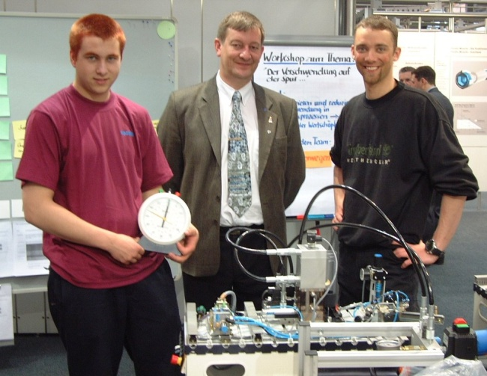
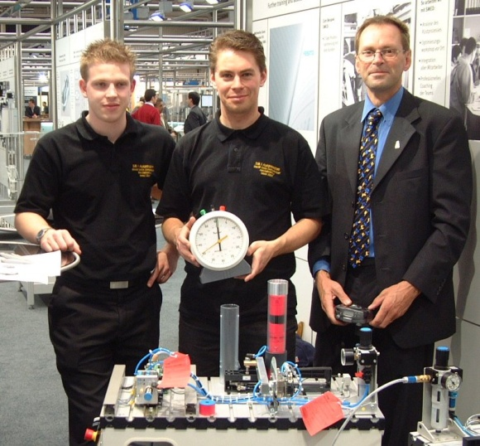
Another productivity game
The Challenge: Changeover time too long = large lot numbers The Solution: Game – Fast Changeover
Hydraulic Punch Hydraulic Press Station 12 mins * -> 41s
Pneumatic Gripper Pneumatic Distribution Station 8 mins* -> to 20 secs
* after training and practice
12
Notes:
Skills profiles must be transparent to HR and employees. What level of which skills is necessary, what is the current status, what measures can be taken to close the gap.

Slide 13
Another productivity game 2
The Challenge: Changeover time too long = large lot numbers The Solution: Game – Fast Changeover
Question Everything! Question Everything! Question Everything!
Hydraulic Punch Hydraulic Press Station 12 mins * -> 41s
Pneumatic Gripper Pneumatic Distribution Station 8 mins* -> to 20 secs
* after training and practice
13
Notes:
Skills profiles must be transparent to HR and employees. What level of which skills is necessary, what is the current status, what measures can be taken to close the gap.

Slide 14
Training the Trainer
Internal Training: “Mastering Key Trainer Skills” The Challenge We want to train as effectively and enjoyably as possible. Customers worldwide expect trainers to be excellent – and accredited. The Solution We run training for our trainers in 2 modules of 3 days over 3 months with an interim project to achieve the following outcomes:
Notes:
Skills profiles must be transparent to HR and employees. What level of which skills is necessary, what is the current status, what measures can be taken to close the gap.

Slide 15
Outcomes of “Mastering Key Trainer Skills”
On completion of training, the participant can
identify and formulate competency-based training outcomes
write a professional lesson plan
name elements of personal impact and strategies for improving them
make professional use of key interactive training methods
use 5 key media professionally
give and receive feedback professionally
deal with difficult training situations and demonstrates willingness to improve his/her training skills profile
Notes:
Skills profiles must be transparent to HR and employees. What level of which skills is necessary, what is the current status, what measures can be taken to close the gap.

Slide 16
Carl Peters, Lincoln Electric
Notes:
Skills profiles must be transparent to HR and employees. What level of which skills is necessary, what is the current status, what measures can be taken to close the gap.

Slide 17
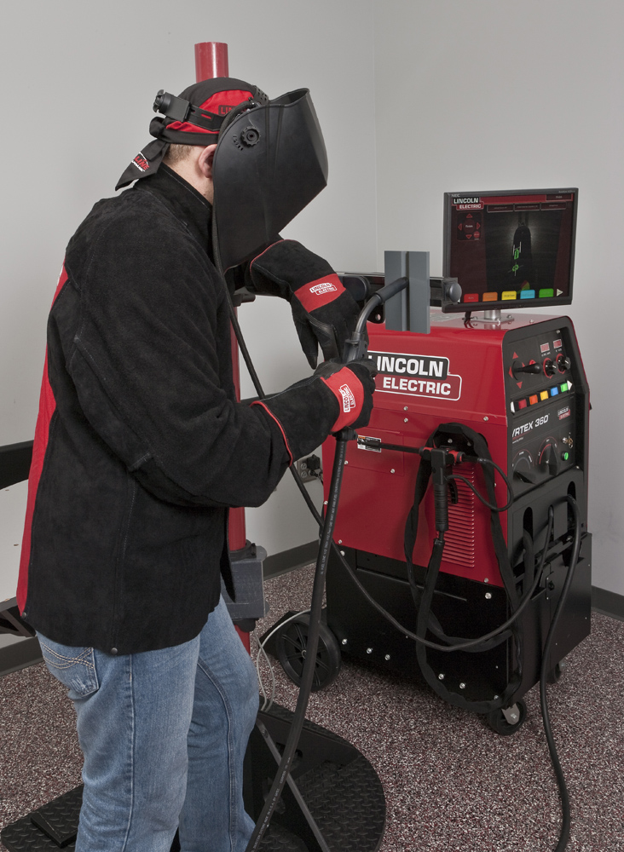
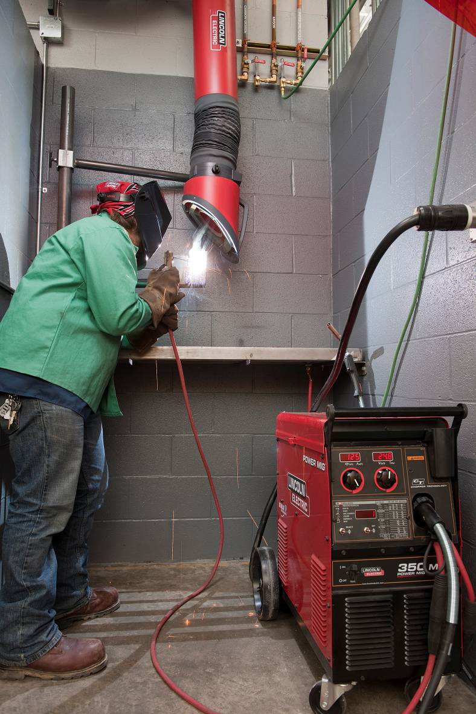
Virtual v Reality
Notes:
Skills profiles must be transparent to HR and employees. What level of which skills is necessary, what is the current status, what measures can be taken to close the gap.

Slide 18
When to use Virtual Reality?
100%
100%
% Effective
Books
Computer- aided learning
?
On the job training
Training Methods
18
Notes:
Skills profiles must be transparent to HR and employees. What level of which skills is necessary, what is the current status, what measures can be taken to close the gap.

Slide 19
Replay
Run video
Notes:
Skills profiles must be transparent to HR and employees. What level of which skills is necessary, what is the current status, what measures can be taken to close the gap.

Slide 20
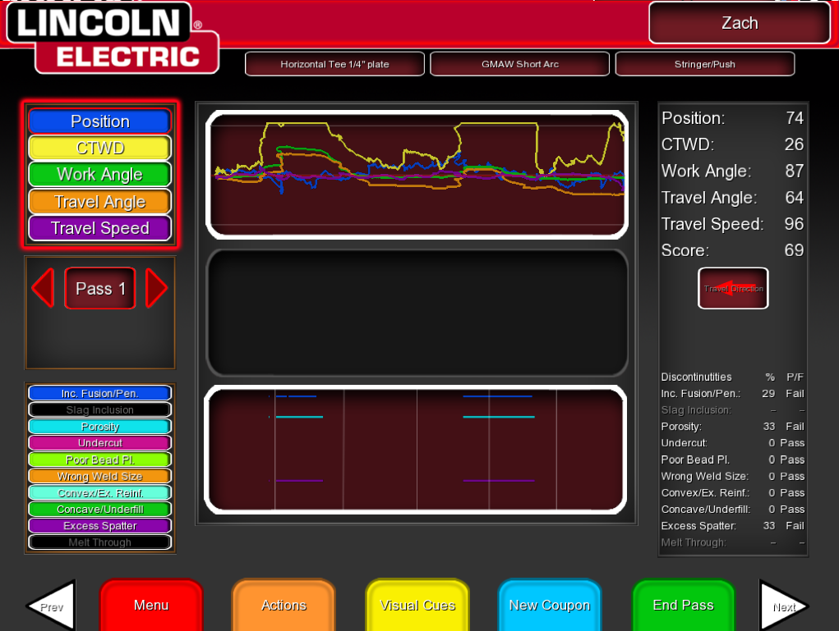
Helping evaluate
LASER Screen (Live Action Student Evaluation Report)
20
Notes:
Skills profiles must be transparent to HR and employees. What level of which skills is necessary, what is the current status, what measures can be taken to close the gap.

Slide 21
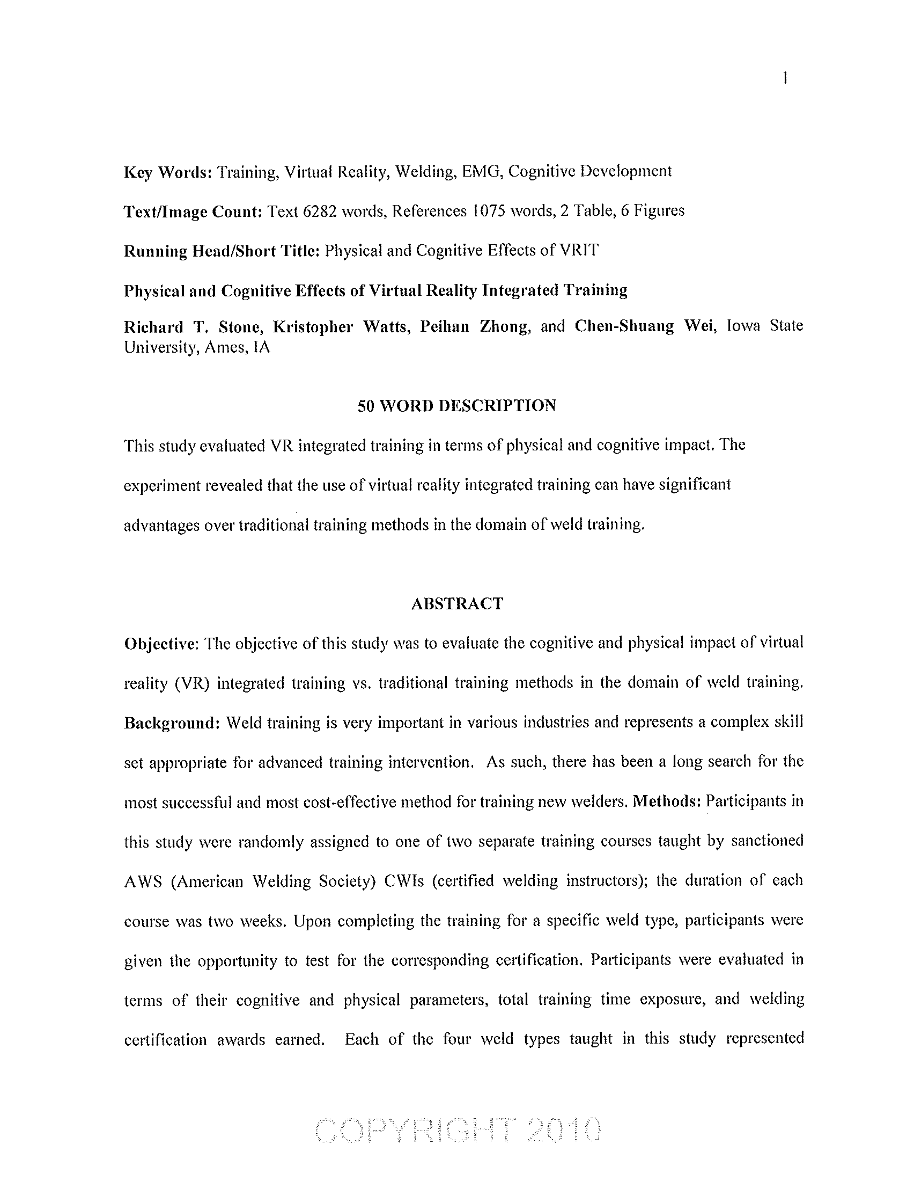
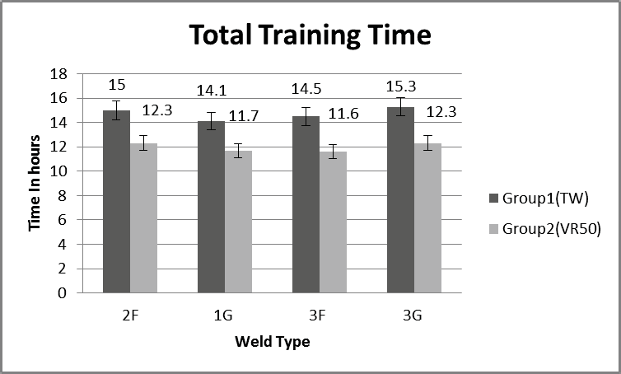
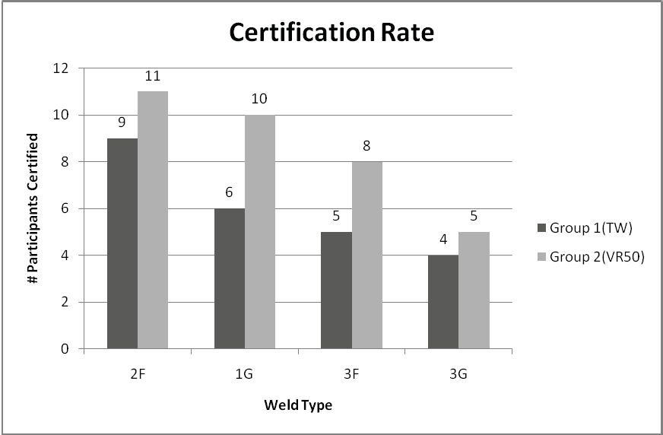
Studies at Iowa State University
TW = Traditional Welder
VR50 = 50% VRTEX
21
Notes:
Skills profiles must be transparent to HR and employees. What level of which skills is necessary, what is the current status, what measures can be taken to close the gap.

Slide 22
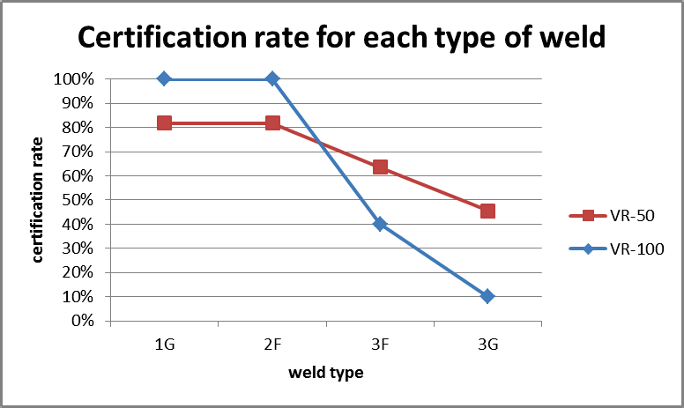
100% VR Study by Iowa State University
100% pass 1G test with 100% VR
100% pass 2F test with 100% VR
22
Notes:
Skills profiles must be transparent to HR and employees. What level of which skills is necessary, what is the current status, what measures can be taken to close the gap.

Slide 23
Christian Callegari, Siemens
Notes:
Skills profiles must be transparent to HR and employees. What level of which skills is necessary, what is the current status, what measures can be taken to close the gap.

Slide 24
SMSCP
The Siemens Mechatronics Systems Certificate Program (SMSCP)strives to develop competent individuals who have both practical, as well as theoretical experience and are able to understand mechatronic systems
International standard industry certification in
mechatronic systems
Comprehensive skills certification offered in three levels,
not a product certification
Delivered together with partner schools
Verified through certification examinations
Consistent standards of achievement worldwide
Result: Well-grounded individuals who can adapt to new work situations quickly and appropriately − with all-round competence
24
Notes:
Skills profiles must be transparent to HR and employees. What level of which skills is necessary, what is the current status, what measures can be taken to close the gap.

Slide 25
Siemens Automation Cooperates with Education
In today’s fast-paced business world, the SCE program strives to develop competent students who have practical experience in automation systems, as well as some theoretical background.
EDUCATION is facing the challenge of keeping pace with the short innovation
cycles of the industry
Result: SKILLED individuals with practical know-how for competitive, innovative and energy efficient solutions

Slide 26
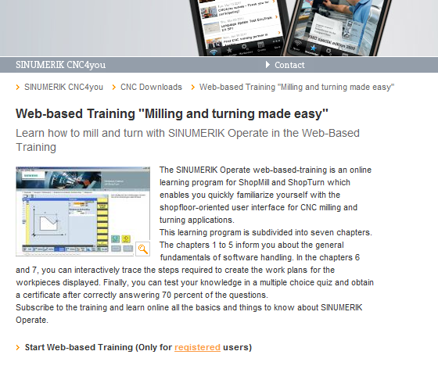
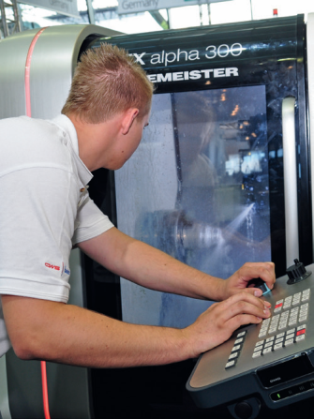
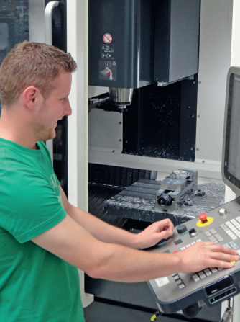
Siemens CNC4YOU
In today’s fast-paced business world, the Siemens CNC4YOU strives to give free of charge access to CNC Education by going Web , App and CBT Based
The triple play to get the student fast on the road http://www.cnc4you.siemens.com
Result:
CNC Know-How without expensive setup and need for Milling and tuning machine
Individuals in developing economies have access to an state of the art learning environment
Notes:
Skills profiles must be transparent to HR and employees. What level of which skills is necessary, what is the current status, what measures can be taken to close the gap.

Slide 27
Summary
We have seen
Synchro Game and
Internal training “Mastering Key Trainer Skills” from Festo
Virtual Reality training for welders from Lincoln Electric
Siemens Mechatronic System Certificate Program,
Siemens Automation Cooperates with Education and
CNC4YOU from Siemens
showing - realistic games and simulation, and giving ready access to them - training offered with other training providers / educational institutions - how to ensure trainers acquire the skills they need to foster in others skills for tomorrow’s world.
Notes:
Skills profiles must be transparent to HR and employees. What level of which skills is necessary, what is the current status, what measures can be taken to close the gap.

Slide 28
Thank you!
Martin Williams Festo
de6u2951@de.festo.com
Carl Peters Lincoln Electric
Carl_Peters@lincolnelectric.com Christian Callegari Siemens christian.callegari@siemens.com
Notes:
Skills profiles must be transparent to HR and employees. What level of which skills is necessary, what is the current status, what measures can be taken to close the gap.

